Slide 1
Changing Materials
Hello year 5. This is the final lesson for your materials topic.
You will learn about how materials can be changed (knowledge).
You will work scientifically by grouping and sorting changes into:
Reversible changes
Irreversible changes

Slide 2
Important vocabulary
Heated
Cooled
Reversible
Irreversible
Evaporate
Dissolve
Melt
Freeze
Condense
Burning
Do you already know what some of these words mean?

Slide 3
To identify reversible and irreversible changes
Materials can change when they are:
Mixed
Heated
Cooled

Slide 4
Reversible changes
Sometimes you can get back the materials you started with. This is a reversible change.
Reversible changes can be caused by heating
Melting can happen when a material is heated
For example: chocolate melts when heated. If you leave it to cool you will get your solid chocolate back.
Evaporating can happen when a material is heated
For example: heating water causes it to change into water vapour (steam). How do you get steam back to water?

Slide 5
Reversible changes
Reversible changes can also be caused by cooling the material.
Condensing happens when a material is cooled
For example: water vapour turns back to water when it is cooled.
Freezing happens when a material is cooled.
For example: water turns to ice when cooled.

Slide 6
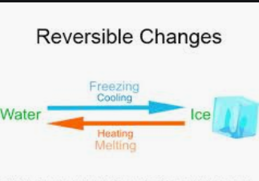

Slide 7
Reversible changes
Reversible changes can also include dissolving.
You can get a dissolved solid back from a mixture by letting the liquid evaporate.
For example: salt dissolved in water. If you leave the water to evaporate you will be left with the salt
If a solid has not dissolved, you can get it back by filtering the mixture.

Slide 8
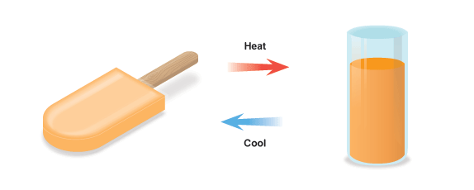
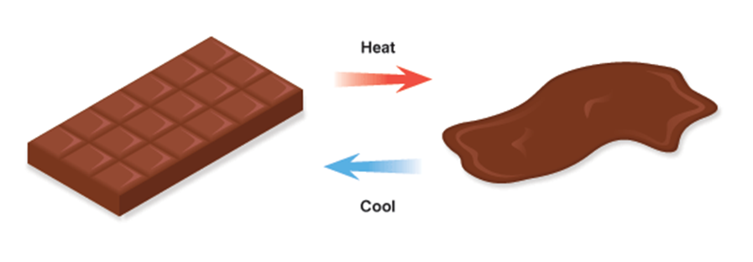
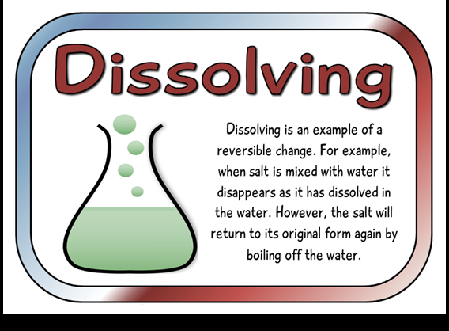
Reversible Changes - summary

Slide 9
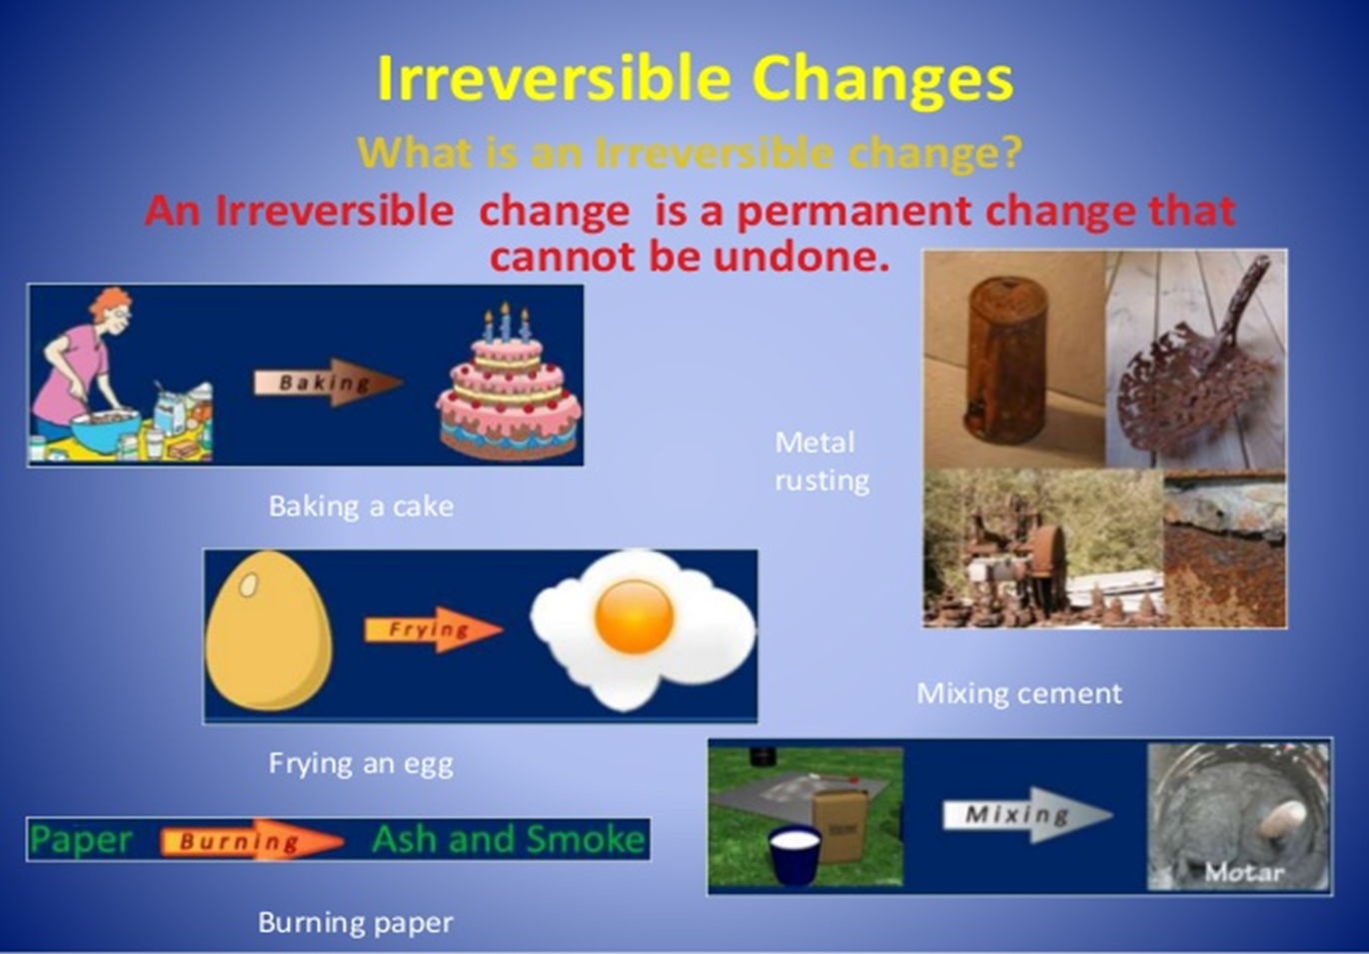
Irreversible changes
https://www.bbc.co.uk/bitesize/topics/zcvv4wx/articles/z9brcwx

Slide 10
Irreversible changes
Sometimes new materials are made when you mix things.
Sometimes the mixture sets hard when it dries (like cement), and sometimes bubbles of a gas are given off (such as when you mix lemon juice or vinegar with bicarbonate of soda).
These changes are irreversible, because you cannot get the starting materials back again.
Heating can also cause new materials to form. Cooking an egg, baking a cake, and firing clay are all examples of irreversible changes caused by heat.

Slide 11
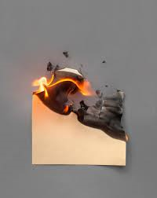
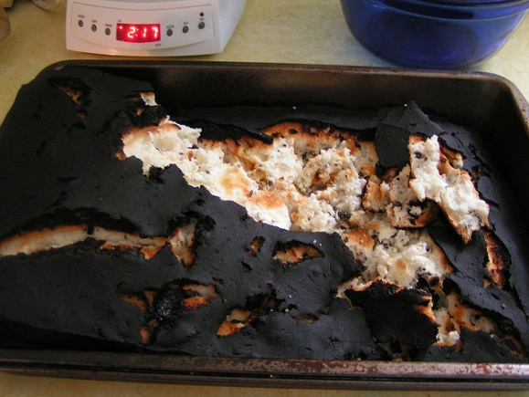
Irreversible changes
Burning is an example of an irreversible change.
New materials are made when things burn. One of the materials is usually an invisible gas.
Some materials produce poisonous gases when they burn.

Slide 12
Decide whether these changes are reversible or irreversible when heated

Slide 13
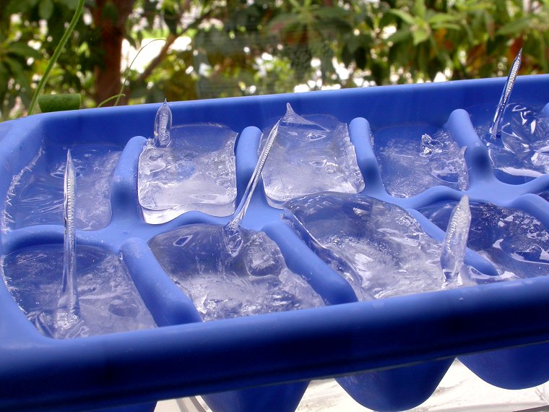
When ice is heated will it cause a change that can be reversed?

Slide 14
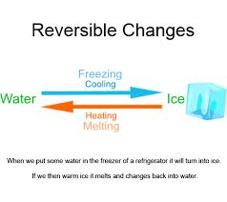
This is a reversible change

Slide 15
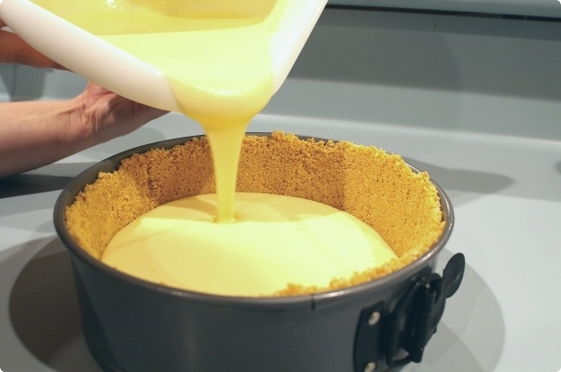
When cake mixture is heated will it cause a change that can be reversed?

Slide 16
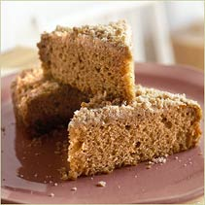
This is an irreversible change

Slide 17
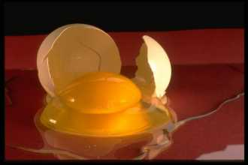
When an egg is heated will it cause a change that can be reversed?

Slide 18
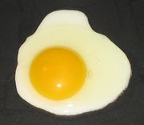
This is an irreversible change

Slide 19
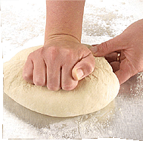
When bread dough is heated will it cause a change that can be reversed?

Slide 20
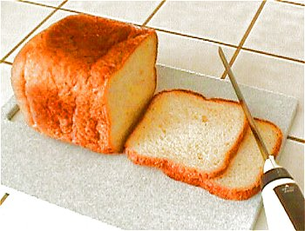
This is an irreversible change

Slide 21
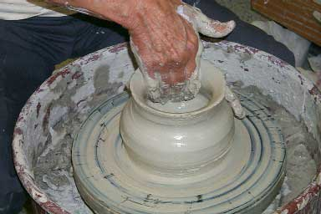

Slide 22
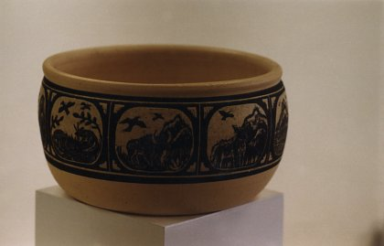
This is an irreversible change

Slide 23
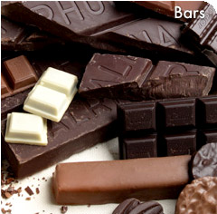
When chocolate is heated will it cause a change that can be reversed?

Slide 24
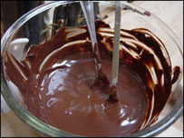
This is a reversible change

Slide 25
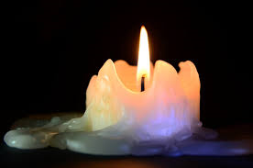
Irreversible or reversible change?
But what happens when a
Candle is heated?
What is happening to
the wick?
What is happening to
the wax?

Slide 26
What have you learnt?
Can you explain what a reversible change is?
Can you give an example of a reversible change?
Can you explain what an irreversible change is?
Can you give an example?

Slide 27
Activities
1. Log on to espresso. Log on to https://www.discoveryeducation.co.uk/
Select the Espresso dropdown box in the top right hand corner.
Username: student28853
Password: oaktree
Search for reversible changes KS2
Complete the video sorting activity to sort reversible and irreversible changes
2. Complete the worksheet called reversible and irreversible changes that is on the school website (write your answers on paper if you don’t have a printer).
Need a further challenge?
Find the Treasure Hunt reversible changes cards and recording sheet from the school website
Cut up the question cards. Ask someone to scatter them around your garden. Go on a hunt to find the 30 cards. Fill in the answer on your answer grid.
OR match the question with its answer.
No printer – write the answer to each question on a piece of paper.

