Slide 1
Welcome back!
I hope that you have had a relaxing half-term and are ready to continue with our interesting local history topic of Leatherhead.
It is important that you complete the first four lessons before beginning this next lot. It doesn’t matter if you have not finished them yet, but I would rather you complete lessons 1-4 first. If you do not finish all the next set of lessons, it is not important-I wish for you to enjoy doing these and not become anxious because you are unable to finish them all.
If you do not have the first four lessons still, email me and I’ll send them to you. Mrs Martin

Slide 2
Lesson 5
How did Moulds start the Great Fire of Leatherhead?
Kit Haskins was a small boy during the beginning of the 1900’s ( over 110 years ago) and grew up in Leatherhead.
He wrote his memoirs as an older man. (A memoir is a historical account written from personal knowledge).
His memoirs of Leatherhead and a map he drew of the shops are an important record of what daily life was like at that time. This record is kept in Leatherhead Library.

Slide 3
Kit Haskin’s Memoirs
Read the attached sheet of Kit Haskin’s memories. It is a very long book so Mr Gumbrell ( Mrs Gumbrell’s husband) has found some interesting parts for you to read. Mr Gumbrell is a historian and has carried out lots of research about Leatherhead and the people who lived in the area.

Slide 4
Kit Haskin’s Memoirs
Look at the attached map that Kit Haskin’s drew of the Leatherhead shops in the early 1900’s.
Find the High Street, Bridge Street ( goes down to the River Mole) and North Street.
Locate The Swan Hotel and Moulds.
Find The Fire Engine House in North Street.
If you have a printer, print off the map and colour in those places above. It doesn’t matter if you can’t do this.

Slide 5
Kit Haskin’s Memoirs
Moulds
Moulds in the High Street sold all sorts of things.
From reading Kit Haskin’s memoirs, we know that Kit visited the shop often to buy ‘things for his dad’.
Moulds was a hardware shop. It sold lots of things used for home improvements. Today, there are similar shops like B & Q, Homebase, Wickes, Brackenbury’s in Bookham High Street and William Dyas.

Slide 6
It was snowing one January day in 1908……
A fire broke out in Moulds.
A quick-thinking employee turned off the gas straight-away.
Others removed the oil that was stored in the basement underneath the shop floor.
Someone ran for the Fire Brigade around the corner in North Street close by.

Slide 7
But they had forgotten the gunpowder also stored in the basement!
The gun powder exploded, taking the roof off the store.
Three fire brigades came- Leatherhead, Epsom and Dorking.
They were unable to save the burning building although they saved the surrounding shops and buildings!

Slide 8
Quick-thinking employees and the local fire brigades saved the High Street from the fire.
Stephen Mould was fully insured and was able to erect the existing building and carry on trading.
He was one of the town’s most important shop keepers and he was active in the church and local politics. Basically, he helped to run the town!

Slide 9
Let’s investigate!
Look at the following photographs of Leatherhead fire service today and from the early 1900’s.
Interesting fact: The Clock Tower in North Street was built in 1859 to house the fire cart. Before that, it was kept in the Clock Tower of St. Nicholas parish church. That’s why the church has such tall doors!

Slide 10
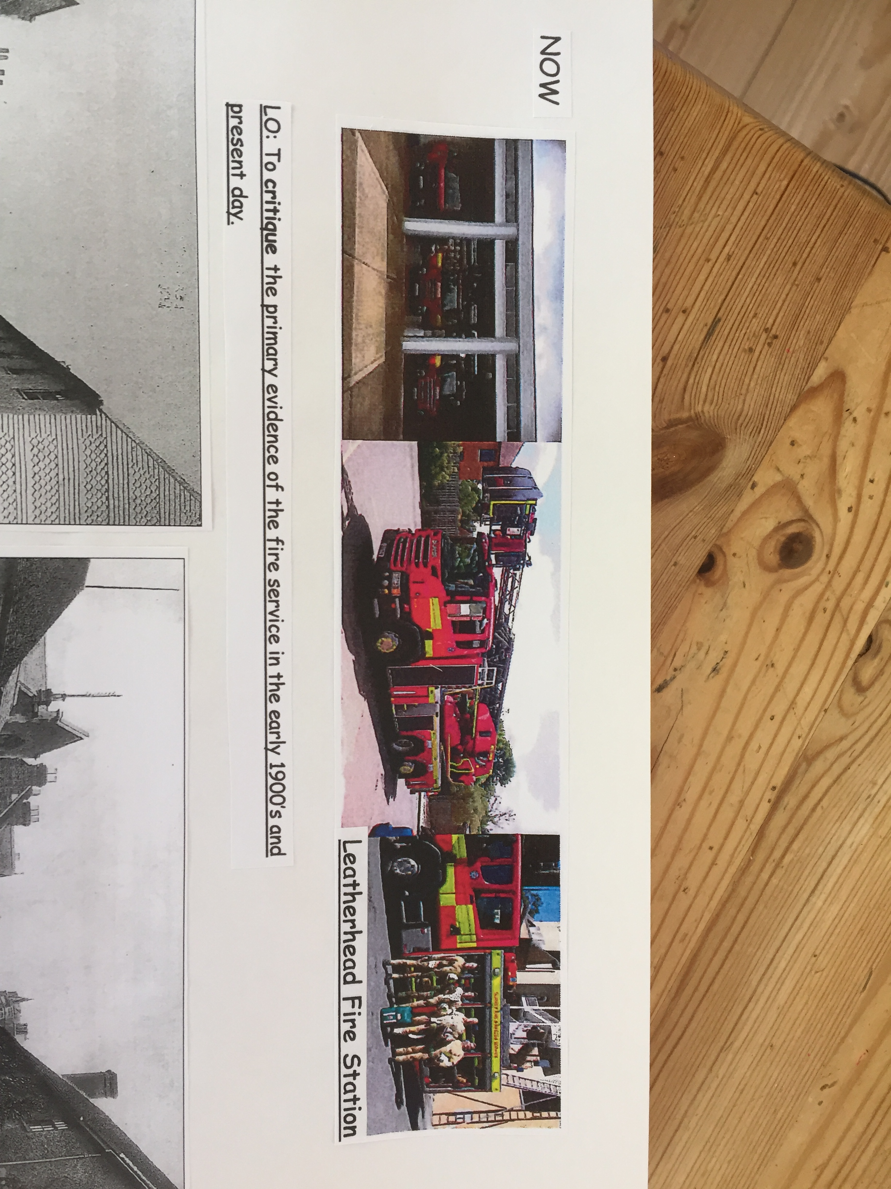

Slide 11
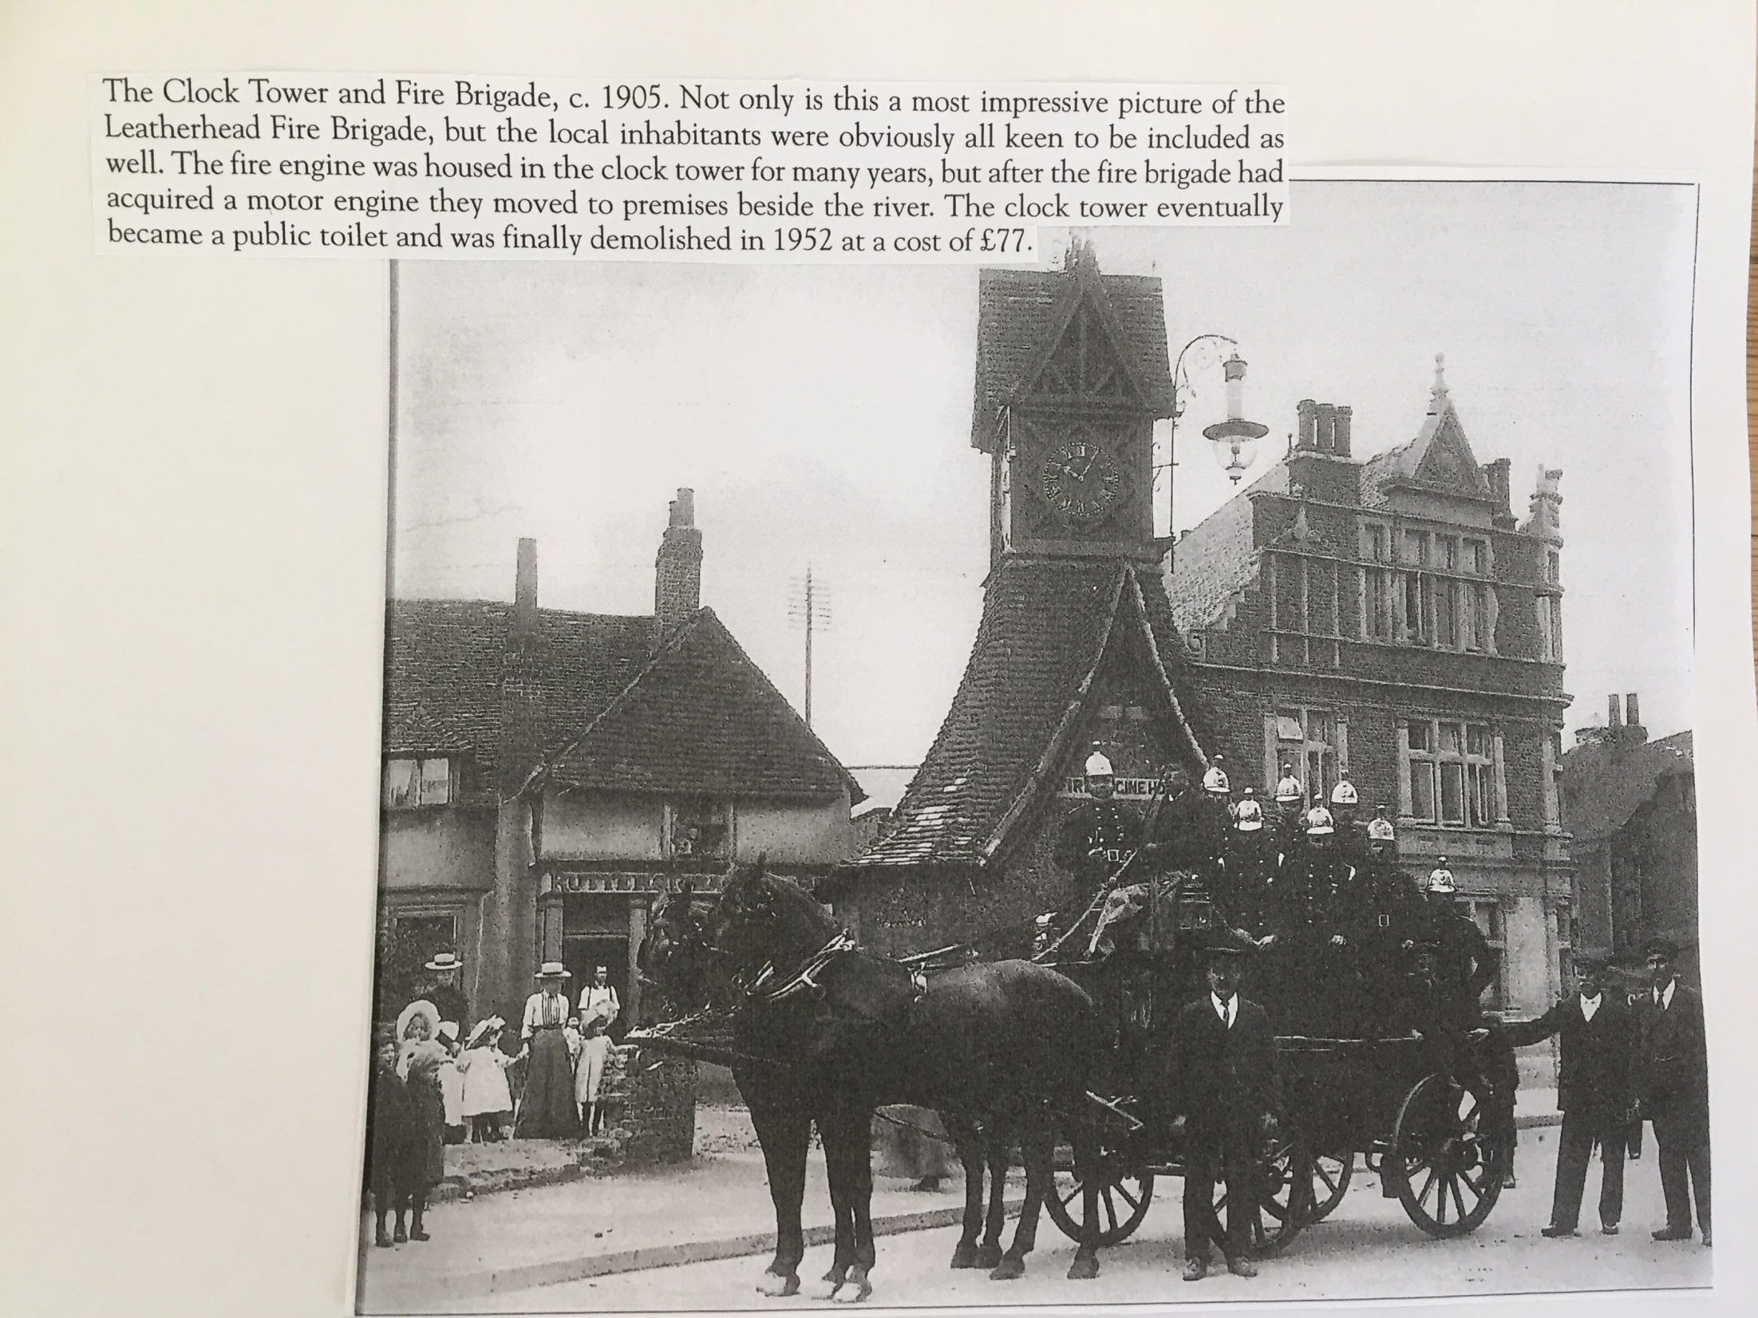

Slide 12
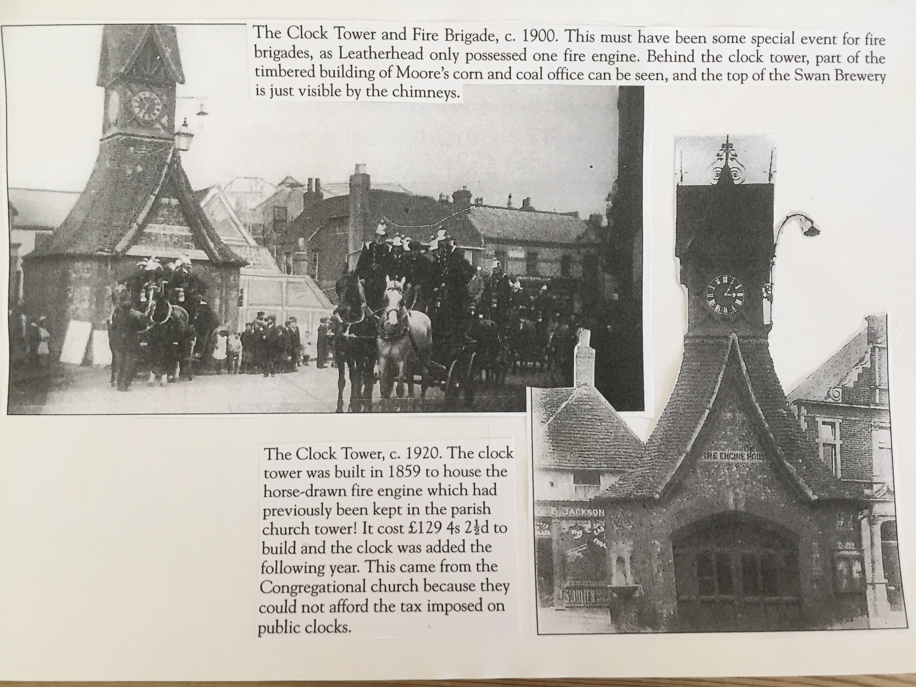

Slide 13
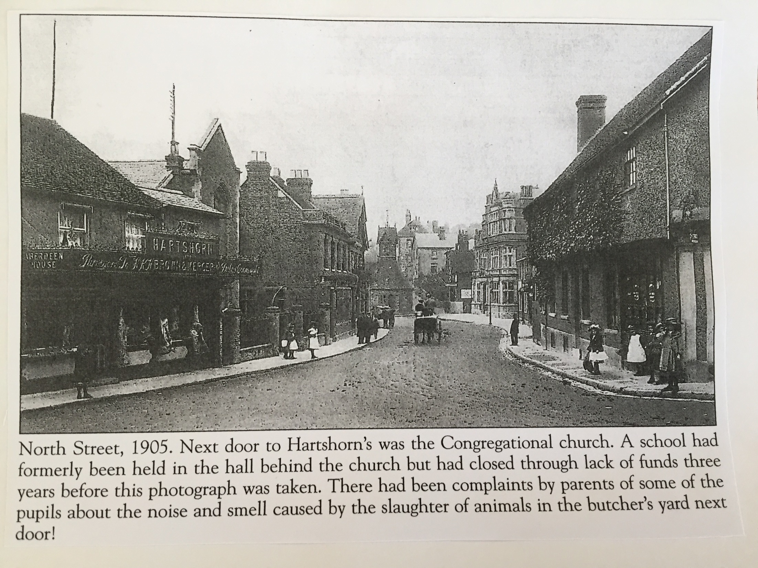

Slide 14
Compare and Contrast the differences between the Fire Brigade in the early 1900’s to now.
Draw a table on your page with two columns.
Heading for column 1 is Fire Brigade in the early 1900’s.
Heading for column 2 is Fire Brigade in 2020.
Compare and contrast them both. Think about transport, equipment, safety, station, communication, where? etc.
You may need to do some research on the Fire Brigade and Leatherhead Station now. Remember your e-safety when using Google.

