Slide 1
Welcome back again!
During your last lesson, you learnt about the fire in Moulds in the High Street.
You learnt about the local Fire Brigade and how the Fire Brigade is different now to back in the early 1900’s.

Slide 2
Lesson 6
Where do you spend your pocket money?
Read Kit Haskin’s memoirs again especially the part highlighted in purple for this lesson.
Look at Kit Haskin’s map again.
Find all the shops on the map that children would like to spend their pocket money in.

Slide 3
What shops did you find?
Talmey Thompson’s
W.G Wright Confectioner
Gregory’s the Baker
Fairs the Sweet Shop
Fairs the Fruit Shop
Battens Toys
The Picture Palace ( a cinema)
If you have a printed map of the shops, colour all these types of shops in one colour and create a key. If you have no printer, do not worry that you cannot do this but did you find all these shops?

Slide 4
Read through the next six slides which tells you all about the history of sweets through the decades.
The Victorians
The Victorians created many of the classic sweets which we all remember.
Historically, sweets and confectionaries were hand-made luxury items available only to kings, queens and aristocrats. The industrial revolution brought about many technological advances; lowering prices for refined sugar and allowing for factory produced sweets and confectionary.
Owing to these changes, sweets were no longer luxurious items for the super-rich.
Pear Drops, Sherbet Lemons, Cough Candy, Rhubarb and Custard, Aniseed Twists, Marshmallows, Candy Floss, Fruit Pastilles and Fruit Gums all originate from the mid-19th century to the turn of the 20th century.

Slide 5
The Victorian sweets with the most interesting back story are Liquorice Allsorts ‘created’ in 1899. According to legend, a travelling salesman dropped his tray of samples. The salesman may have thought that he’d blown the pitch but his customer so loved the assortment of shapes and colours arrayed on the floor that he asked if these sweets could be made intentionally!
1900’s
The most famous sweet released during the first decade of the 20th century is the wine gum. Unusually this sweet wasn’t aimed at children but at adults- hence the alcohol inspired name. Although the name might suggest otherwise there is no wine involved in the making of these delicious sweets, children eat these just as gladly. This decade also saw the introduction of the first lollipops!
1910’s
Peace Babies were all the rage when they were launched in 1918 to celebrate the end of the Great War which had devastated Europe. These soft sugar candies are still made today although you’ll probably recognise (and enjoy) them under the name they now go by- Jelly Babies.

Slide 6
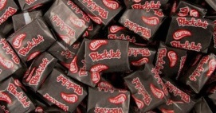
1920’s
With Britain struggling to recover from the devastation of world war one, sweet production was not top of the national priority list. Even so, this decade produced one of the UK’s favourite sweet creations- the Black Jack. The wrapper of this iconic aniseed flavoured chew is a pirate.
1930’s
Coming hot on the heels of the Wall Street Crash and ending with the outbreak of WW2, you might think that the 1930’s would be a decade to forget for the British sweet industry. However, the attraction of sweets is so powerful that even this dark decade has a few bright sparks. 1935 saw the launch of the popular Extra Strong Mint, a product still available today.
1940’s
The “mint with a hole” was scheduled for launch in late 1939, but the outbreak of war scuppered the manufacturer’s plans. The 1940’s were scarred by war and rationing and even the production of Peace Babies was suspended such were the hardships of this decade. The Polo mint was belatedly launched in 1948. The other iconic sweet launched in the 1940’s were Parma Violets.

Slide 7
1950’s
The 1950’s saw the introduction of one of the most iconic sweets ever created- Love Hearts. These hard tablets of fruit-flavoured sugary goodness are stamped with messages such as “I’m Shy”, “Kiss Me”, “Its love” and “I Love You”.
The same company also launched the world’s first chewable lolly in 1957 with the accidentally invented Drumstick. According to the official story, the son of one the company’s owners was experimenting with a new machine and unintentionally learned that it was possible to make a sweet with two different flavours. Raspberry and milk were chosen and the Drumstick was born!
1960’s
The swinging sixties saw the introduction of many famous sweets, not least the Dib Dab and its rival the Double Dip. These sherbet sensations were innovative in so much as they combined two already popular sweets- the lollypop and sherbet dust- into one irresistible package.

Slide 8
1960’s
A second hugely popular introduction in this decade was the humble fruit chew. These chewable fruit flavoured sweets were sold under the Opal Fruits and Chewits labels. Both have survived to the present day although Opal Fruits are now sold under their global name- Starburst.
The final intergalactic addition to the confectionary universe was the now infamous flying saucer. The release of a sweet made from sherbet packaged in an edible paper in the shape of a flying saucer was bound to be a hit in an era where the space race had captured the popular imagination.
1970’s
The biggest innovation in the world of British sweets during the decade of flared trousers and polyester shirts was the introduction of Pacers. The delicately flavoured, mild minty chews were a relaunched version of the sweet originally known as the Opal Mint (yes they were the sister of Opal Fruits) and the addition of three green stripes proved a huge hit. These were discontinued in the 1980s and are sorely missed.

Slide 9

This decade also saw the start two enormously popular phenomena both with the same name –
one a pop duo involving George Michael and Andrew Ridgeley and the second a fantastic chewy and fizzy bar of raspberry flavoured goodness.
1980’s
The UK has a heritage in confectionary which stretches back over a hundred years and the British should be as proud of our sweets as the French are of their wine or the Italians of their shoes.

Slide 10
What an exciting journey through the history of sweets in Britain!
Kit Haskins in his memoirs mentions lots of biscuits and sweets that you may have heard of.
Make a list of all these on your paper.

Slide 11
Here are some that I found in his memoirs. Did you find them all?
McVitie biscuits
Jacob and Carrs biscuits
Ginger Nuts ( my favourite)
Rich Tea
Bourbon
Digestives
Lemon Puffs ( not sure what these were)
Butterscotch sweets
Cadbury’s Milk Tray
Black Magic chocolates
Terry’s Gold chocolates
Swiss Lindt chocolate ( still more expensive today)
Quality Street
Wine Gums
Foxes Glacier Mints

Slide 12
Packaging has changed greatly over the years even if the product
(sweet/chocolate/biscuit) stays the same.
On the next few slides I have found pictures and dates of the changing packaging/advertisements of some favourite sweets and chocolate. You are going to create a timeline of these.
Sellotape 2 sheets of A4 paper together.
Draw a line 36cms long across the middle of your sheet of paper.
Label the timeline beginning in 1840 and finishing in 2020 – 2cms for each decade (10 years)n.
See the next slide to see mine.

Slide 13
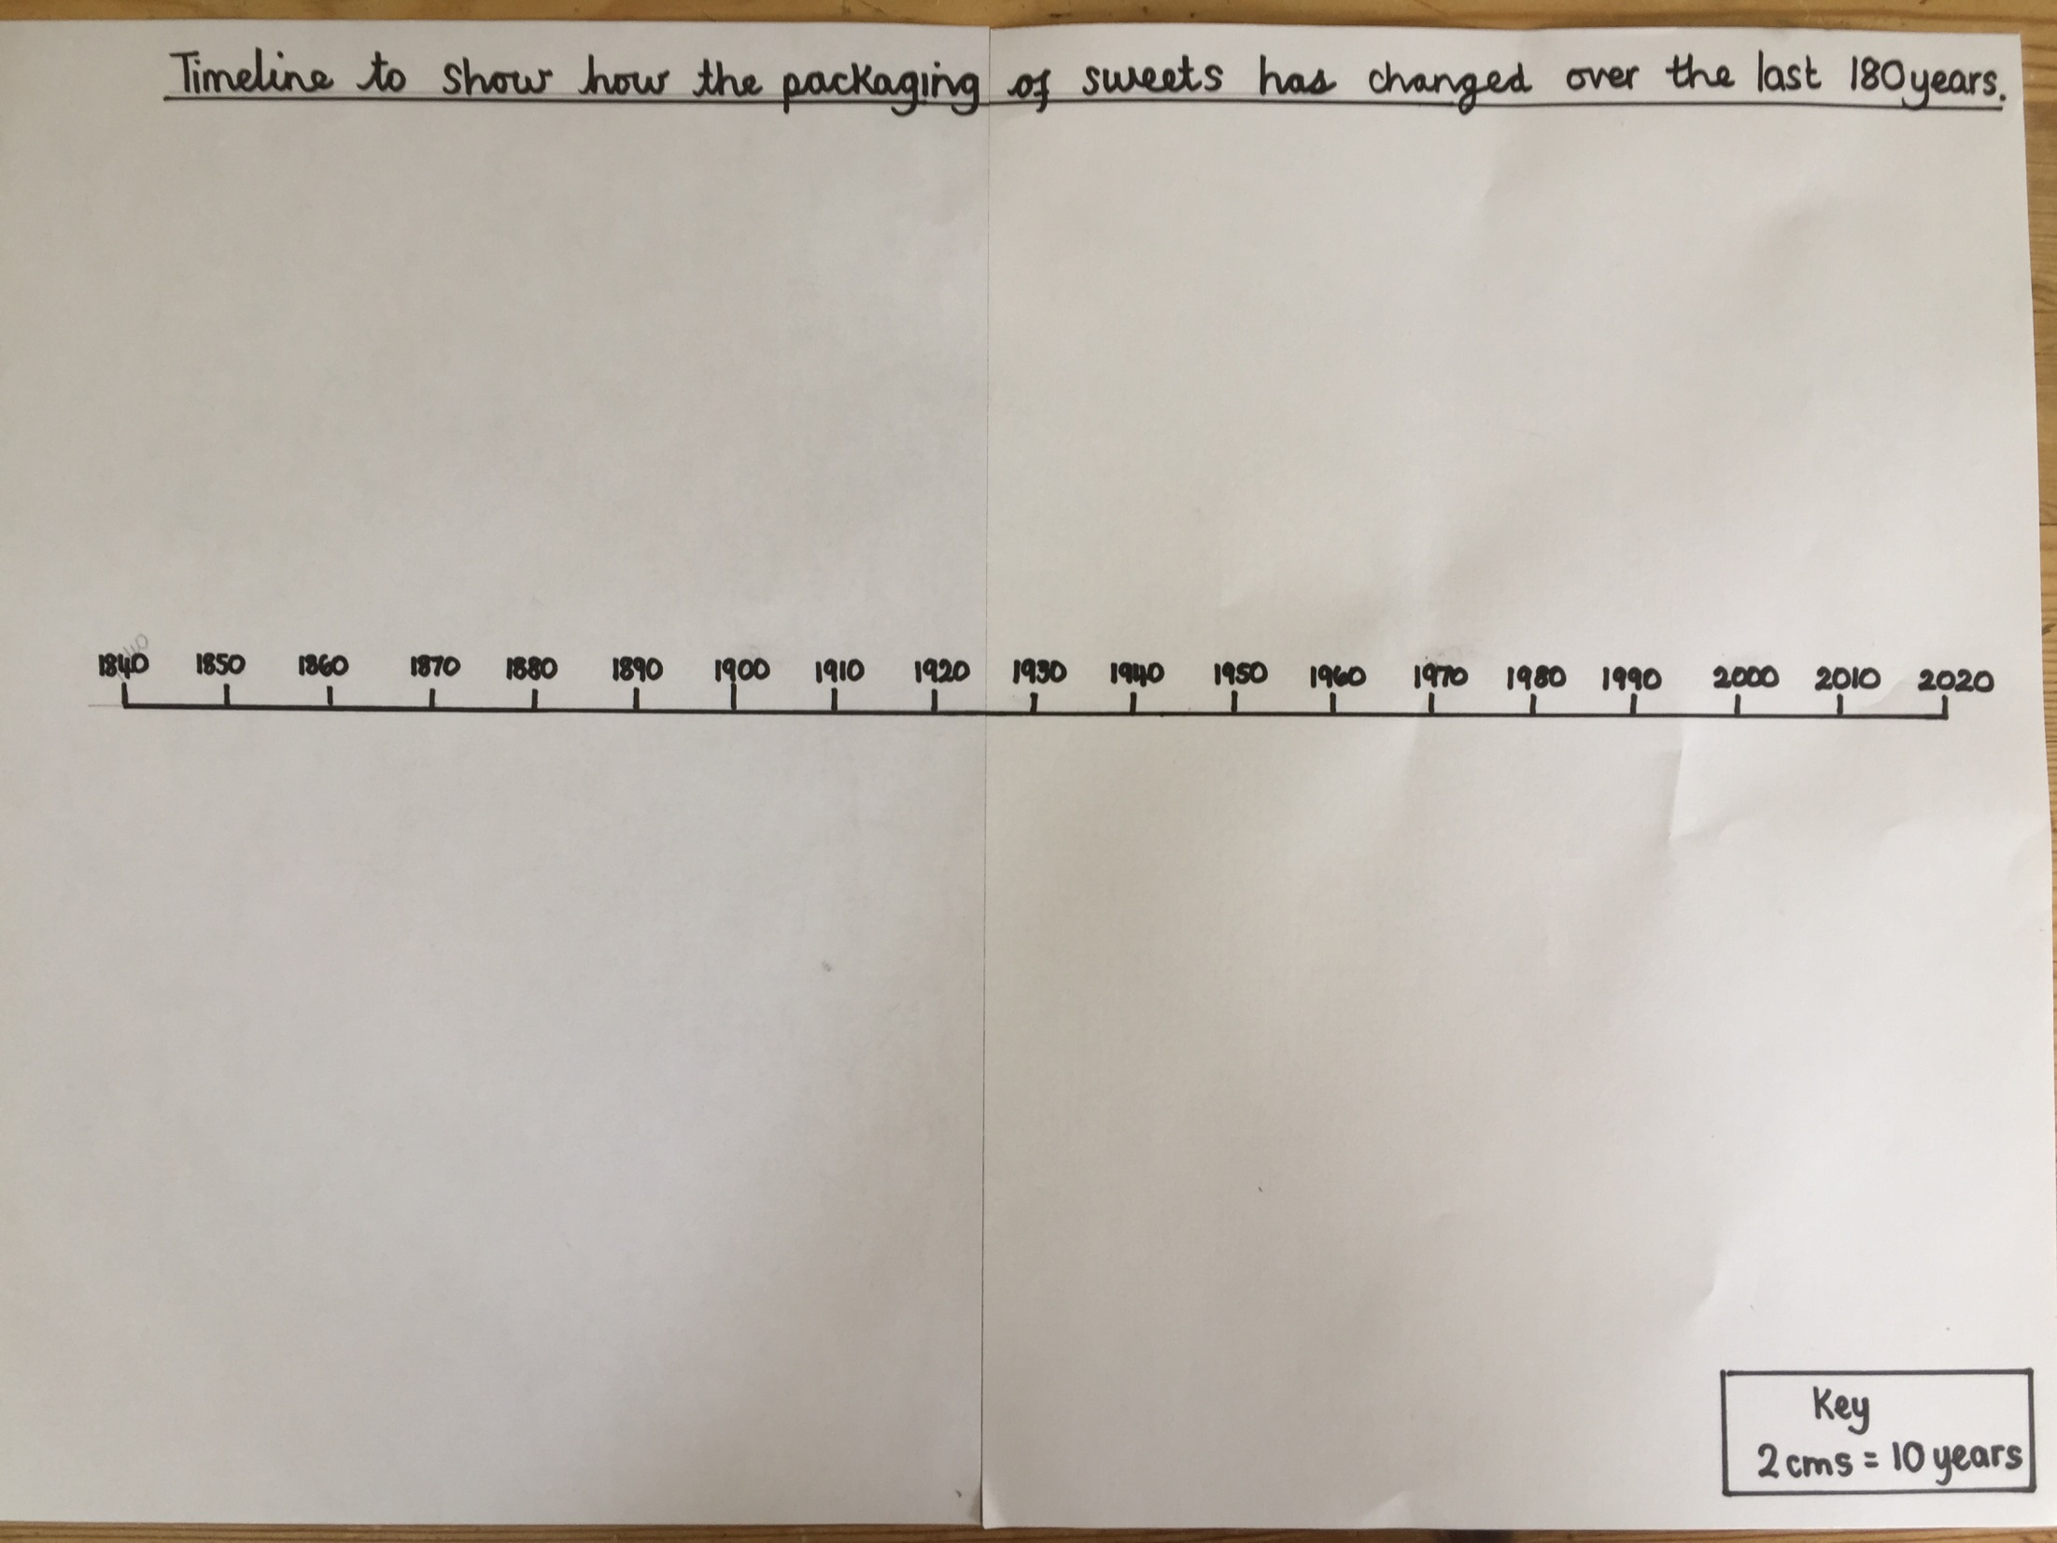

Slide 14
You have a choice to make.
Which sweets are you going to choose?
Choose one from the following choices- Liquorice Allsorts, Fry’s chocolate or Wine Gums.
On the following slides you need to find the pictures of your choice.
You are going to try and put your choices in chronological order ( date order).
Look carefully at the packaging and advertisements as some of them have clues. Look at the colours, clothes the people are wearing and the price.
If you have a printer, cut out the pictures and put them in order. ( Do not stick down yet on your timeline).

Slide 15
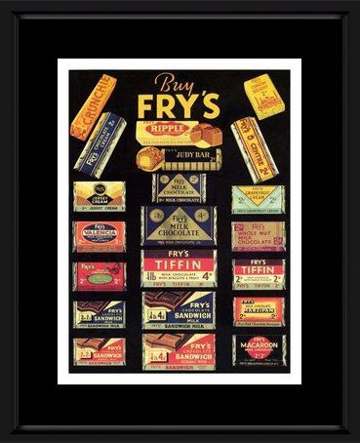
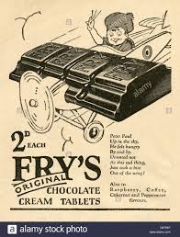
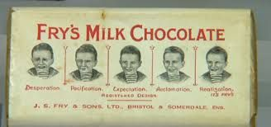
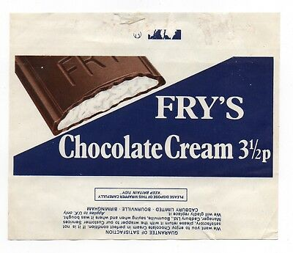
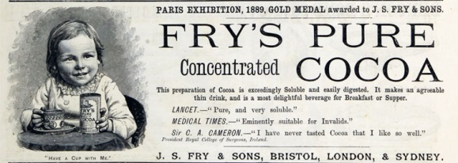
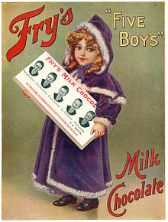
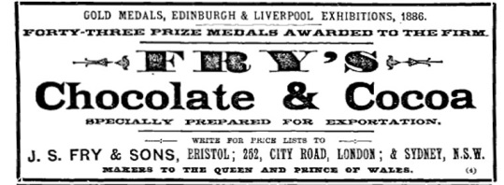
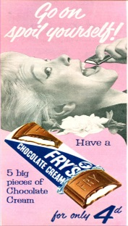
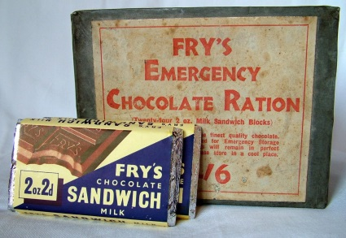
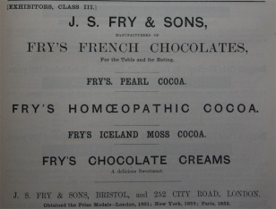
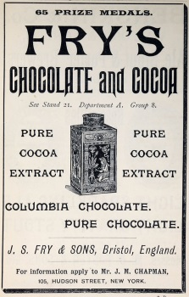
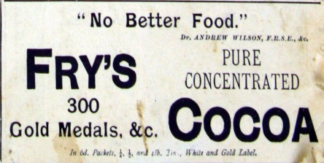
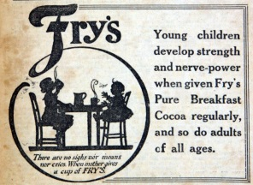
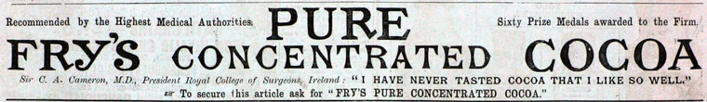

Slide 16
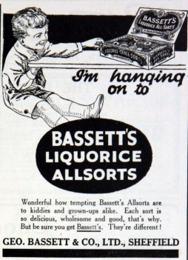
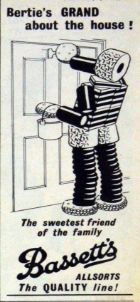
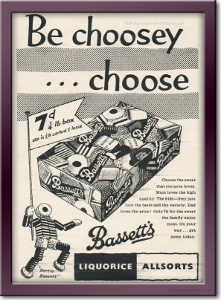
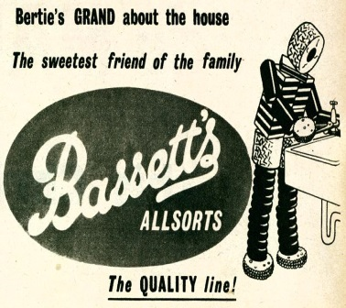
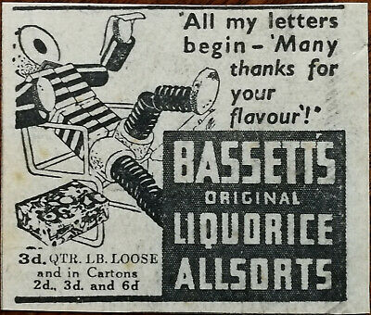
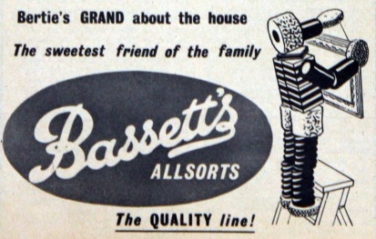
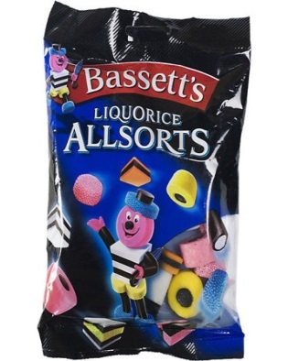
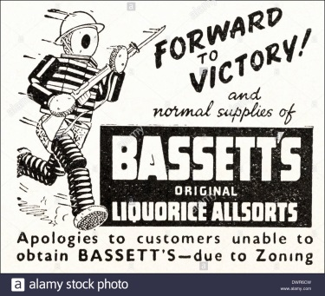

Slide 17
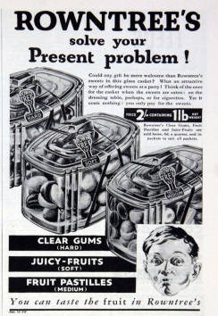
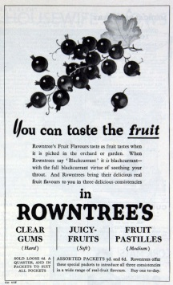
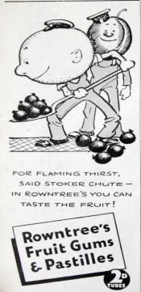
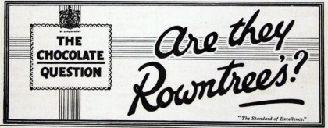
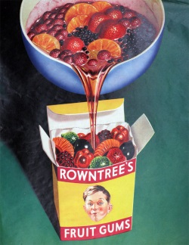
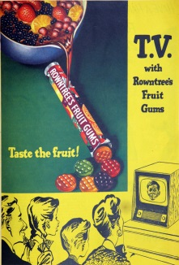
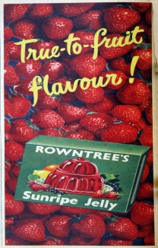
1862 Rowntree was founded, in York, by Henry Isaac Rowntree when he bought the business of Samuel Tuke and Co
1869 He was joined by his brother the philanthropist Joseph Rowntree
1897 Rowntree and Co was registered on 3 March, to take over the business of H. I. Rowntree and Co, manufacturers of cocoa, chocolate etc. ^{[1]}
1933 Black Magic was launched.
1935 Aero introduced.
1936 Maltesers were introduced.
1948 Introduced Polo Mints.
1969 It merged with rival Mackintosh to become Rowntree Mackintosh.

Slide 18
Here are the answers…are you right?
Stick the pictures in the correct order on the time line.
If you do not have a printer, draw them briefly.
Don’t forget to add the date.
Just like my example on the next slide.
What do you notice about the packaging and advertisements? Colours, price, how they advertise? What has changed?
Can you find any pictures from 2020 and add them to your timeline?
( remember your e-safety/use Google images safely).

Slide 19
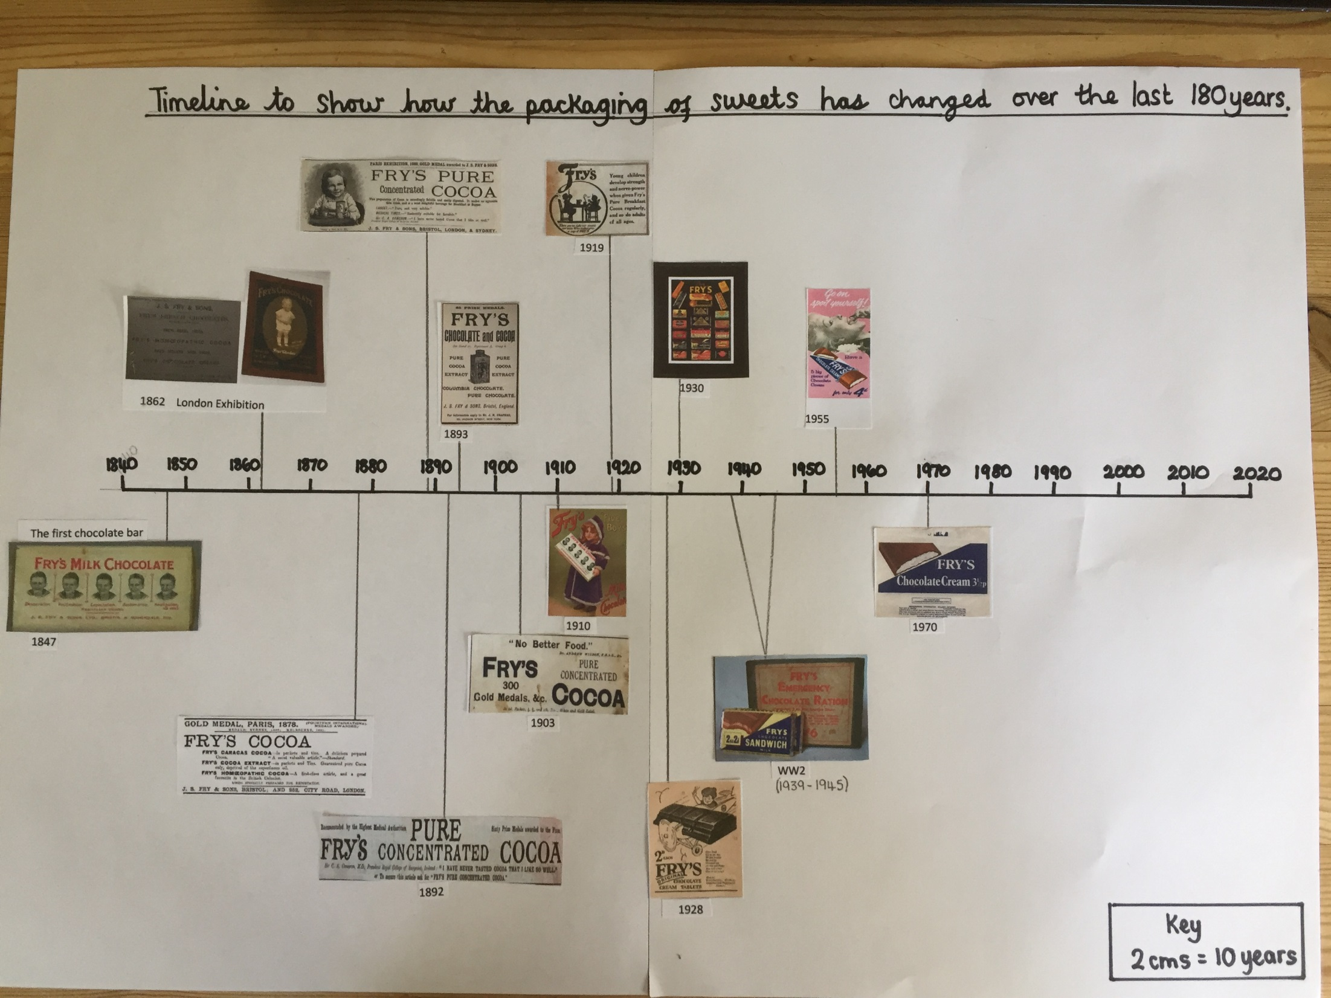

Slide 20
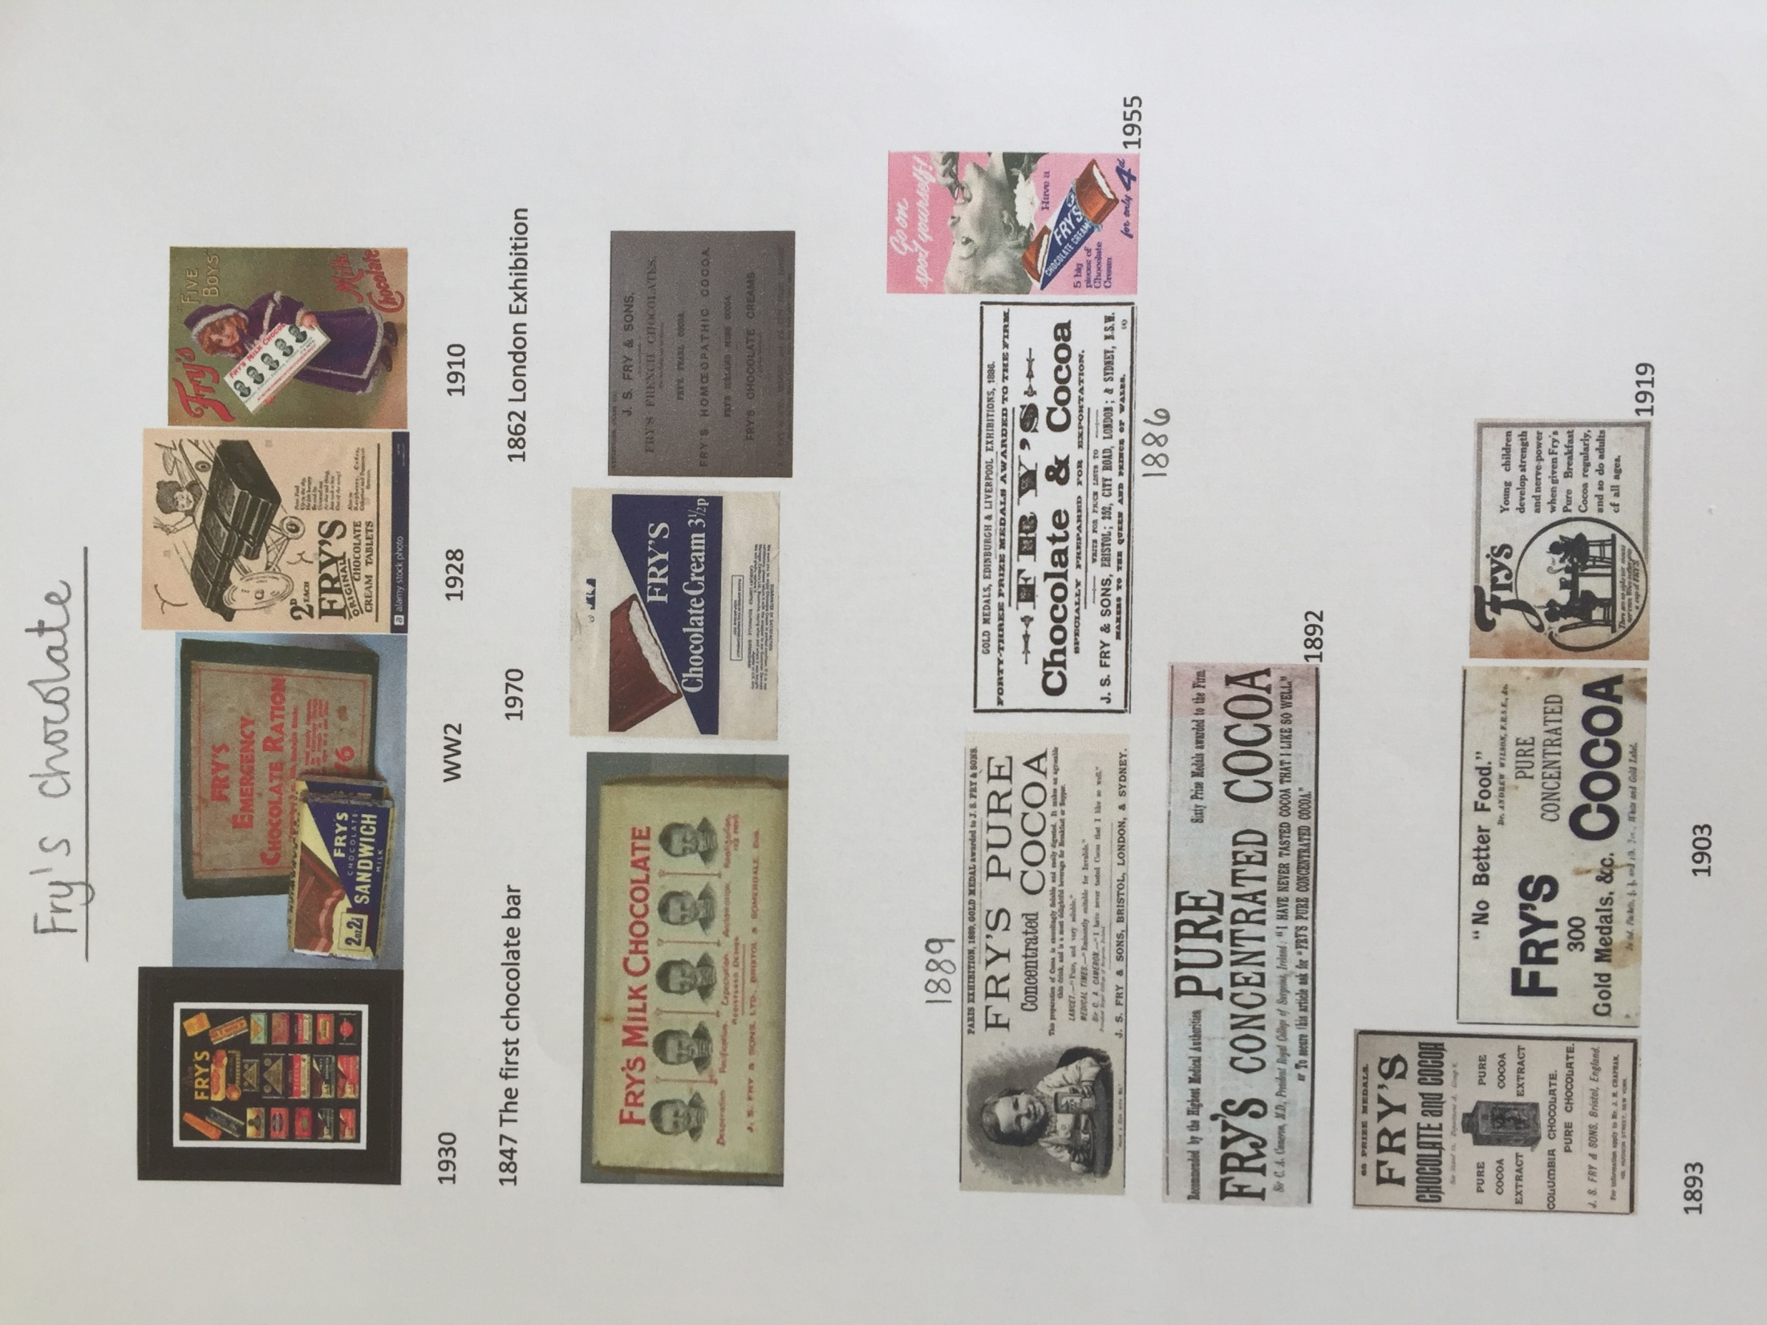

Slide 21
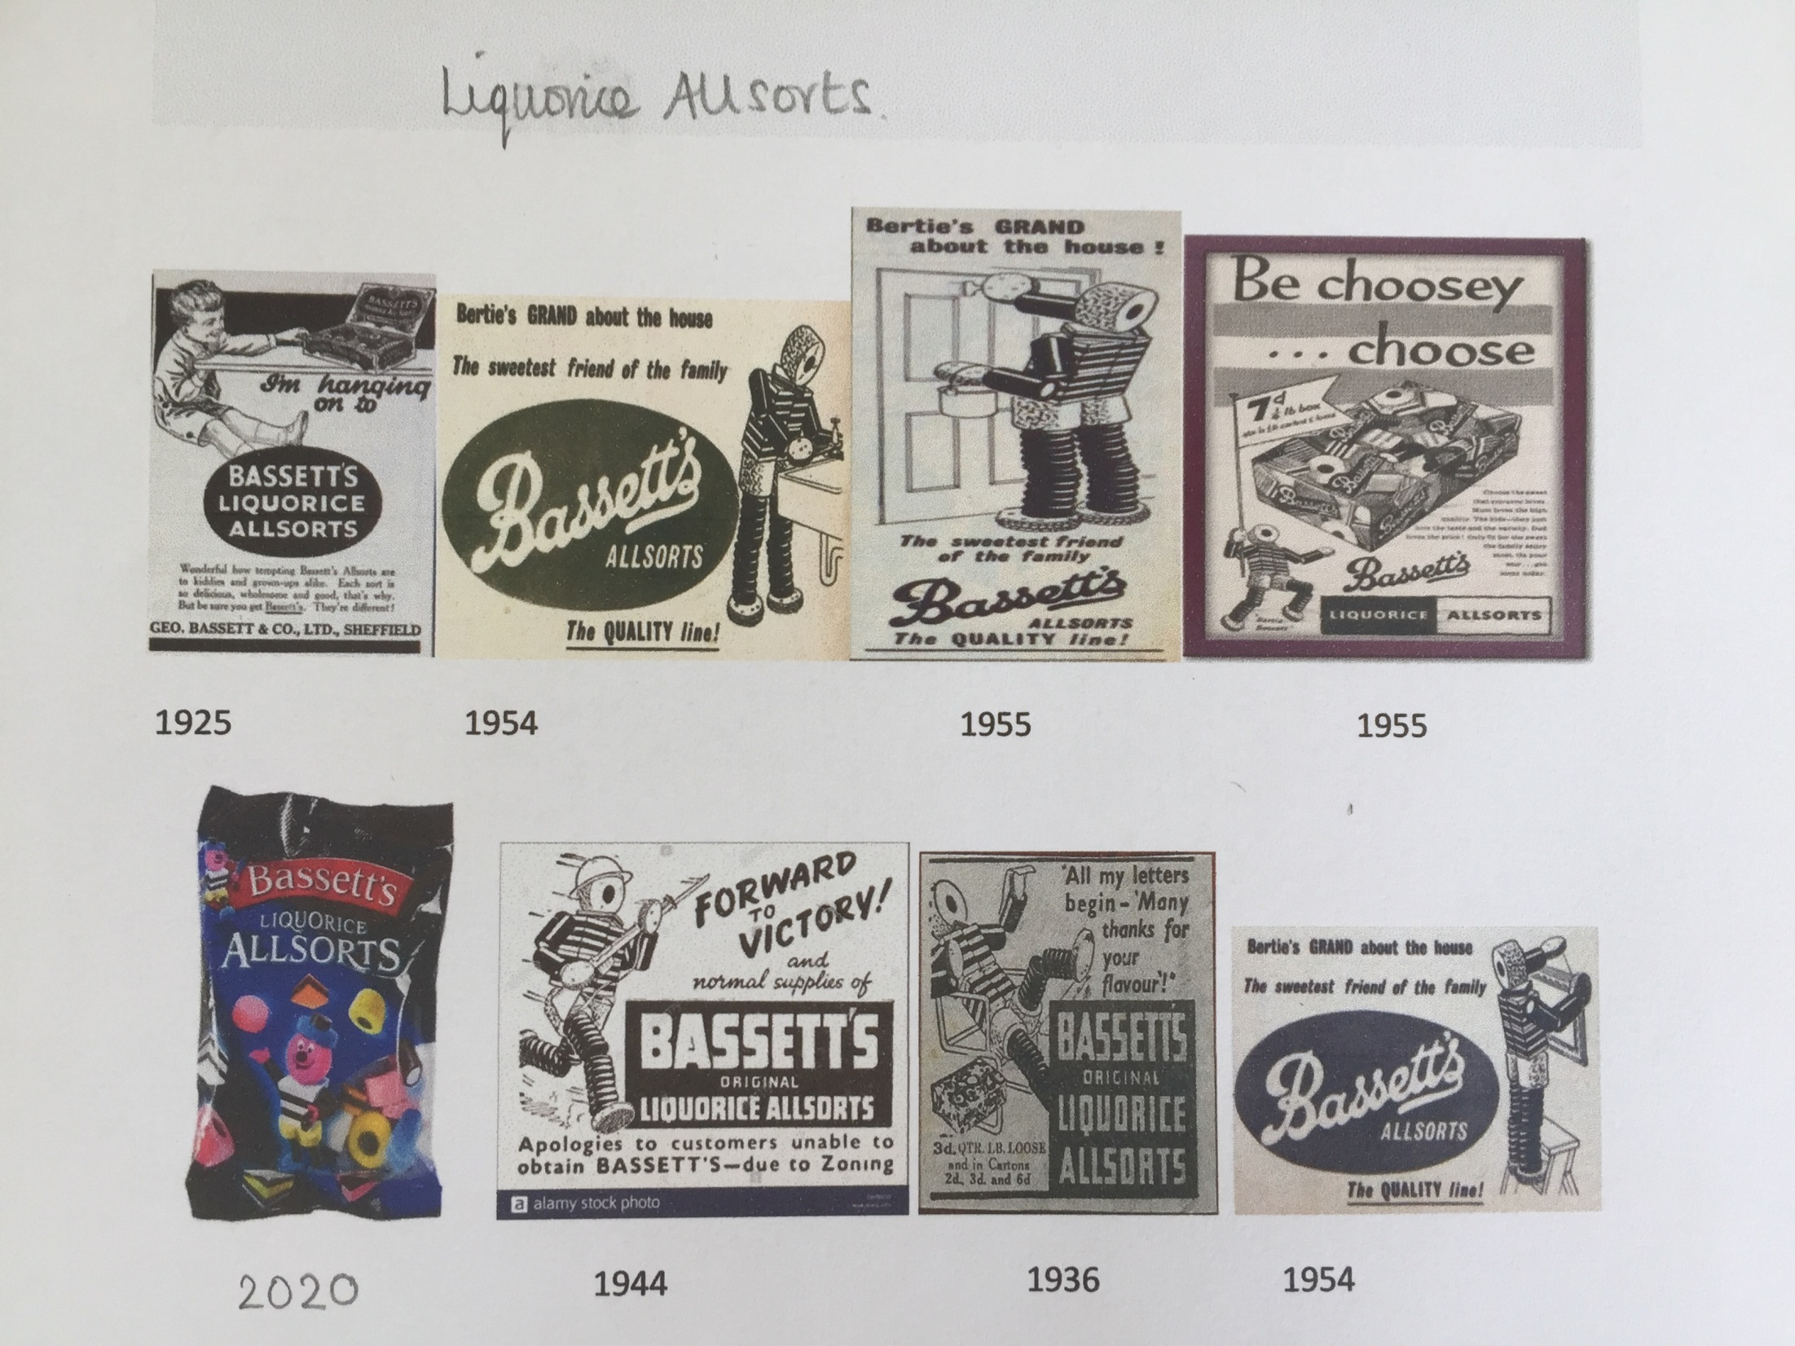

Slide 22


