Slide 1
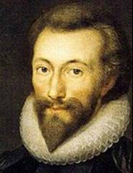
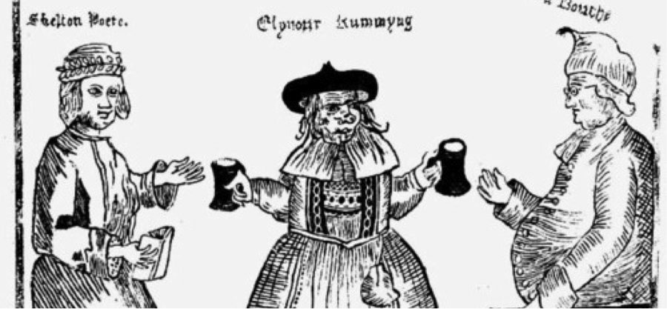
Lesson 7
Eleanor or Edmund?
Who was the most interesting Tudor living in Leatherhead?

Slide 2
Sir Edmund Tylney or Eleanor Rummin?
Both of these people were influential ( use a dictionary if unsure of the meaning) during The Tudor times in Leatherhead.
The Tudors began with Henry VII taking the throne of England from Richard III in 1485, through his son Henry VIII, then his children Edward VI, Mary I and Elizabeth I. Elizabeth I died in 1603 and ended the Tudor dynasty as she was childless.

Slide 3
In the following slides are information on these two Leatherhead residents.
At the end, you are going to decide who you think out of Edmund and Eleanor, was the most interesting person living in Leatherhead during the Tudor times.
Let’s begin!

Slide 4
Sir Edmund Tylney
In our English lessons, you read many plays by William Shakespeare.
On the next 3 slides are photographs of a very famous book which is in the British Library in London.
What dates does this book cover?
Find Sir Edmund Tylney’s name.
Find Shakespeare’s name. ( written as Shaxberd)
Find the names of six Shakespeare plays. ( They maybe spelt differently today)

Slide 5
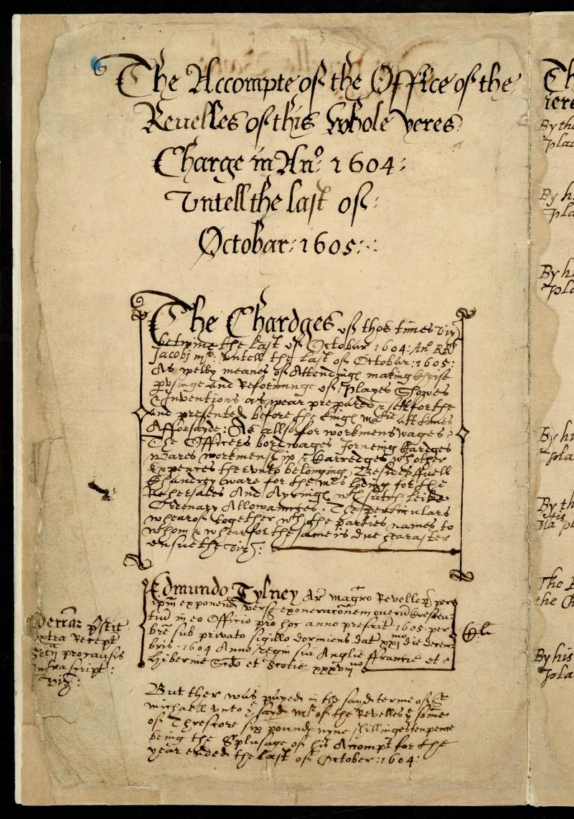

Slide 6
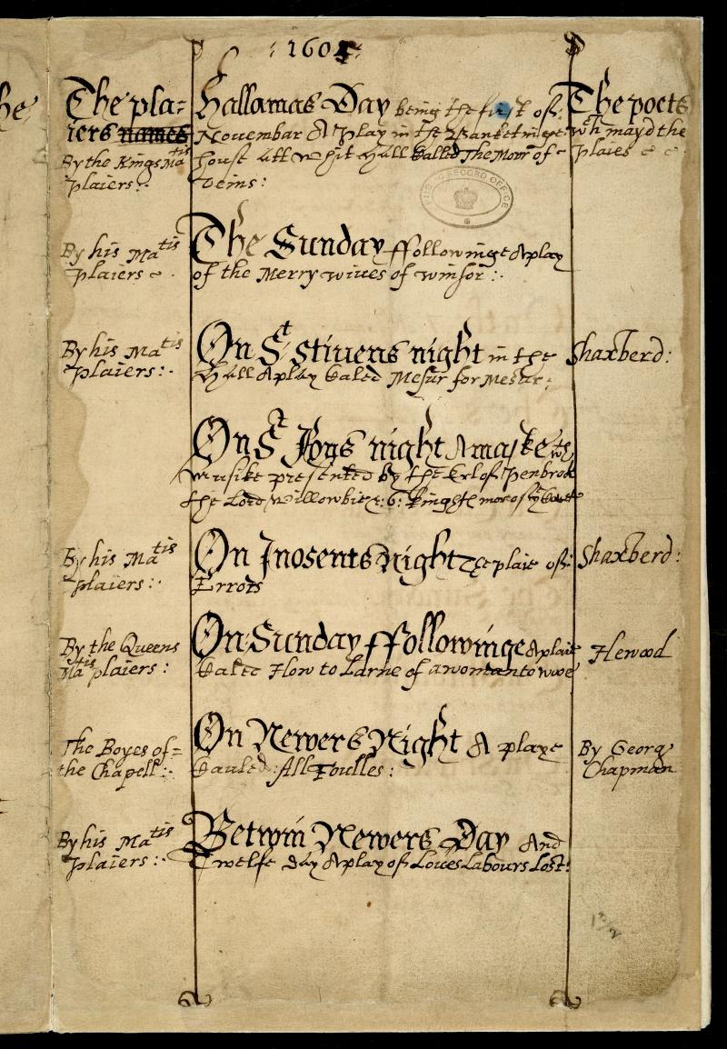

Slide 7
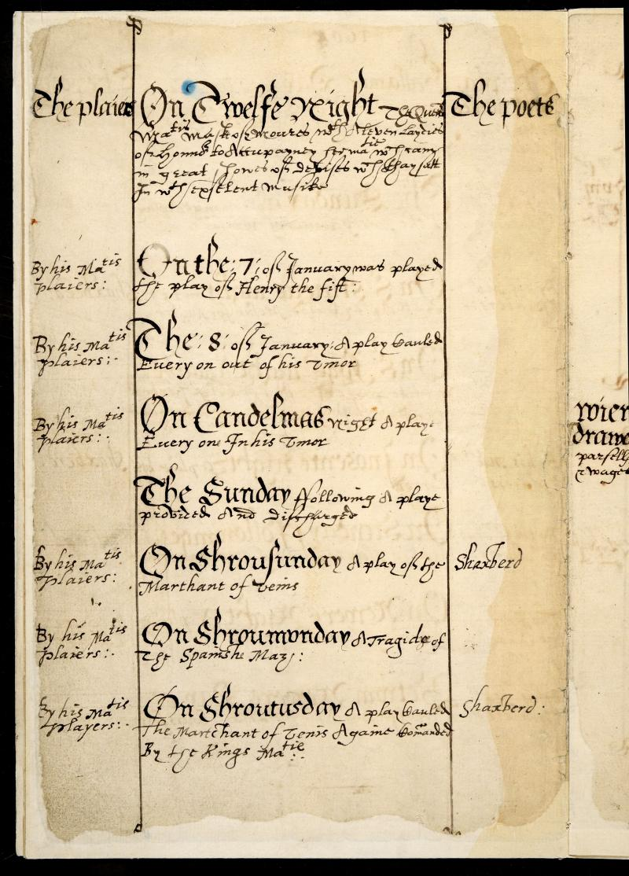

Slide 8
Here are the answers-were you right?
Slide 1
The book covered November 1604-October 1605.
Tylney’s name is spelt Edmundo Tylney.
Slide 2
Plays mentioned are Comedy of Errors, Love Labor’s Lost, Measure for Measure and The Merry Wives of Windsor.
Slide 3
Henry V and The Merchant of Venice

Slide 9
This book is called the
Book of Revels.
It is a record of all the plays that were performed.
The person in charge of deciding which plays would be performed was called
The Master of the Revels.

Slide 10
Sir Edmund Tylney
Master of the Revels
The job of Master of the Revels grew in importance during the Tudor reigns of Henry VII and his son Henry VIII.
Sir Edmund held this post between 1579-1610 and he became a very influential and important man during this time.
He became rich and bought The Mansion House in Leatherhead which is where Leatherhead Library and Registry Office is now.

Slide 11
Sir Edmund Tylney’s Job
He would read manuscripts and often attend rehearsals.
Once he approved a play, he would sign the last page of the manuscript.
He approved the building of new playhouses.
Shakespeare’s theatre The Globe was built in
1599 so he would have needed Sir Edmund’s
permission to build it.
He gave permission for thirty of Shakespeare’s plays in total.
He charged 7 shillings per day for his services.
If you didn’t get his permission he could send you to prison!

Slide 12
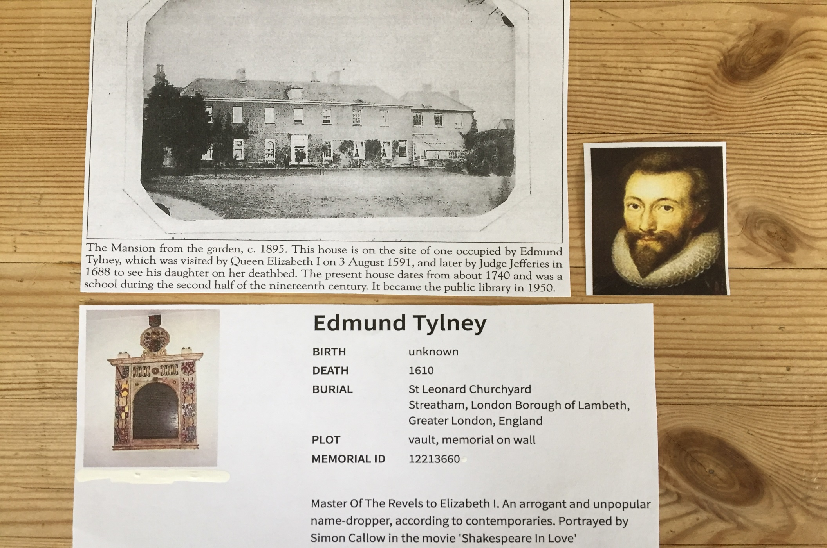

Slide 13
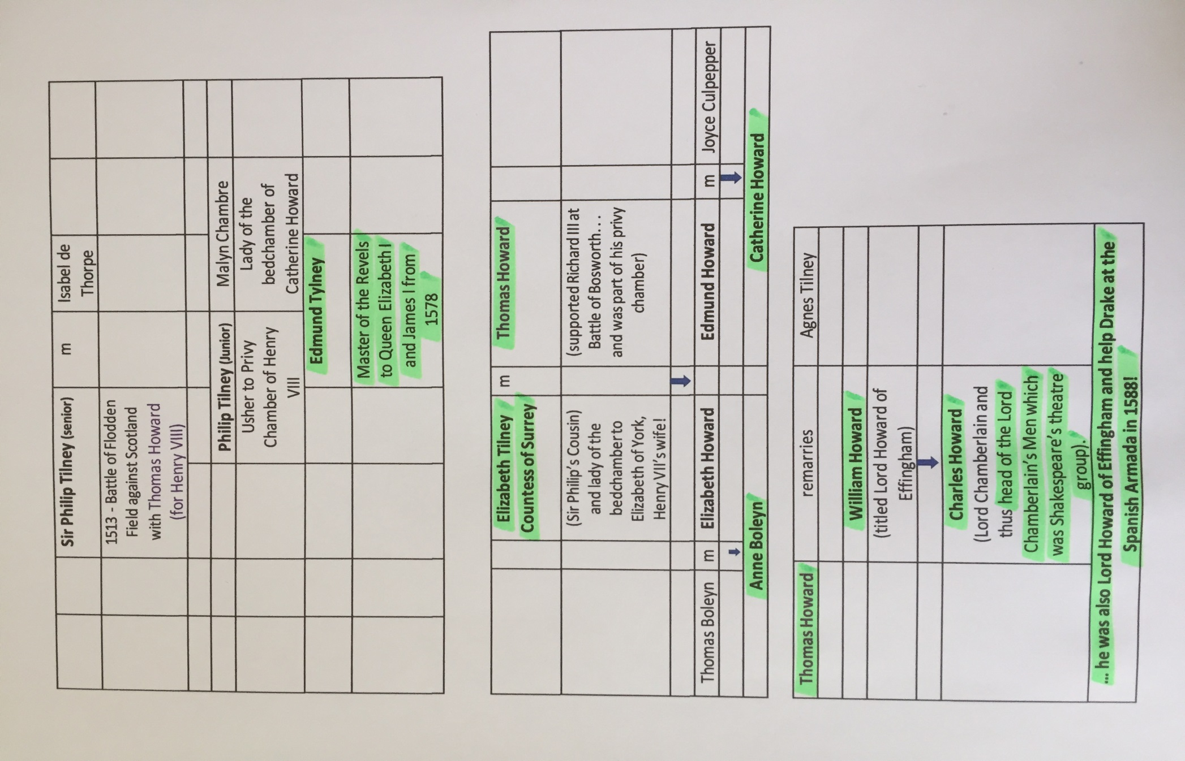
Family Tree of Sir Edmund Tylney and important people highlighted in green.

Slide 14
What pub in Leatherhead is named after him?
Wetherspoons Pub
Just think……if Sir Edmund hadn’t enjoyed Shakespeare’s plays and approved of them, then there would have been no plays, learning his work in schools, films and productions written by the most famous playwright in the world today!
WOW!

Slide 15
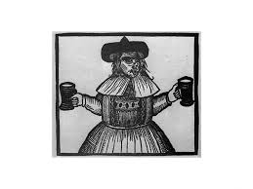
And now Eleanor Rummin!

Slide 16
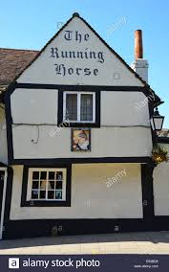
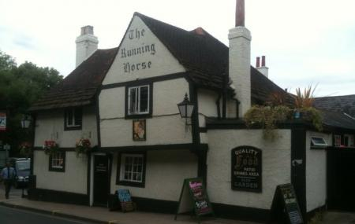
Eleanor Rummin ran the inn (pub) at the bottom of Bridge street.
It was called Rummings House.
Today it is called The Running Horses and it is one of the oldest buildings in Leatherhead.

Slide 17
Did you spot Eleanor’s picture above the door to the pub?
It was unusual for a women during the Tudor times to be in charge of a business so Eleanor was quite a strong character.
She became so well-known that John Skelton, who was Henry VIII’s poet, wrote a poem about her. He wasn’t very flattering about her and quite unkind.
See the next slide for some quotes.

Slide 18
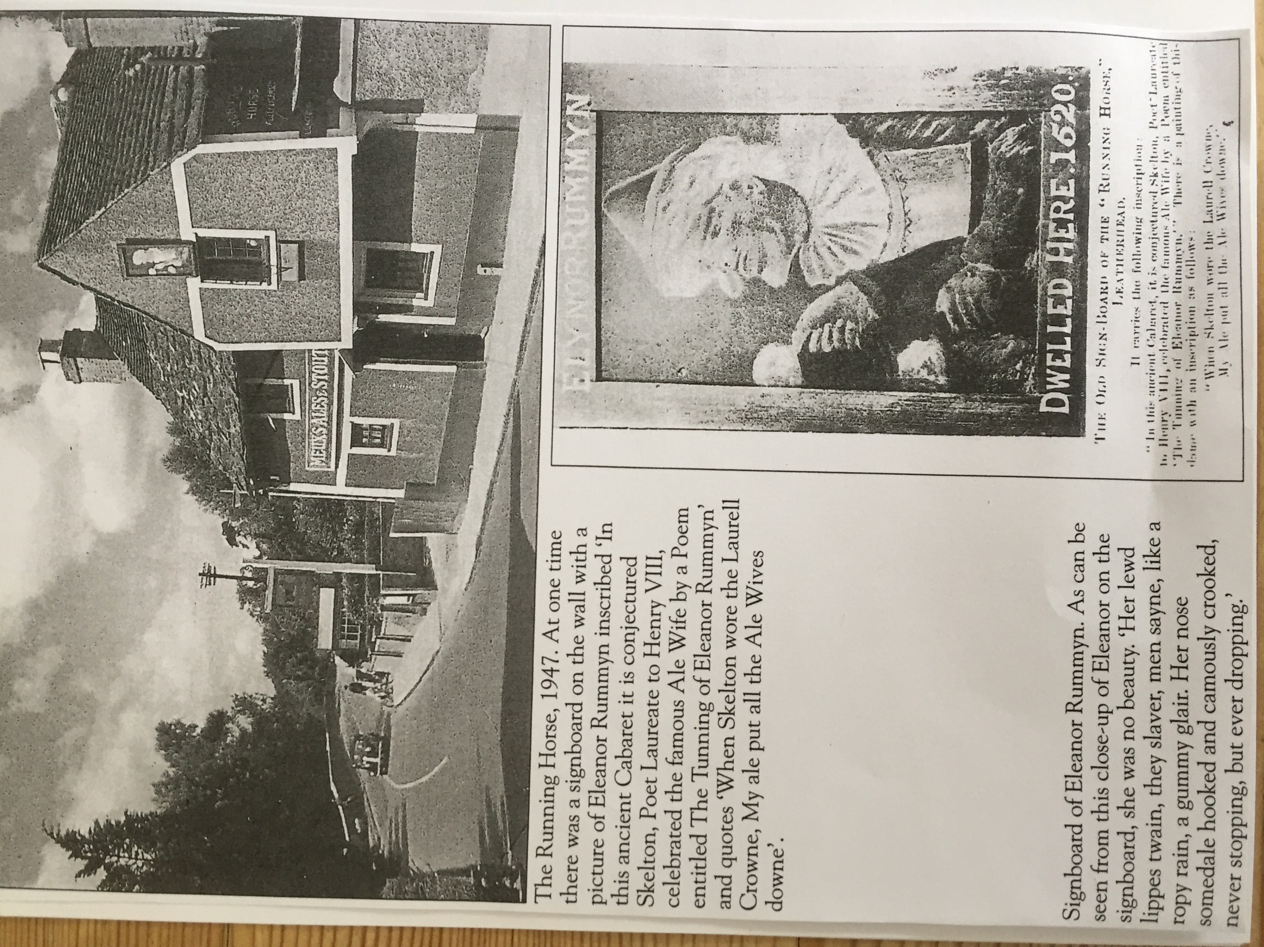

Slide 19
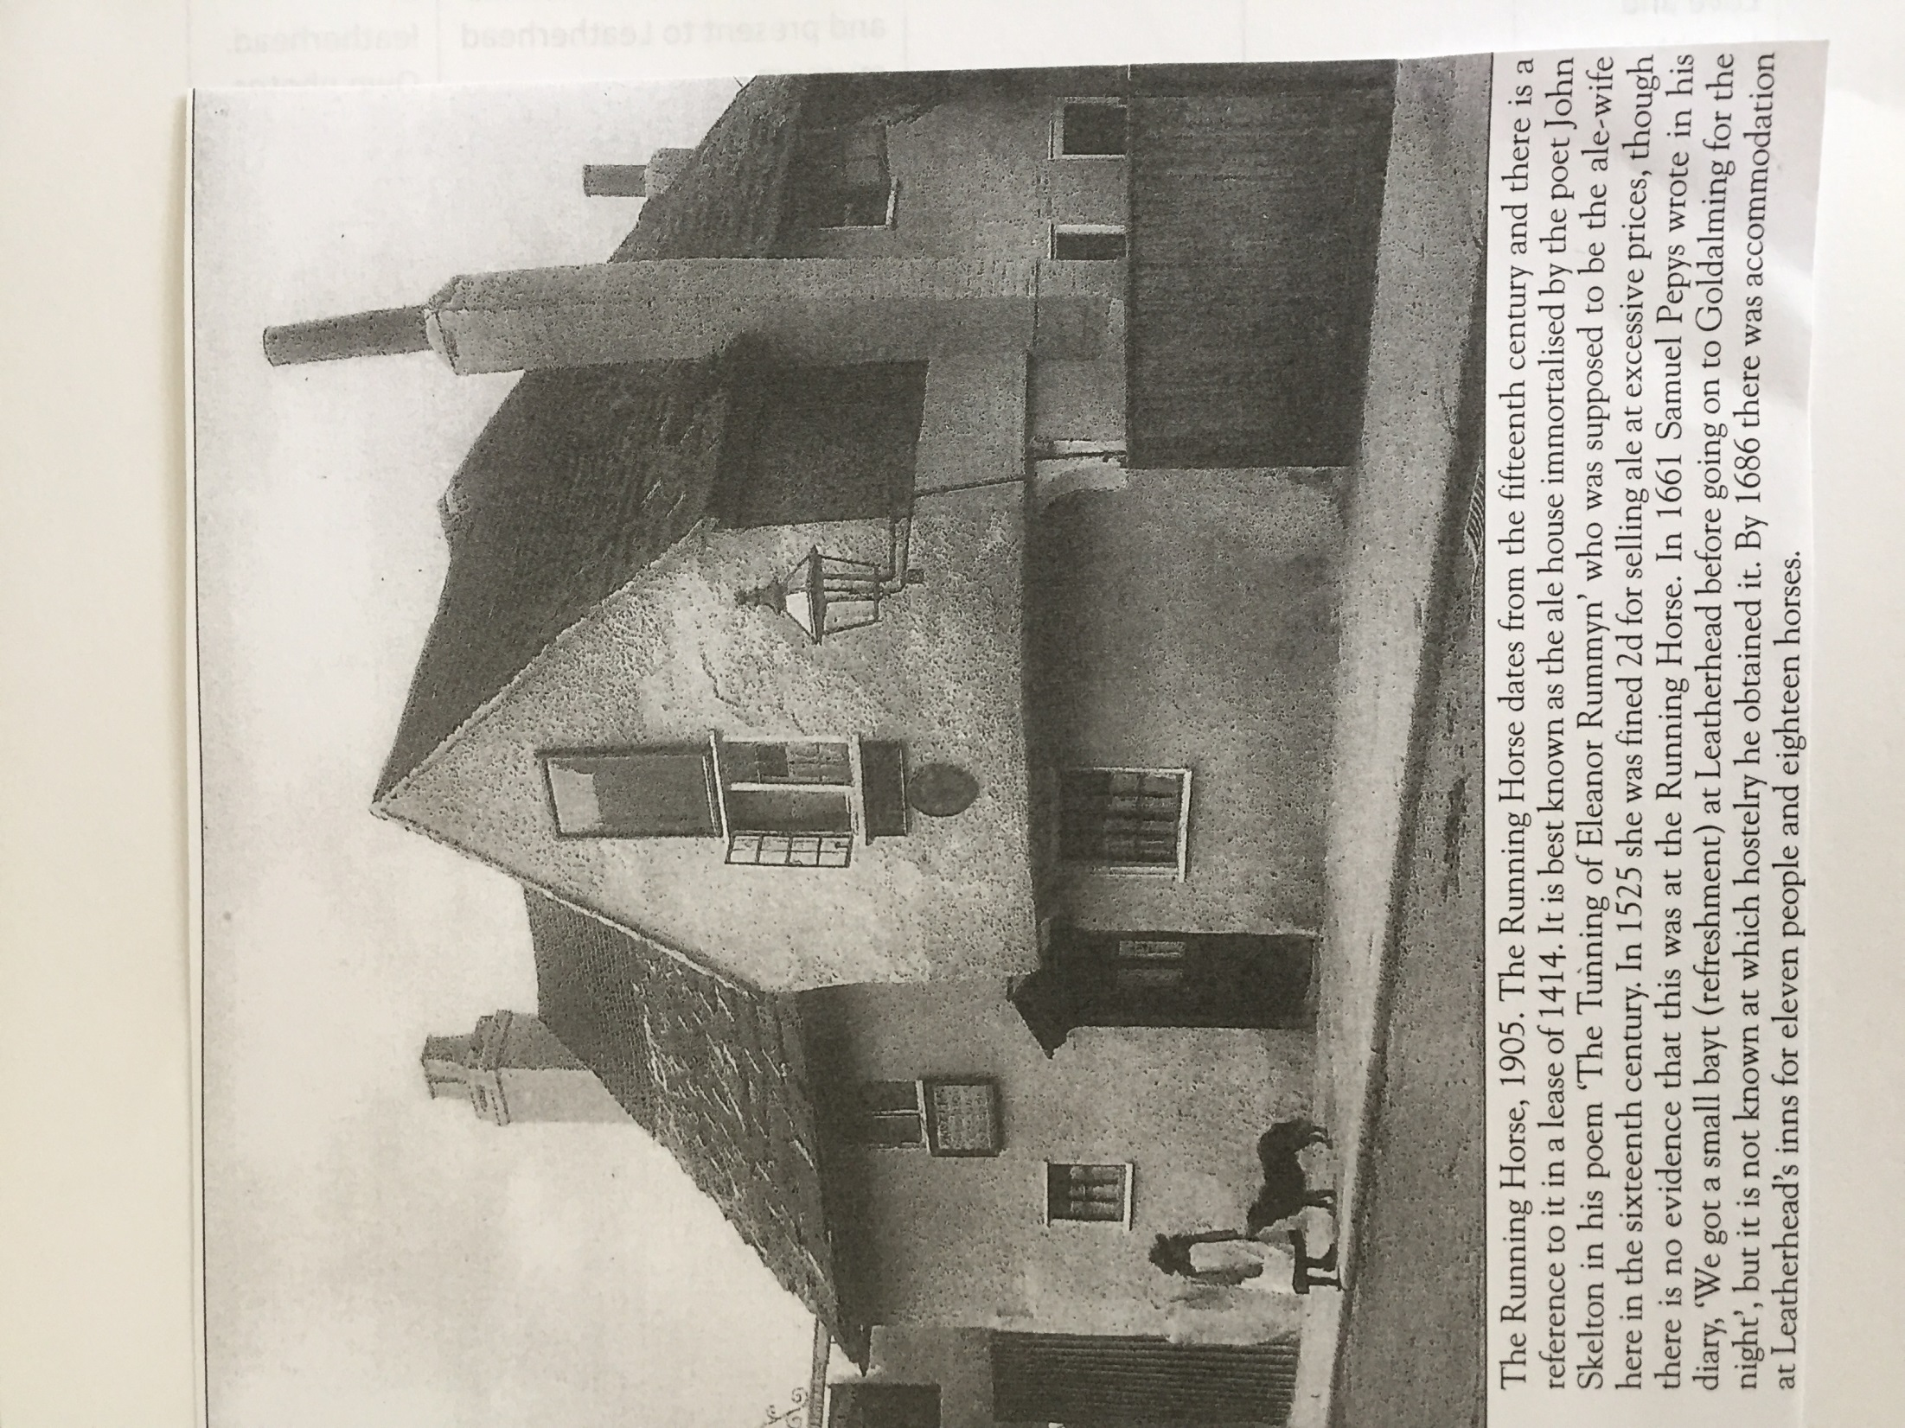

Slide 20
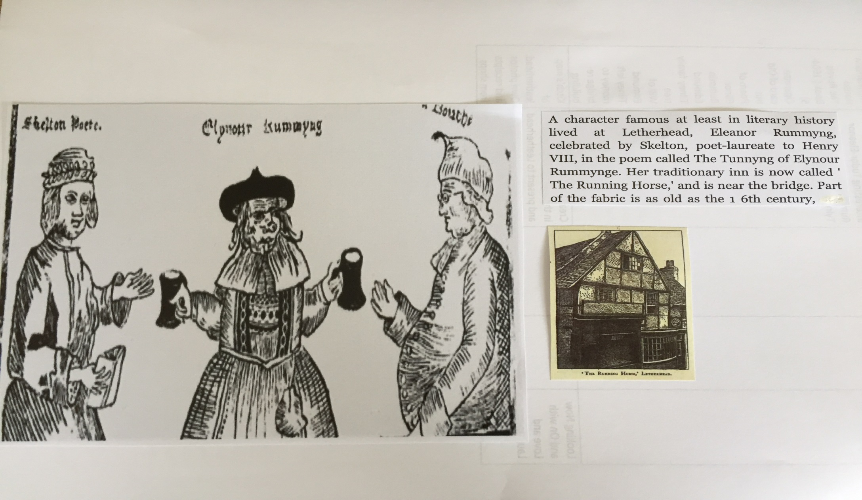
A drawing of Eleanor with the poet John Skelton on the left.

Slide 21
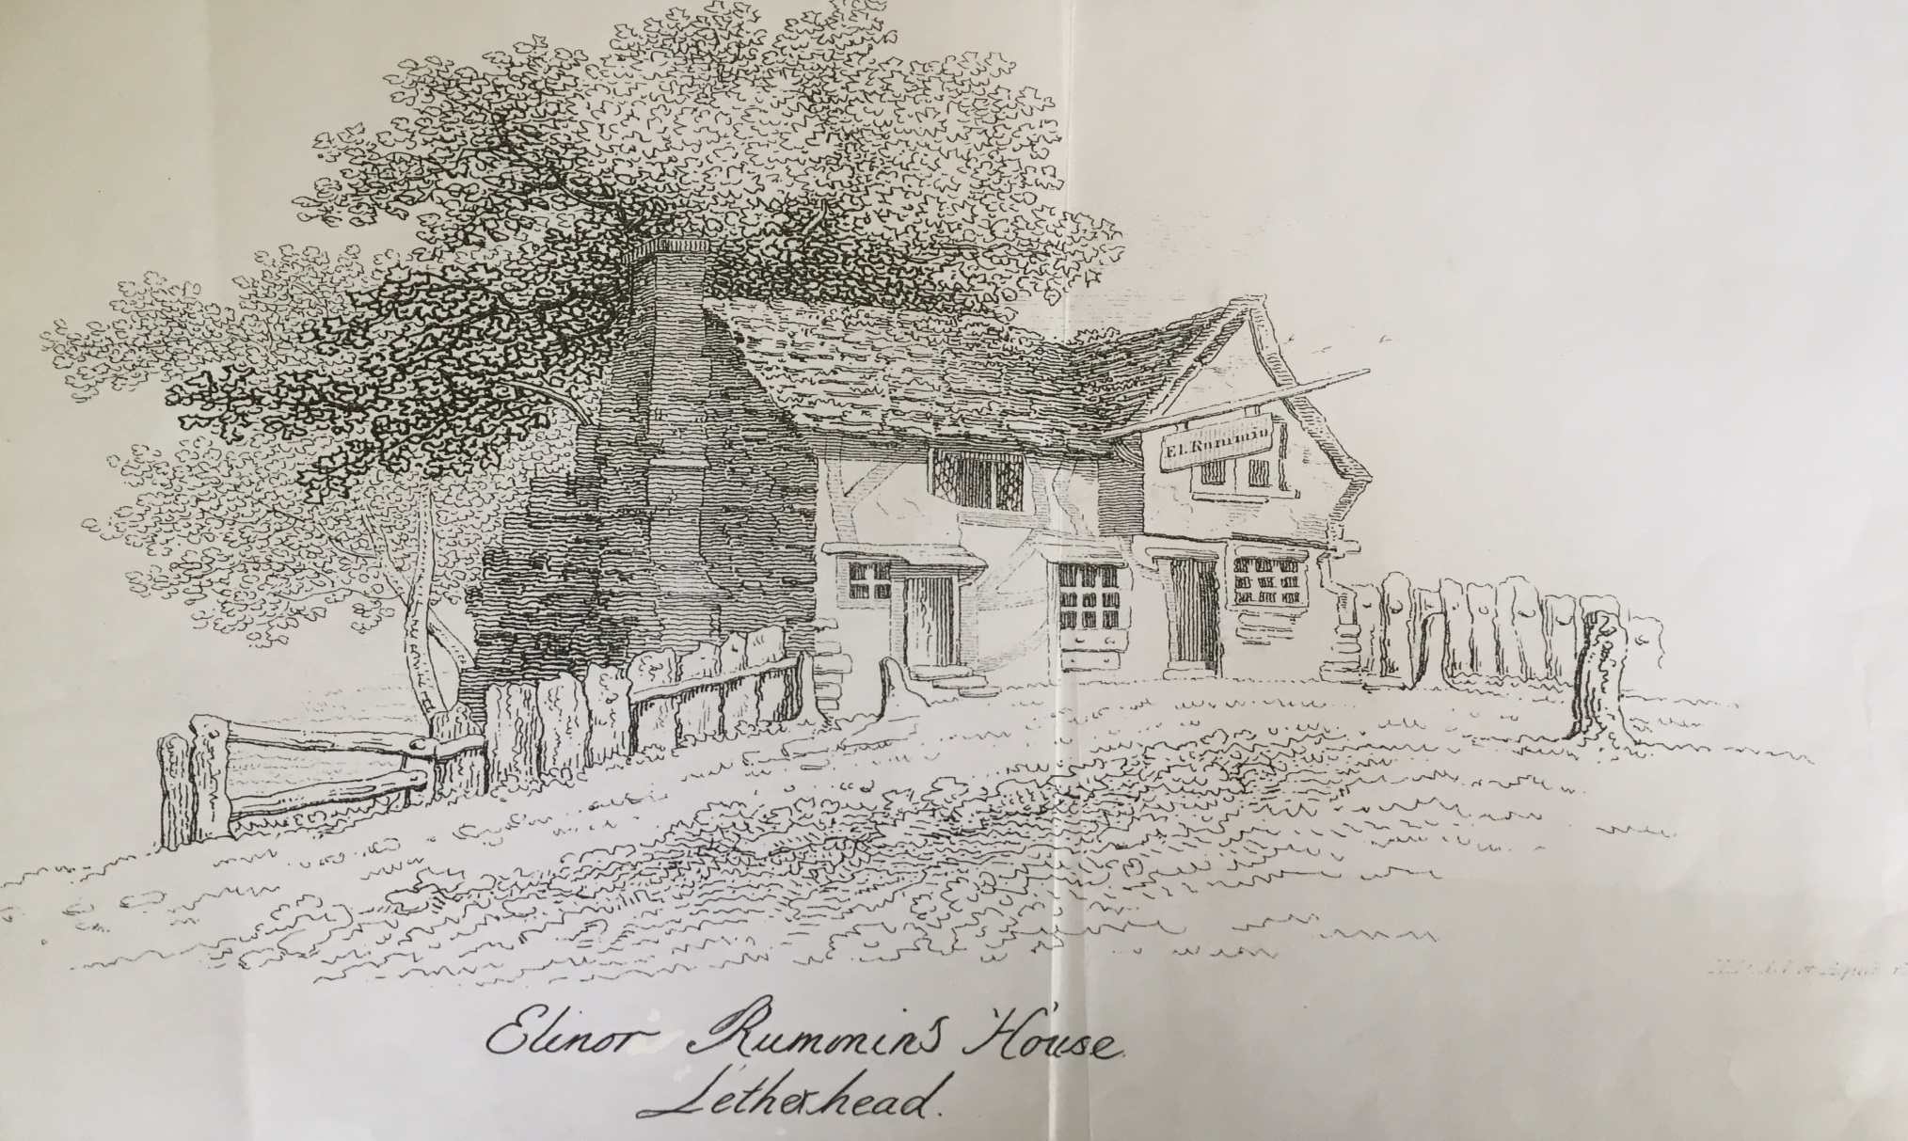
A drawing of the inn as it was in 1805 by the Vicar of Leatherhead’s wife, Mrs Dalloway.

Slide 22
Watch this programme
Tony Robinson’s History of Britain
Season 1
Episode 1
The Tudors
https://www.my5.tv/tony-robinson-s-history-of-britain/season-1/episode-1-018b9e01-14bb-4d9a-925c-83ecb4ca55a8
START watching from 28 minutes 48
seconds
STOP at 32 minutes

Slide 23
Your turn now to decide who was the most interesting Tudor in Leatherhead-Edmund or Eleanor?
Read through all the slides again and choose your person.
Write at least ½ page telling me why you have chosen your person and not the other.
You could try and do some more research about them-remember your e-safety.
I look forward to reading about your choices and why.

