Slide 1


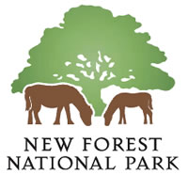

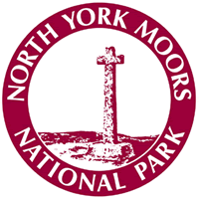





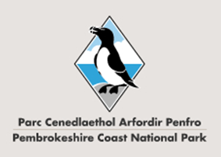
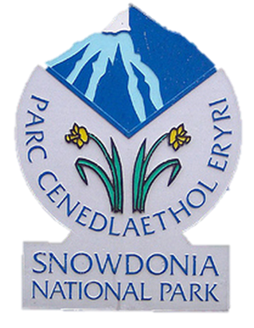



National Parks

Slide 2
What is a National Park?
There are currently _ _ National Parks found in the UK. They are areas of land _ _ _ _ _ _ _ _ by the government because of their _ _ _ _ _ _ _ _ _ countryside, wildlife and cultural _ _ _ _ _ _ _ _. Their farms, villages and _ _ _ _ _ are also protected. An example of a National Park is the L _ _ _ D _ _ _ _ _ _ _.
15
Protected
beautiful
heritage
towns
Lake District

Slide 3
Who owns the National Parks?
Private landowners
Farmers and organisations like the National Trust are some of the landowners, along with the thousands of people who live in the villages and towns.
National Park Authorities own bits of land.

Slide 4
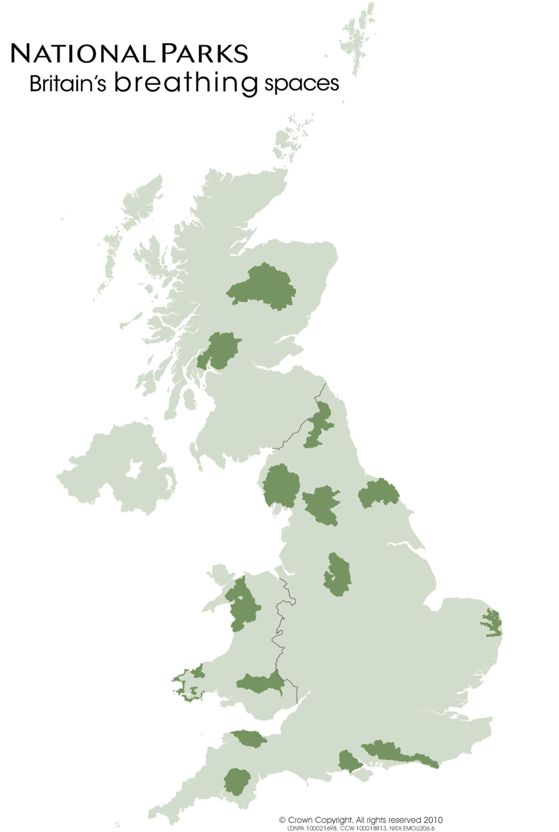
Task:
Can you identify each of the National Parks found in the UK.

Slide 5
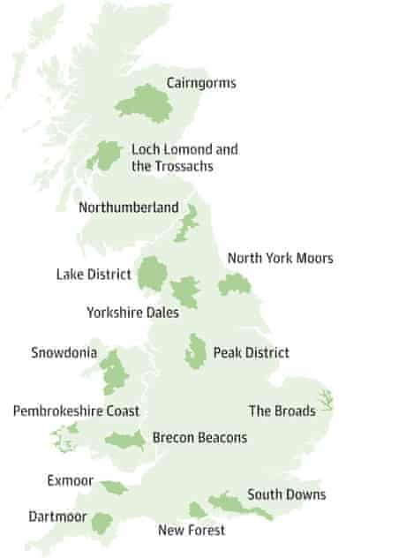

Slide 6
The 15 National Parks
1. Brecon Beacon
2. The Broads
3. Cairngorms
4. Dartmoor
5. Exmoor
6. Lake District
7. Lock Lomond
8. New Forest
9.Northumberland
10. N.York Moors
11. Peak District
12. Pembrokeshire Coast
13. Snowdonia
14. South Downs
15.Yorkshire Dales

Slide 7
Task
Choose one National Park from the map.
Produce a powerpoint presentation on your National Park, including the follow, and anything else that you think is important.
Location (map).
How big it is?
When did it become a National Park?
Why did it become a National Park?
The geographical features eg. rivers and mountains
What is it renowned for?
Activities on offer in the National Park.
What wildlife, trees and flowers are there?
Information about the local area.
Number of people that visit each year.

Slide 8
The National Park websites are:
Brecon Beacons National Park: www.breconbeacons.org
The Broads National Park: www.broads-authority.gov.uk
Cairngorms National Park: http://cairngorms.co.uk
Dartmoor National Park: www.dartmoor.gov.uk
Exmoor National Park: www.exmoor-nationalpark.gov.uk
Lake District National Park: www.lakedistrict.gov.uk
Loch Lomond and The Trossachs National Park: www.lochlomond-trossachs.org
New Forest National Park: www.newforestnpa.gov.uk
Northumberland National Park: www.northumberlandnationalpark.org.uk
North York Moors National Park: www.northyorkmoors.org.uk
Peak District National Park: www.peakdistrict.gov.uk
Pembrokeshire Coast National Park: www.pembrokeshirecoast.org.uk
Snowdonia National Park: www.eryri-npa.gov.uk
South Downs National Park: www.southdowns.gov.uk
Yorkshire Dales National Park: www.yorkshiredales.org.uk

