Slide 1
YEAR 6 HOME LEARNING

Slide 2

2 WEEK BLOCK: ENGLISH

Slide 3

ACTIVITY 1
COMPREHENSION
Please start each English session with a mini comprehension from www.activelearnprimary.co.uk
Or go to school website www.oakfieldjunior.com and follow the links at the side of the page.
User name: First initial then space followed by last name. Eg Paul Smith = p smith
Password is: password
School code: XLPA
Tasks: 4 Reading Comprehension Tasks have been set on here for Y6 to complete:
Ultimate Explorers
Greek Myths 1
Greek Myths 2
Glass Cupboard
10 MINUTES

Slide 4

ACTIVITY 2
GRAMMAR
Choose a game each day from one of the websites below and complete your online SPAG.Com assessment each week.
https://www.topmarks.co.uk/english-games/7-11-years/spelling-and-grammar
http://www.sheppardsoftware.com/grammargames/pandapopPartsofSpeech.htm
http://www.crickweb.co.uk/ks2literacy.html
https://www.bbc.co.uk/bitesize/topics/zhrrd2p
http://www.primaryhomeworkhelp.co.uk/literacy/
http://www.funenglishgames.com/grammargames.html
10 MINUTES

Slide 5

ACTIVITY 3
WRITING COMPOSITION
Please follow this link to Authorfy website where authors have posted daily writing challenges. Children can choose their own author challenge from the growing selection available. A new challenge is posted daily.
https://authorfy.com/10minutechallenges/
Alternatively or as well as they could choose a writing task from the next slide!
30 MINUTES

Slide 6
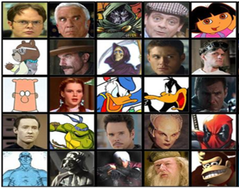
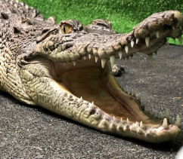
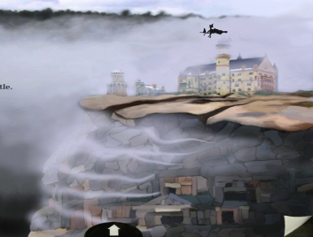

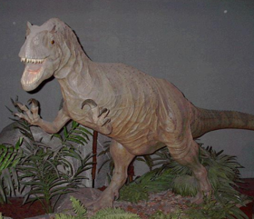
WRITING COMPOSITION
Choose a task each day or alternatively spend longer on one task over a few days
If you could have any fictional character as your best friend, who would you choose and why? What would you do together?
Write an information report about an animal of your choice.
Write a story about this picture and give it a name.
Recreate a new ending for the last book you read.
What would earth be like if dinosaurs were not extinct? Write a paragraph describing a world where dinosaurs do exist.

Slide 7
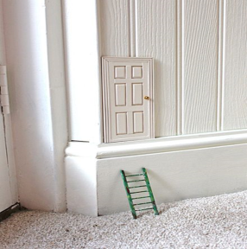



WRITING COMPOSITION
Choose a task each day or alternatively spend longer on one task over a few days
One day you find this door in the corner of your room. What is it for? Where does it take you?
Write a blurb for a story you have read.
Create a travel brochure for a chosen destination.
Write a set of instructions for an activity you have completed, an experiment you have carried.

Slide 8

ACTIVITY 4
SPELLING
Please continue to work through the Year 6 lists – aim to learn 10 new spellings each week and revisit 10 from previous weeks.
Get someone to test you on them at the end of the week.
10 MINUTES

Slide 9

ACTIVITY 5
READING
Please ensure the children continue to read a good quality reading book from the year 6 list
http://trentceprimaryschool.co.uk/wp-content/uploads/2016/11/100-Books-To-Try-And-Read-Before-You-Leave-Year-6.pdf
Talk to someone at home about the book that you are reading.
Read a few pages alpud to somebody; this is a different skill to silent reading. Can you make it exciting? Use different voices.
30 MINUTES

