Slide 1
YEAR 6 HOME LEARNING

Slide 2

2 WEEK BLOCK: ENGLISH – Week beginning: 22nd June and 29th June

Slide 3

Main Activity – Option 1
Click on the link below to access your English lessons for the next two weeks using the National Oak Academy website
https://www.thenational.academy/online-classroom/schedule
Select – Year 6
Then Select the English lesson for each day this week

Slide 4

Alternatively…..
Main activity – Option 2
BBC Bitesize – Daily English lessons
Click on the link below to access the daily English lessons for Year 6 from BBC Bitesize
https://www.bbc.co.uk/bitesize/dailylessons
Select – Year 6
Then select the daily English lesson each day this week

Slide 5


Extra Activities/Tasks
Doodle English / Doodle Spell
Spend 10 minutes playing on the Doodle App for English or spelling each day.
10 MINUTES
You can download the computer apps here:
English: https://www.doodleenglish.com/download-doodleenglish-windows-macs/
Or you can use the Google Chrome web browser on your PC, laptop or Mac:
students.doodleenglish.com
students.doodleenglish.com/spell

Slide 6

SPELLING
Please continue to work through the Year 6 lists – aim to learn 10 new spellings each week and revisit 10 from previous weeks.
Get someone to test you on them at the end of the week.
10 MINUTES

Slide 7

READING
Please ensure the children continue to read a good quality reading book from the year 6 list
http://trentceprimaryschool.co.uk/wp-content/uploads/2016/11/100-Books-To-Try-And-Read-Before-You-Leave-Year-6.pdf
Talk to someone at home about the book that you are reading.
Read a few pages aloud to somebody; this is a different skill to silent reading. Can you make it exciting? Use different voices.
30 MINUTES

Slide 8
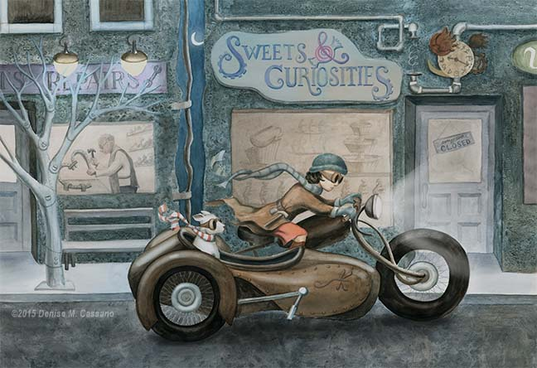

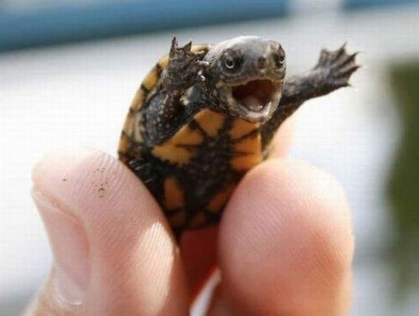
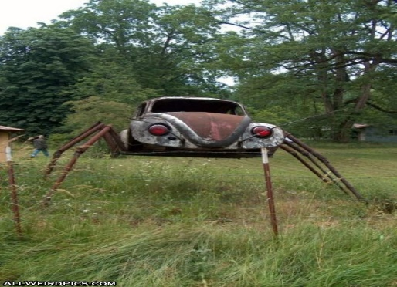

OPTIONAL EXTRA HOME LEARNING EXTENSION ACTIVITIES
WRITING COMPOSITION
Choose a task each day or alternatively spend longer on one task over a few days
Write a story about this picture and give your story a name.
You just discovered a new planet. Tell the story.
This tiny turtle is giving a speech. What is he saying? Who is he speaking to?
A new type of car has just been invented: The Spider car. Write about all the cool features of this car. Then invent your own cool car.
Finish the story to this enticing starter.

Slide 9


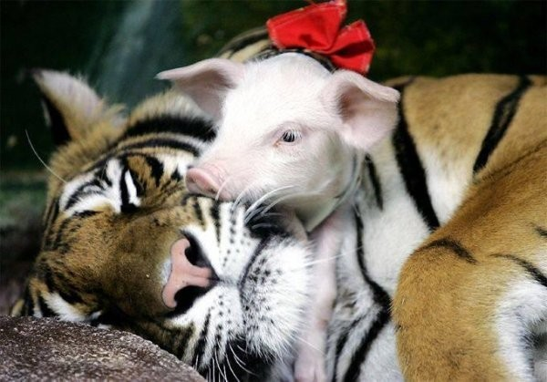
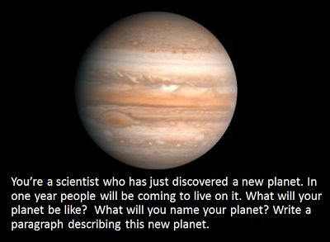

Choose a task each day or alternatively spend longer on one task over a few days
Tell the story Halloween from the perspective of a sweet.
What can humans learn from animals?
Describe your new planet in one paragraph.
Write this conversation.

Slide 10

OPTIONAL EXTRA HOME LEARNING EXTENSION ACTIVITIES
WRITING COMPOSITION
Please follow this link to Authorfy website where authors have posted daily writing challenges. Children can choose their own author challenge from the growing selection available. A new challenge is posted daily.
https://authorfy.com/10minutechallenges/
Alternatively or as well as they could choose a writing task from the next slide!
30 MINUTES

