Slide 1
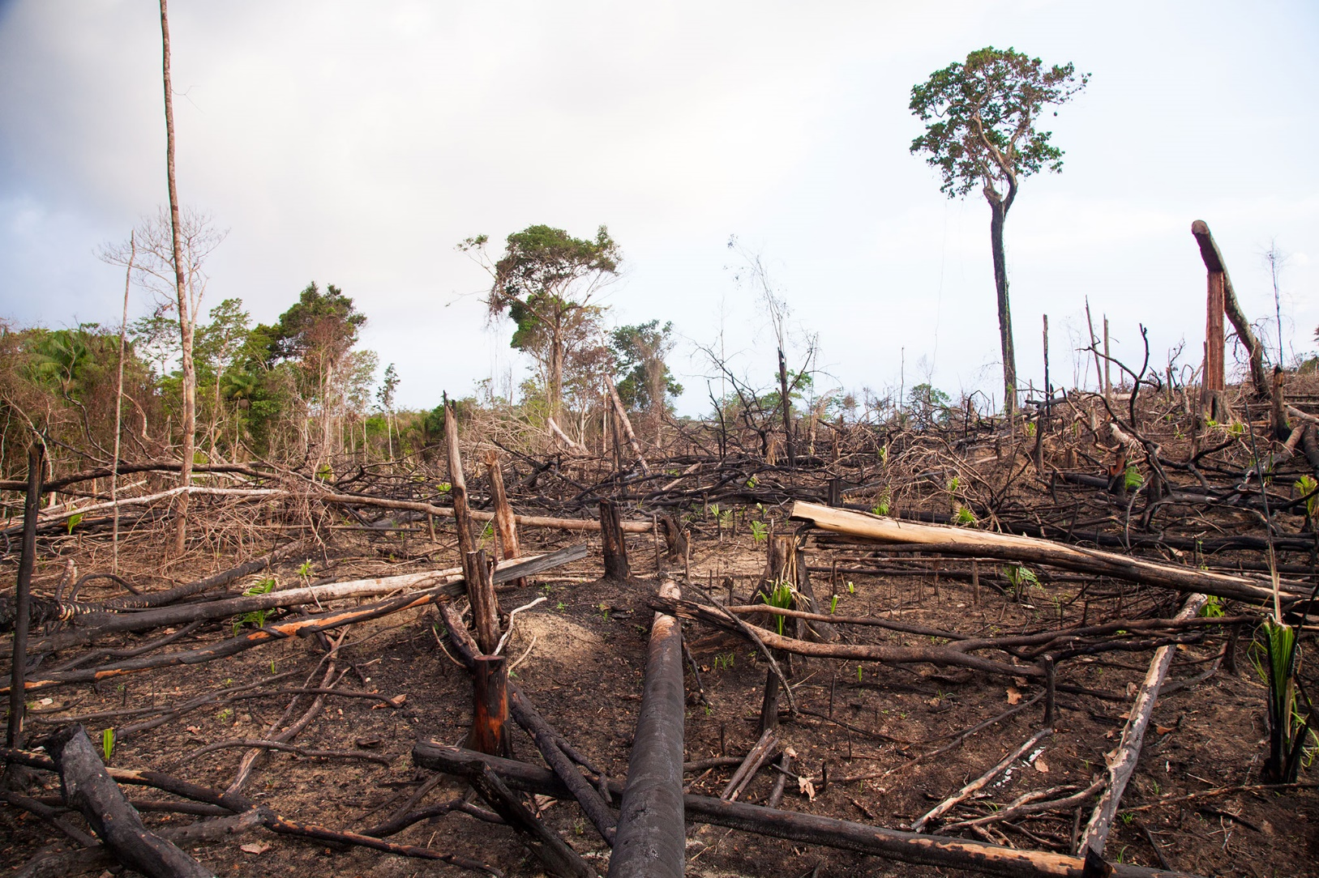
DEFORESTATION
Question: What are the causes and effects of deforestation?

Slide 2
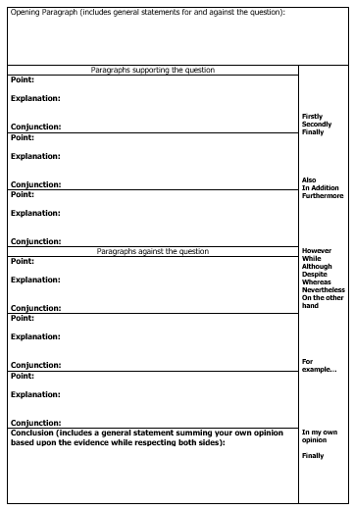
Task 1: To write a persuasive letter to the editor of a newspaper / magazine in which you state the different causes and effects of deforestation and how and why we should decrease it.
I have given you the opening paragraph below or you can write your own. Remember to use conjunctions and modal verbs in your writing. Use this planning sheet to help you structure your letter.
Dear Editor, I feel it is my moral duty to comment on the major problem of deforestation. This world - wide issue is now affecting every person on our fragile planet. Little or nothing is being done to stop the appalling acts taking place in most countries. The impact of deforestation has now reached alarming levels; the consequences will soon be irreversible. I will state my irrefutable points of view, which will hopefully persuade all your readers, to act immediately in order to halt the global decimation of our precious resources.

Slide 3
LO. To understand the term DEFORESTATION
https://www.youtube.com/watch?v=AVh2DEgpvsM
https://www.youtube.com/watch?v=M4jhjt1_eyM
Click on these 2 links above to remind yourself about deforestation is. You should try and make some notes to help you with the content of your writing.

Slide 4
Some points we have discussed in class about deforestation. However, you can safely search the internet for other points and use your points you recorded while watching the 2 videos.
trees make oxygen by using carbon dioxide third of the world's trees are in forests loss of animals and plants - possible extinction damage to ozone layer soil erosion - soil holds less water, nutrients end up in the oceans acid rain - makes water acidic Increase in noise pollution less rain so more areas have droughts or become deserts
forests changed into land for agriculture - 30% of this land not fertile enough 60000 km2 cut down each year - size of Wales 1965 laws passed in certain countries protecting forests and banning logging 760 years before all trees are gone - planet will be a ball of dust Amazon Rainforest gone in 2060, area reduced by half in 2030 third of all trees cut down is used for paper 20 billion sheets of paper saved if font size is reduced by 1 point

Slide 5
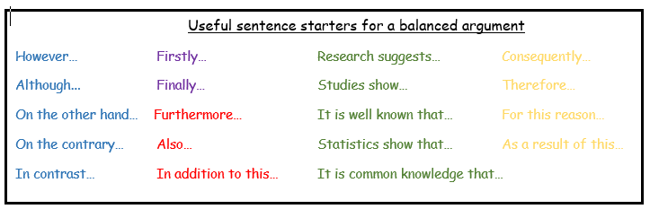
Try to use some of these sentence starters.

Slide 6
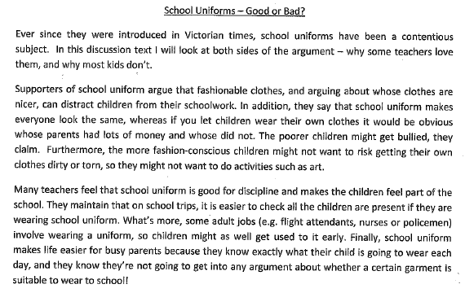
Example of some opening paragraphs of a persuasive letter!

Slide 7
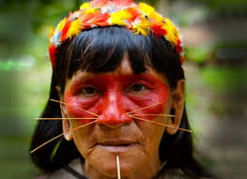
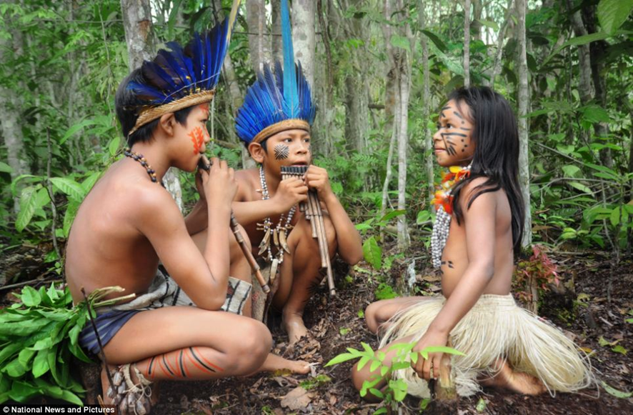
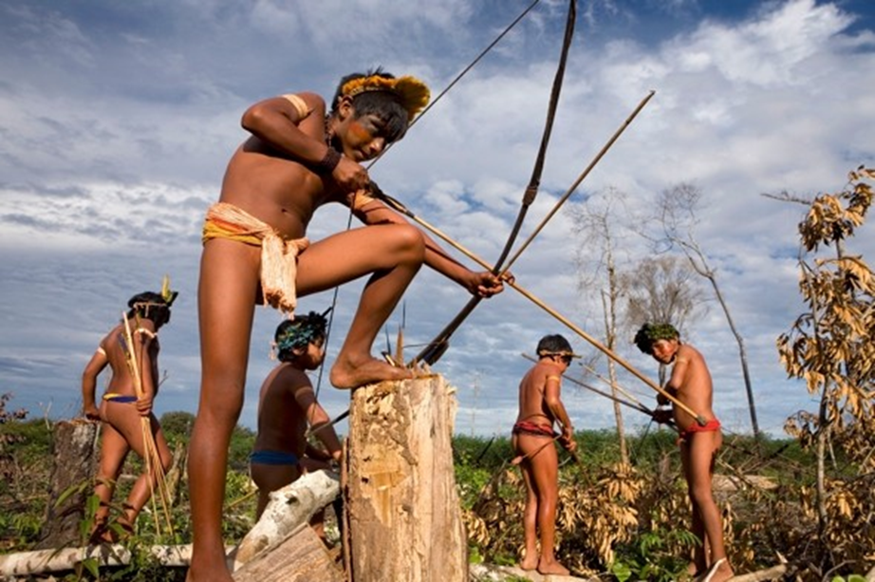
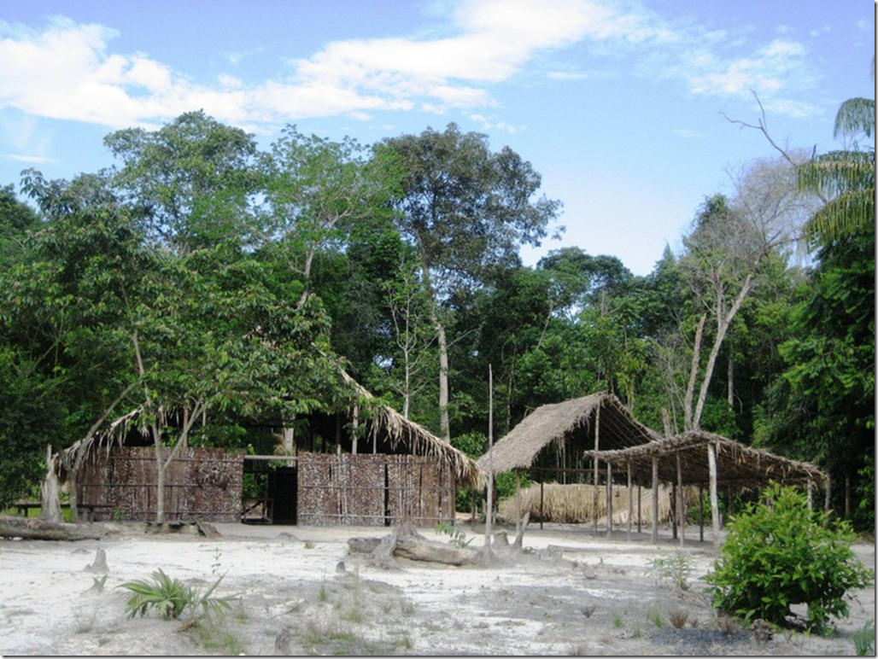
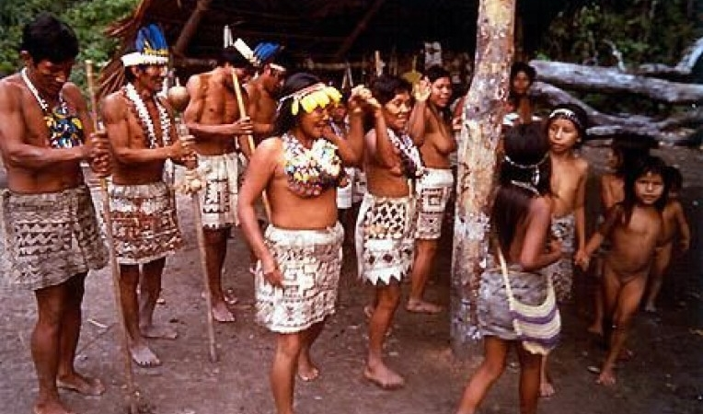
THE JAGUAR TRIBE
Question: How do the Jaguar Tribe live in the Amazon Rainforest?
You can use these pictures in your non chronological report, or find other pictures, or even better – draw your own!

Slide 8

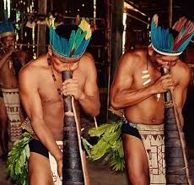
Video on the Jaguar Tribe https://www.youtube.com/watch?v=_DCvDEYhoYA&t=1272s
If you were at school the last day before we went into lockdown you watched this but it would be good to watch it again and to make some notes.
Be aware that the video shows the tribe cooking and eating the wild animals.
Task 2: To write a non chronological report on the Jaguar Tribe.
The next slide will give you some of the points I wrote down but you also need to include your own. If you are researching the Jaguar Tribe on the internet remember to do so safely (put KS2 at the end of your search).

Slide 9
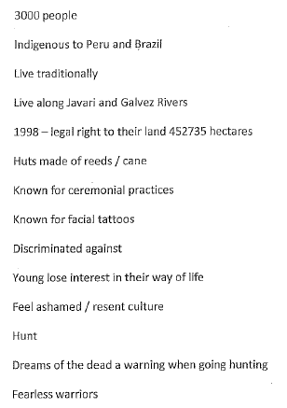
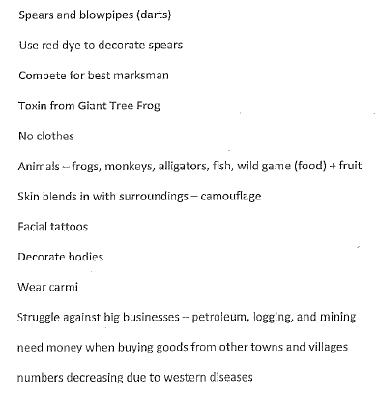
Key facts about the Jaguar Tribe

Slide 10
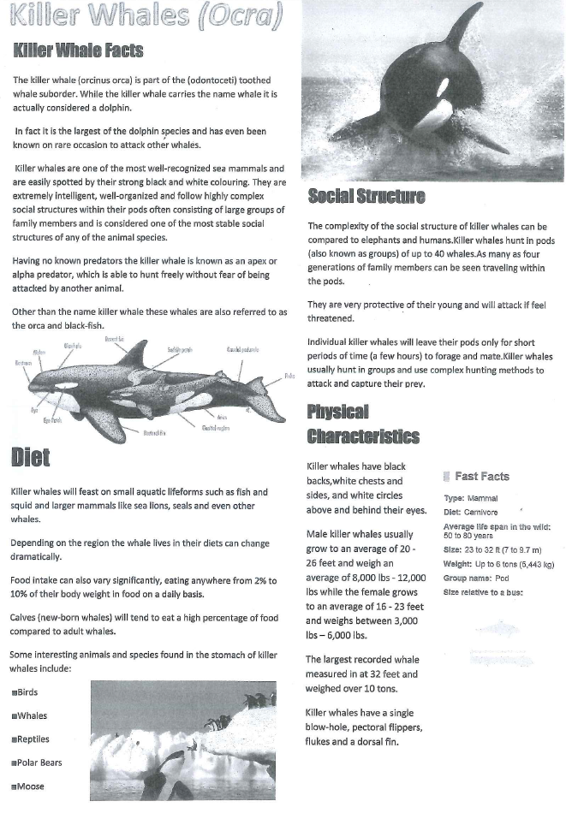
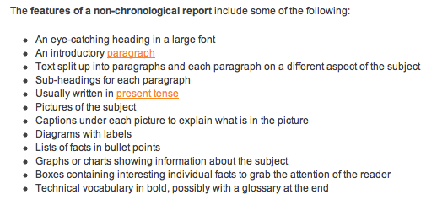
Example of a non chronological report.
I am sure you can find other examples to look at in books that you have at home.
Success Criteria
Success Criteria

Slide 11
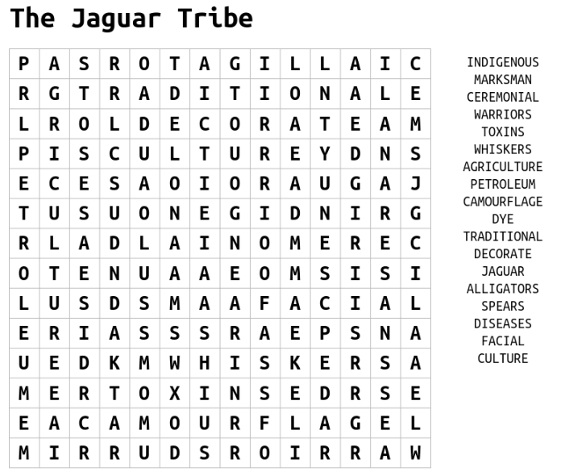
Have a go at doing this wordsearch!

