Slide 1

Year 6 Religious Education
Islam
Key Question
Does belief in ‘Akhirah’ (life after death) help Muslims lead good lives?

Slide 2

Lesson 1
Learning objective: To know that the term ‘Jihad’ can be interpreted differently leading to different actions and consequences.
* For each key question on this Powerpoint, complete your answers on the worksheet ‘RE Lesson 1’.

Slide 3
Meaning of ‘Jihad’
Muslims use the term ‘Jihad’ to describe three different types of struggle:
A believer’s internal struggle to live out the Muslim faith as well as possible.
The struggle to build a good Muslim society.
Holy war – the struggle to defend Islam (with force if necessary)

Slide 4

Key Question 1
How far would you go to stand up for something you believe?
(Complete your answer on your worksheet)
For example: Some vegetarians will not eat meat because they believe it is not right to kill animals. Other vegetarians might not eat meat for other reasons.

Slide 5
Key Question 2
How strongly do you agree with these people’s actions? (Circle your answer on your worksheet)
A person puts a knife in someone’s stomach.
A stranger grabs a child.
A policeman shoots someone.

Slide 6
But now consider this information for each scenario – have you changed your mind? Circle your new answer in a different colour.
The person is a surgeon, operating to save the person’s life.
The child was about to be run over.
The person he shot was about to detonate a bomb in a shopping centre.

Slide 7

Key Question 3
A person robs a bank.
Is this ok? Explain why.
What might the robber’s motivation be?

Slide 8
Key question 4
What is motivation?
What motivates you to do certain things?
Think of a time when you have been motivated to do something.
Would your actions change if you thought someone was watching?

Slide 9
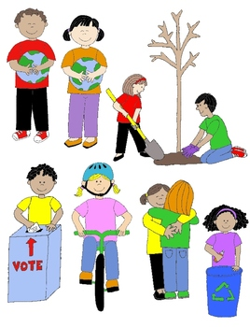
Key question 5
What are good actions?
List 3 things you think are examples of good action on your worksheet.

Slide 10
Task
Think of someone you think leads a ‘good’ life.
Draw a picture of them in the box on your worksheet and write down who they are.
Then write a paragraph that explains why you have chosen them.
What do they do? What do they believe? What actions do they take/make and why?
Use my example on the next slide to help you.

Slide 11
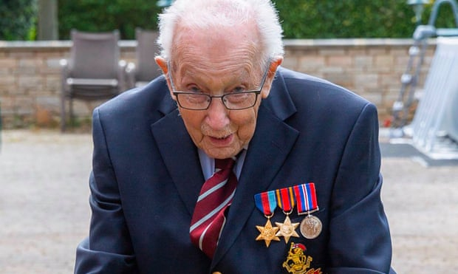
Captain Tom Moore (aged 99)
I have chosen war veteran Captain Tom Moore as someone I believe is leading a ‘good’ life. Whilst everyone has been forced into lockdown due to the Corona virus outbreak, Tom has chosen to walk 10 laps of his garden a day to raise money for the NHS. All the money Moore raises will be donated to NHS charities together to go towards wellbeing packs and rest and recuperation centres for staff on the frontline, as well as electronic devices for patients to communicate with their families while in isolation. I believe he is a fantastic role model for others as he is spending his days doing something that will have such a positive impact on others.

