Slide 1
Lesson 2
Welcome back to your RE unit-
How do Christians show their commitment to God.
In this lesson you will be learning about how
Christians show their commitment to God through The Ten Commandments.

Slide 2
What are The Ten Commandments?
In The Bible, the holy book of Christians, it says that Moses was asked by God to climb Mount Sinai.
God then gave Moses a stone tablet with The Ten Commandments engraved on it.
These Ten Commandments are believed to be how God wants Christians to live their lives- a standard of what is right and wrong.
In The Bible you can find the passage in Exodus 20: verses 2-17.

Slide 3
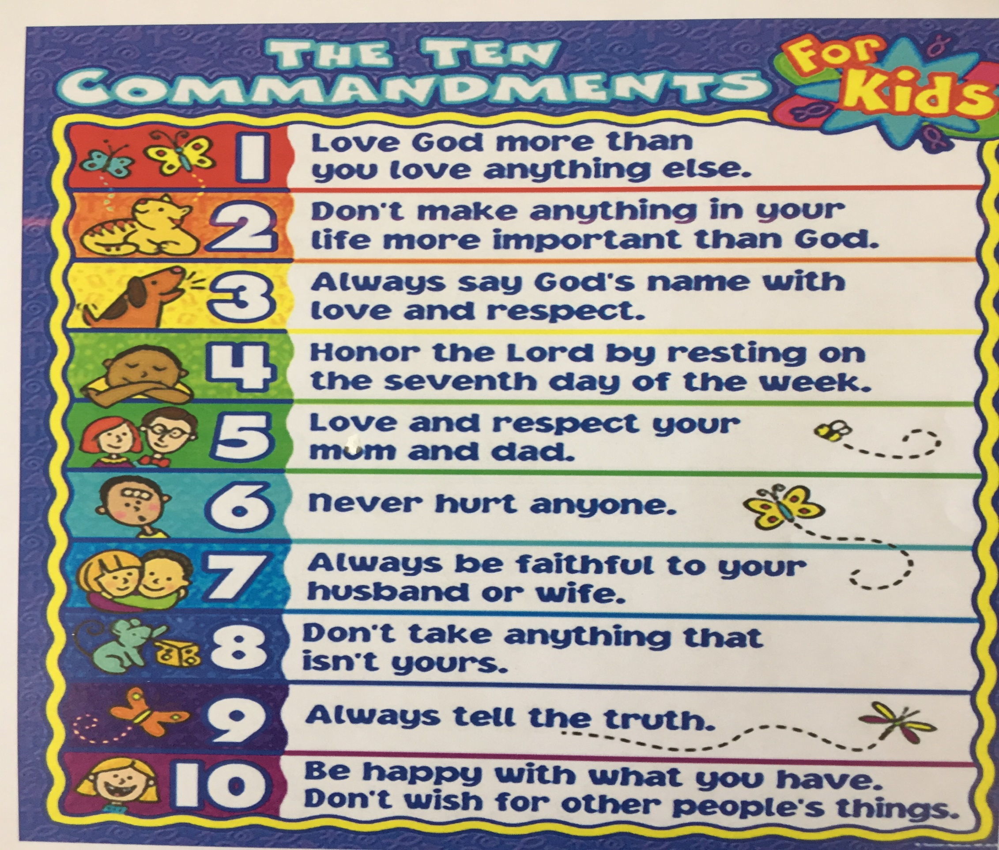

Slide 4
Look at number 9 again.
That is why Corrie and her sister Betsie had a such a dilemma over the Jews that they were hiding.
Order the Ten Commandments according to which ones you think show the most commitment to God. (Just write the numbers)

Slide 5
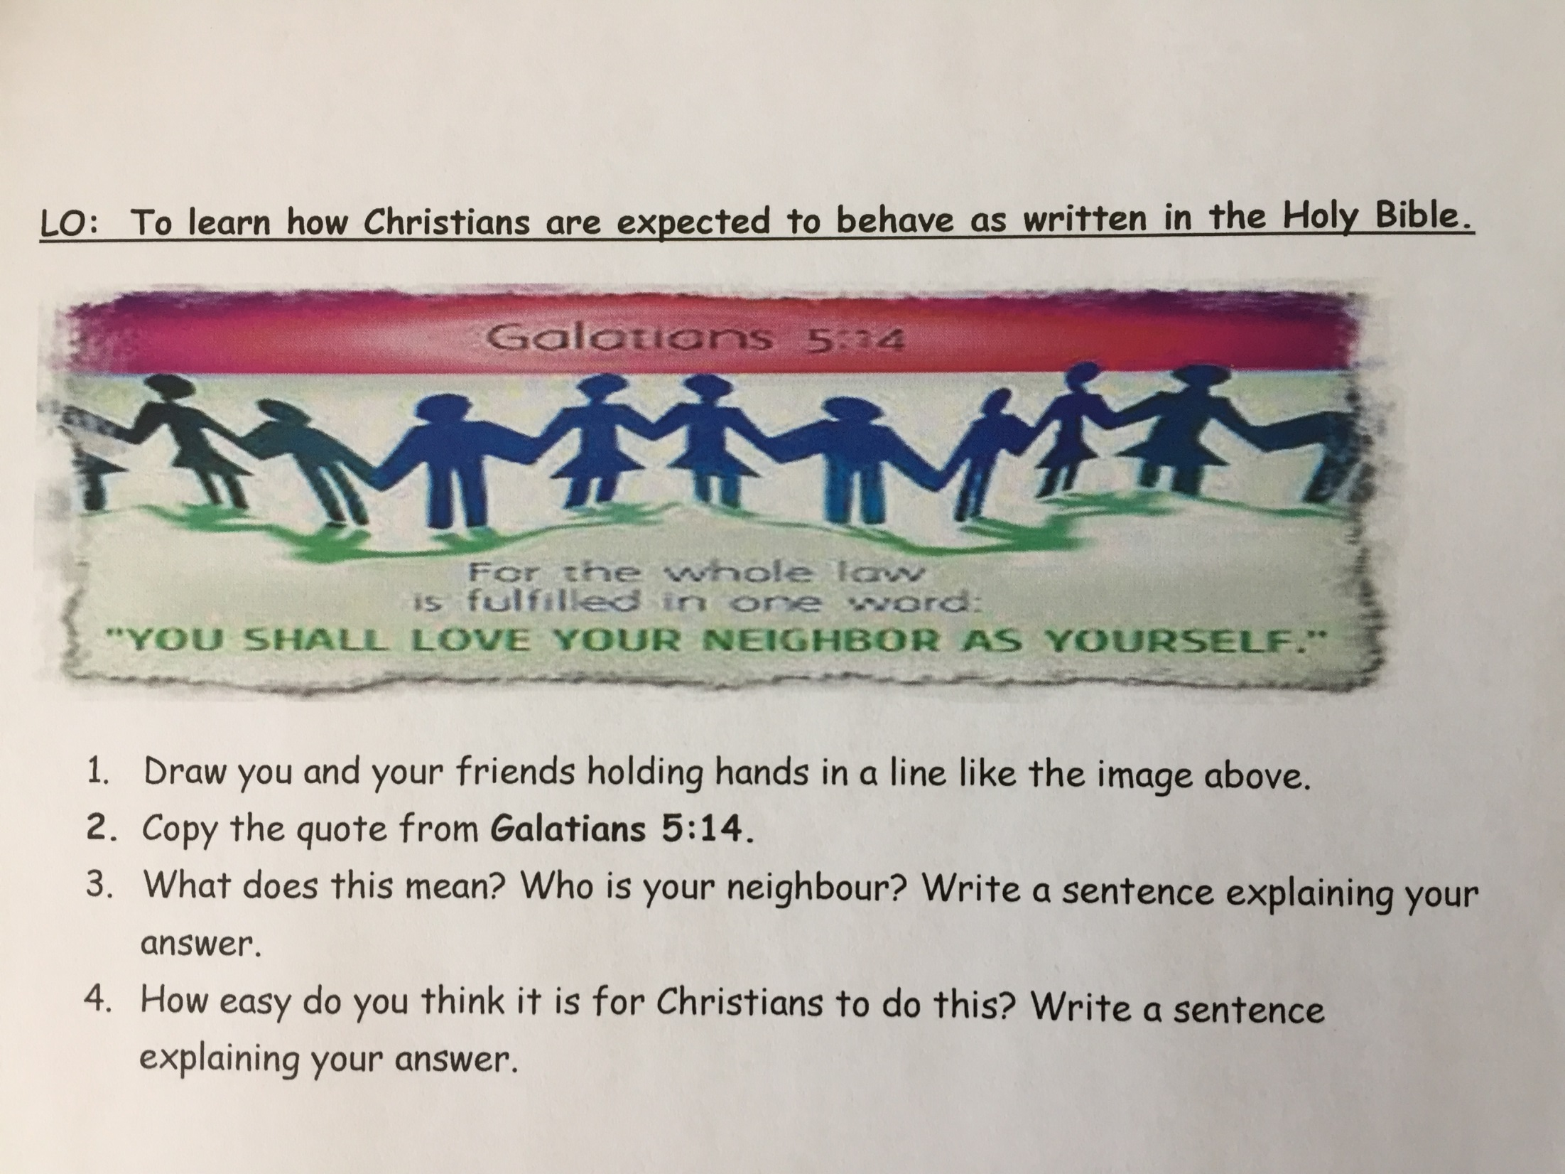

Slide 6


