Slide 1

Lesson 4
To explore why Christians take part in different ceremonies, pray and attend church.
To understand that there are many ways for a Christian to show their commitment to God.

Slide 2
A: Church-What do you think?
Many Christians show commitment to God by attending church every Sunday and worshipping God.
Think- Does attending church every Sunday show commitment to God?
Think- Can Christians still be committed to God if they do not attend church every week?
Think- What does it actually mean to be a good Christian?

Slide 3

B: Prayer-What do you think?
Christians believe that praying to God shows commitment.
Think- Why do Christians pray?
They maybe giving thanks to God, asking
for forgiveness, needing help or just need
someone to talk to.
Think- Is praying necessary to
show commitment to God?

Slide 4
C: Ceremonies
Christians also show commitment through ceremonies such as Baptism, Christening and Marriage in church.
Christening/Baptism
A Christian blessing where a baby or
person is brought into the church family
by sprinkling water over the head.

Slide 5
D: Holy Communion
Christians also show commitment through taking communion.
Watch
www.bbc.co.uk/education/clips/zwcd2hv
The Holy Eucharist or Holy Communion on BBC learning clips. ( Cut and paste this web link into your browser).

Slide 6
Look back over the slides A-D.
Write a sentence explaining each of the ways Christians show their commitment to God.
On the next slide are some drawings. Write your sentence inside each picture.
( If you do not have a printer, draw the pictures).

Slide 7
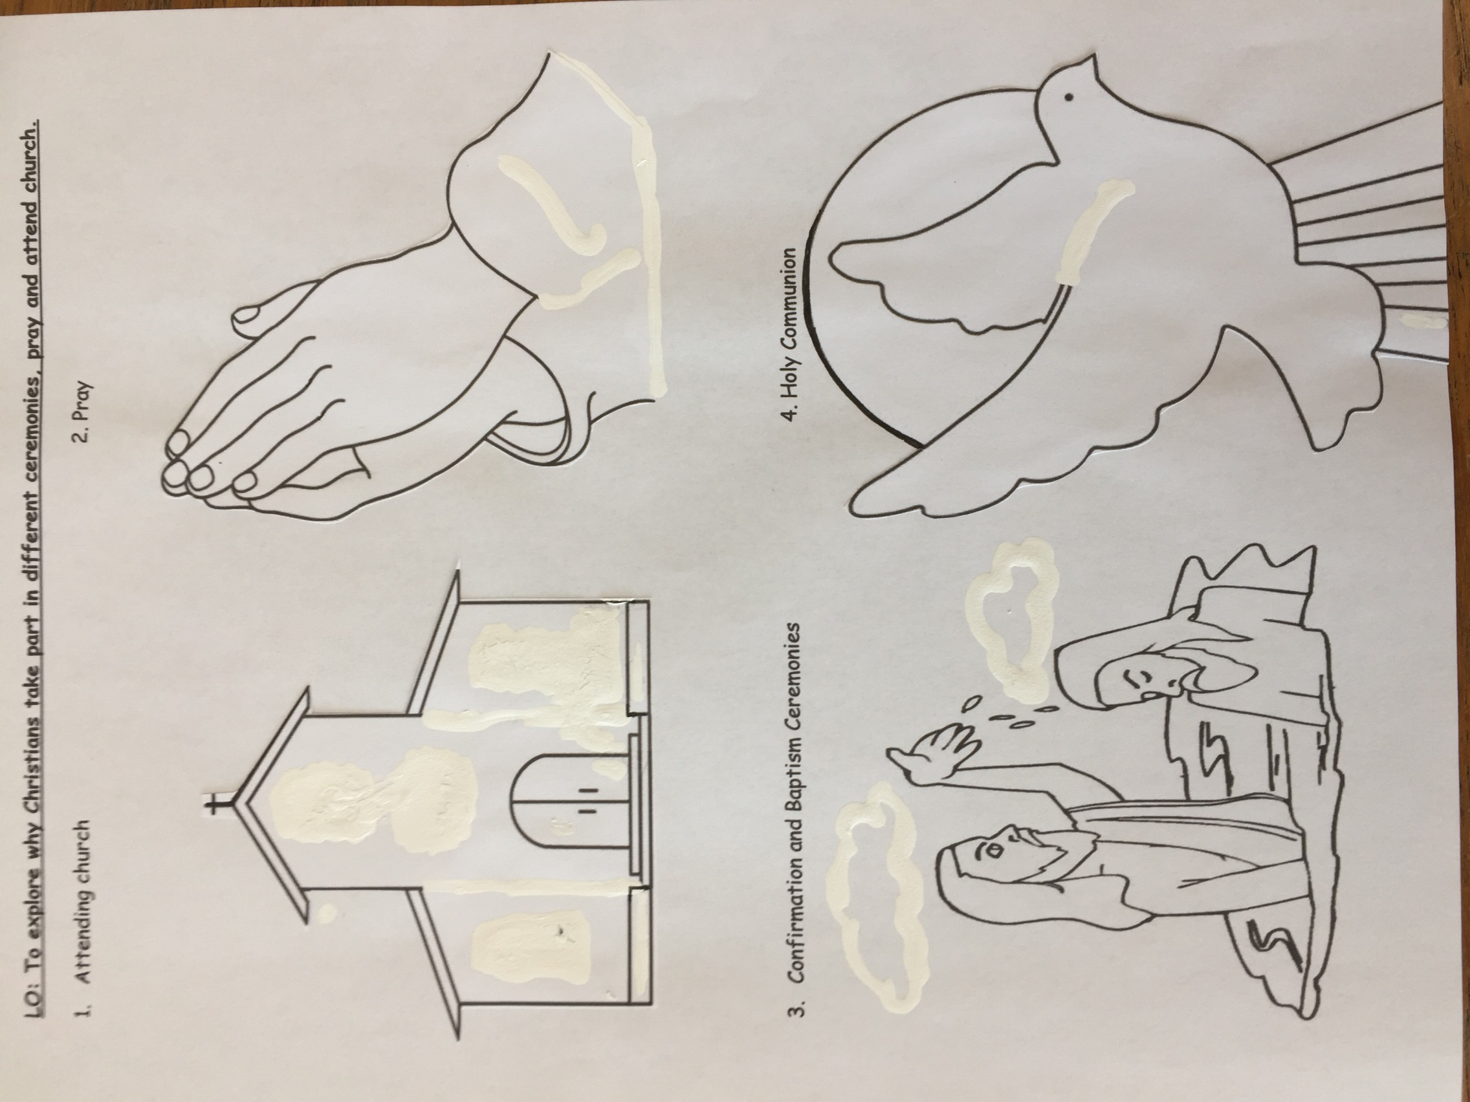

Slide 8
Think of all the ways that you have learnt about how Christians can show commitment to God.
Christy has a dilemma.
Christy is a Christian but is finding church boring but doesn’t want to upset anyone.
Reverend Charlie who works for the church has received a letter from Christy.
Help the Rev. Charlie to reply to the letter using all the other ways that a person can show commitment to God, not just by going to church. Look at the next page.

Slide 9


