Slide 1

Hello Year 6 and welcome to our next RE unit!
You will be learning about how Christians show their commitment to God.

Slide 2

Lesson 1
To understand that
commitment sometimes
causes dilemmas and
difficult decisions.

Slide 3
What do the words mean that are underlined?
Look up each word in the dictionary if unsure.
Commitment
Dilemma
Remember that words in red are for you to do something-do it!

Slide 4
That’s right!
The meanings are :
1. Commitment
The definition of a commitment is a promise, firm decision or agreement to do something. You are dedicated.
Eg: Football players must make a commitment to play for a full season.
2. Dilemma
The definition of dilemma is a situation or problem where you need to make a difficult choice.
Eg: Maisie had a dilemma over which colour to have her bedroom painted as she liked purple and yellow equally.

Slide 5
Is it OK to tell lies?
Think carefully about that question.
I’m going to tell you about an amazing lady, her name was Corrie Ten Boom. She lived in the Netherlands as World War 2 began. Her family were all Christians and helped to hide some Jewish people from the German soldiers. They created a secret room in their home for the Jews to hide in.

Slide 6
Corrie had a dilemma-a very hard decision to make. She decided that if the German soldiers came to their house, she would lie to them and say nothing about the Jews that she had hidden in the secret room.
However her sister, Betsie, had decided that she could not lie due to her Christian commitment to God.

Slide 7
The soldiers did come…….
Corrie lied to the soldiers.
Betsie didn’t.
The Jews were found and arrested. Corrie and Betsie were arrested too. The Jews later escaped but Corrie and Betsie did not.
Betsie believed that God would keep these people safe due to her commitment to the truth.
Think?
What would you have done?
Is telling lies always wrong? Would that have been more important than saving someone’s life?
Commitment sometimes causes dilemmas and difficult decisions.

Slide 8
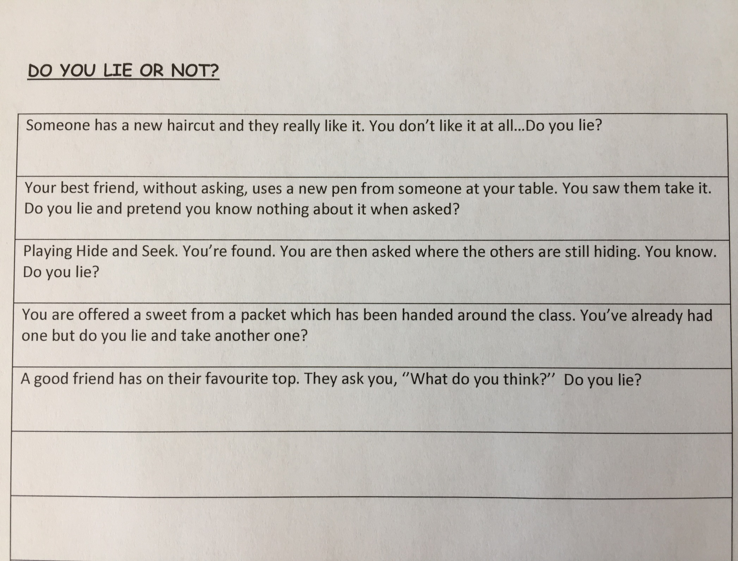
Some tricky dilemmas for you to think about. What would you do?

