Slide 1
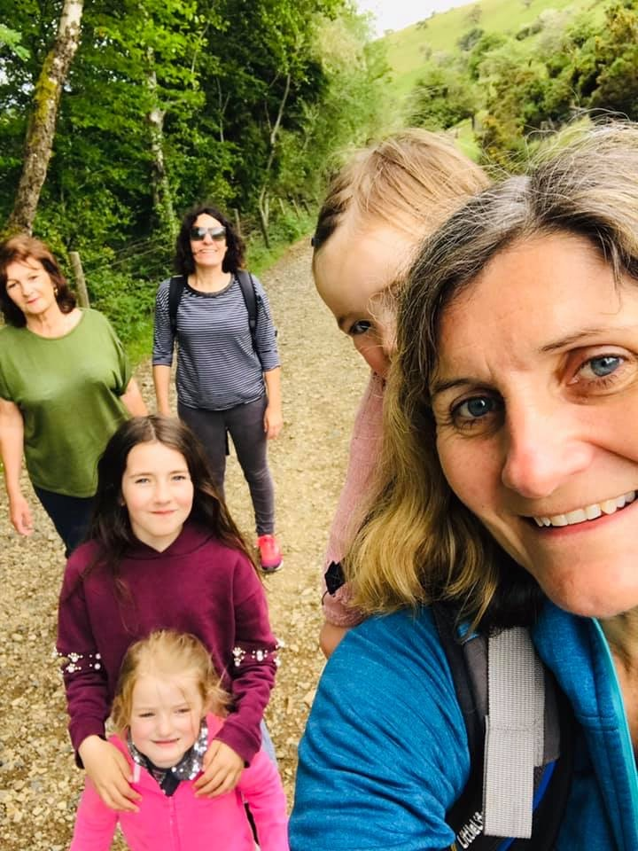
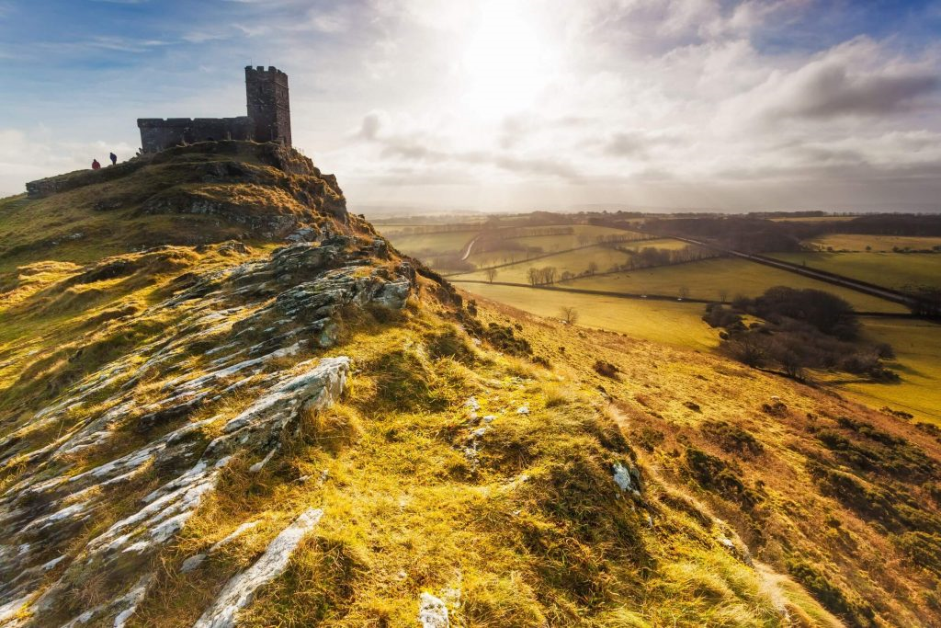
DARTMOOR
Me and my family in Dartmoor.
BY EVIE HOY

Slide 2
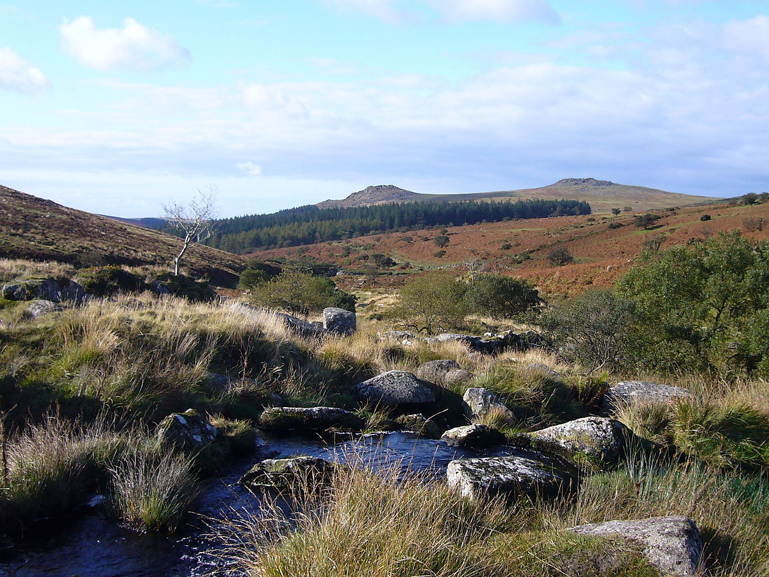

Facts about Dartmoor
Dartmoor is in southern Devon.
Dartmoor has over 8 million visitors a year!
It is home to the River Dart.
Dartmoor covers an area of 368.3 sq miles.
It is home to lots of wildlife such as, Greater Butterfly Orchids, mammals, birds ,fungi and MUCH more.

Slide 3
When and why Dartmoor became a national park
WHEN: Dartmoor became a national park in 1951.
WHY: It became a national park because people wanted to preserve and enhance the natural beauty and to promote the enjoyment by the public. The responsibility to do this was given to the Devon County Council who created a committee to carry out this function.

Slide 4

HILLS,MOUNTAINS AND RIVERS
Rivers , hills and mountains are a big part of Dartmoor. Here are some of the many of them.
Rivers: there are tons of rivers and lakes such as: West Okement, Taw, Teign and River Dart.
Some examples of hills and mountains in Dartmoor are: Cut Hill, Yes Tor and Hangingstone Hill .
The highest Peak on Dartmoor is High Willhays which stands 621m above sea level!

Slide 5
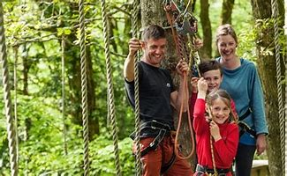
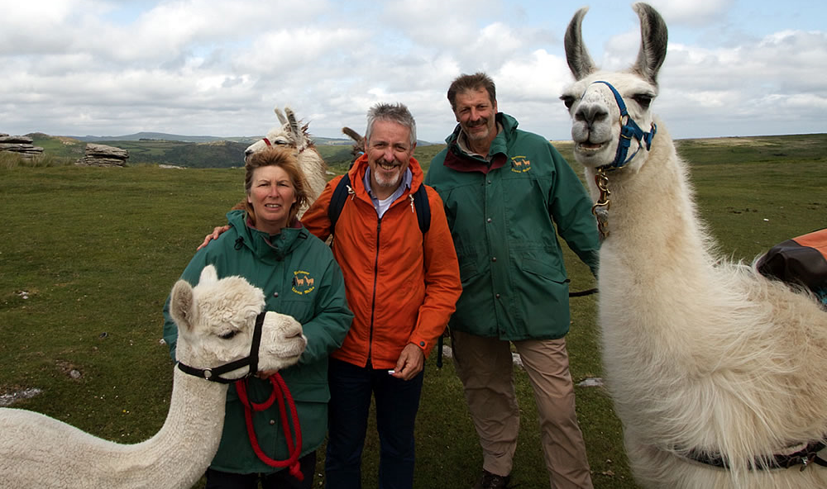
ACTIVITIES ON OFFER!
Dartmoor offers a WIDE range of activities both indoor and outdoor here are some:
Dartmoor Llama walks.
Tree Surfers (Go Ape).
Winding river canoeing.
Manor House hotel golf .
Hot Air Balloon flights.
And MUCH more.

Slide 6

THE LOCAL AREA
Plymouth and Exeter are both towns near Dartmoor, Plymouth is 10k away form Dartmoor and Exeter is 27.6 miles away but smaller towns like Okehampton are nearer!
Okehampton is only 4k away! Okehampton is very lucky to be so near Dartmoor! My auntie also lives very near! She lives in Tedburn St Mary which is about 3 miles from Dartmoor and we always go to Dartmoor when we are there!

Slide 7
THANKS FOR WATCHING!!!!!!!

