Slide 1
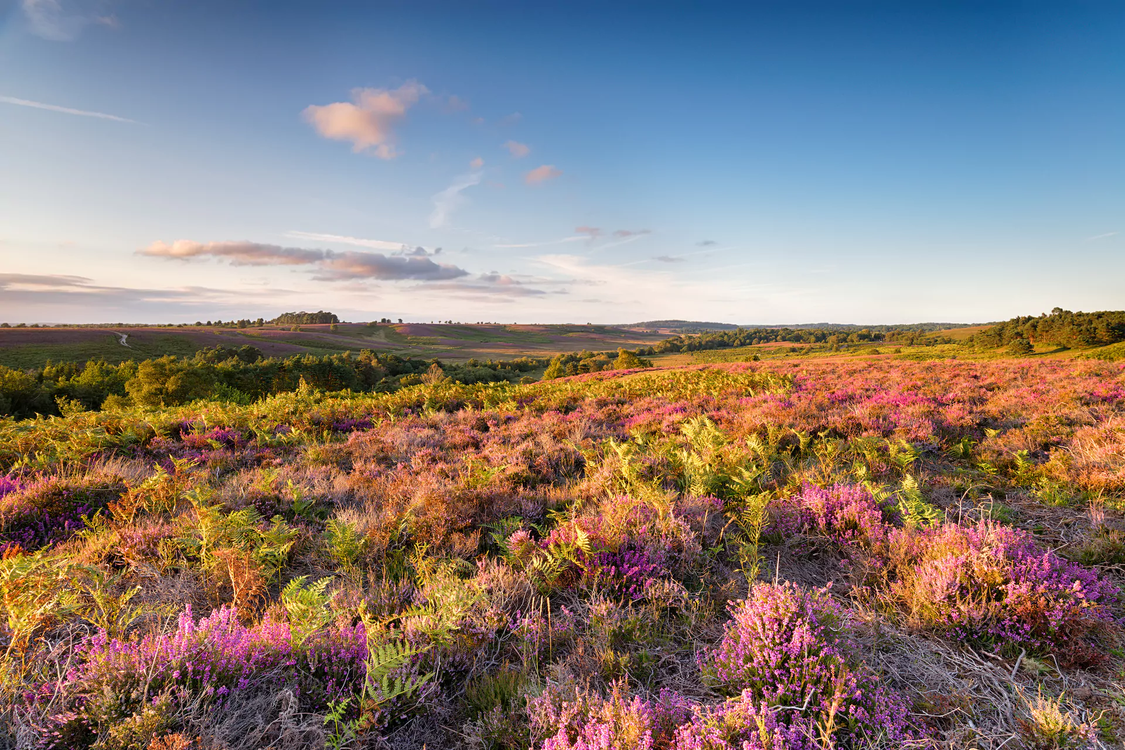
The New Forest
By Isabel Guest

Slide 2
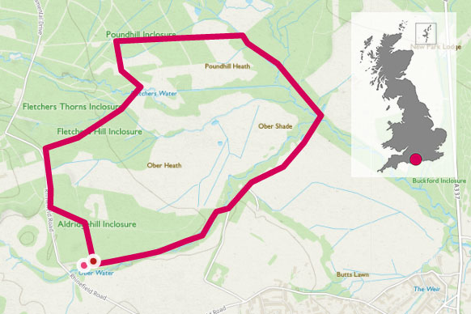
Location
The New Forest is located in the south of England.
It is between Salisbury, Southampton and Bournemouth.
The border of The New Forest to the south east stretches as far as the coast to the Solent.

Slide 3
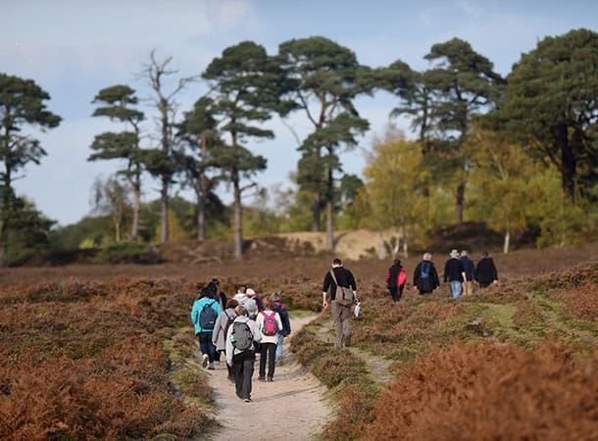
Size
The New Forest is 220 square miles or 566 square km, which is also the same size as the Isle Of Man.
The New Forest is one of the smallest National Parks in Europe but is one of the most visited with over 13.5 million visitors per year (according to the New Forest District Council).

Slide 4
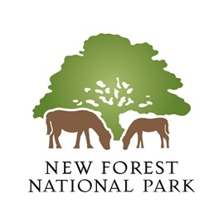
When did The New Forest become a
National Park?
The New Forest dates back to the Bronze Age and was known as Ytene or Land of the Jutes. The Jutes were people originally from Jutland in Denmark.
In 1079 William The Conqueror renamed the land Nova Foresta and it was used as a royal hunting ground.
On the 1st March 2005 The New Forest was formally designated a National Park. On the 1st April 2006 it assumed its full statutory powers.

Slide 5
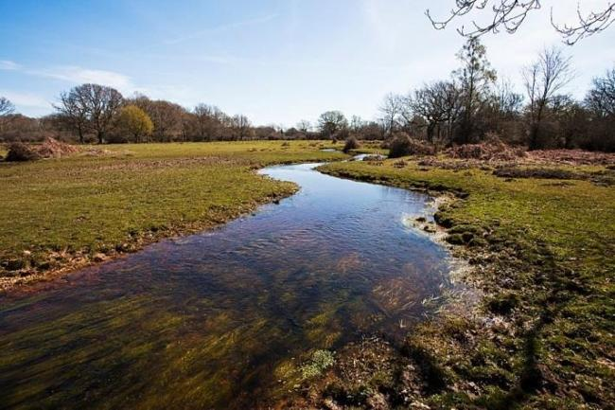

Geographical Features
The New Forest has many geographical features, these include:
Lowland heaths;
Vibrant coastlines;
Wetlands;
Rolling hills;
Ancient woodlands.

Slide 6
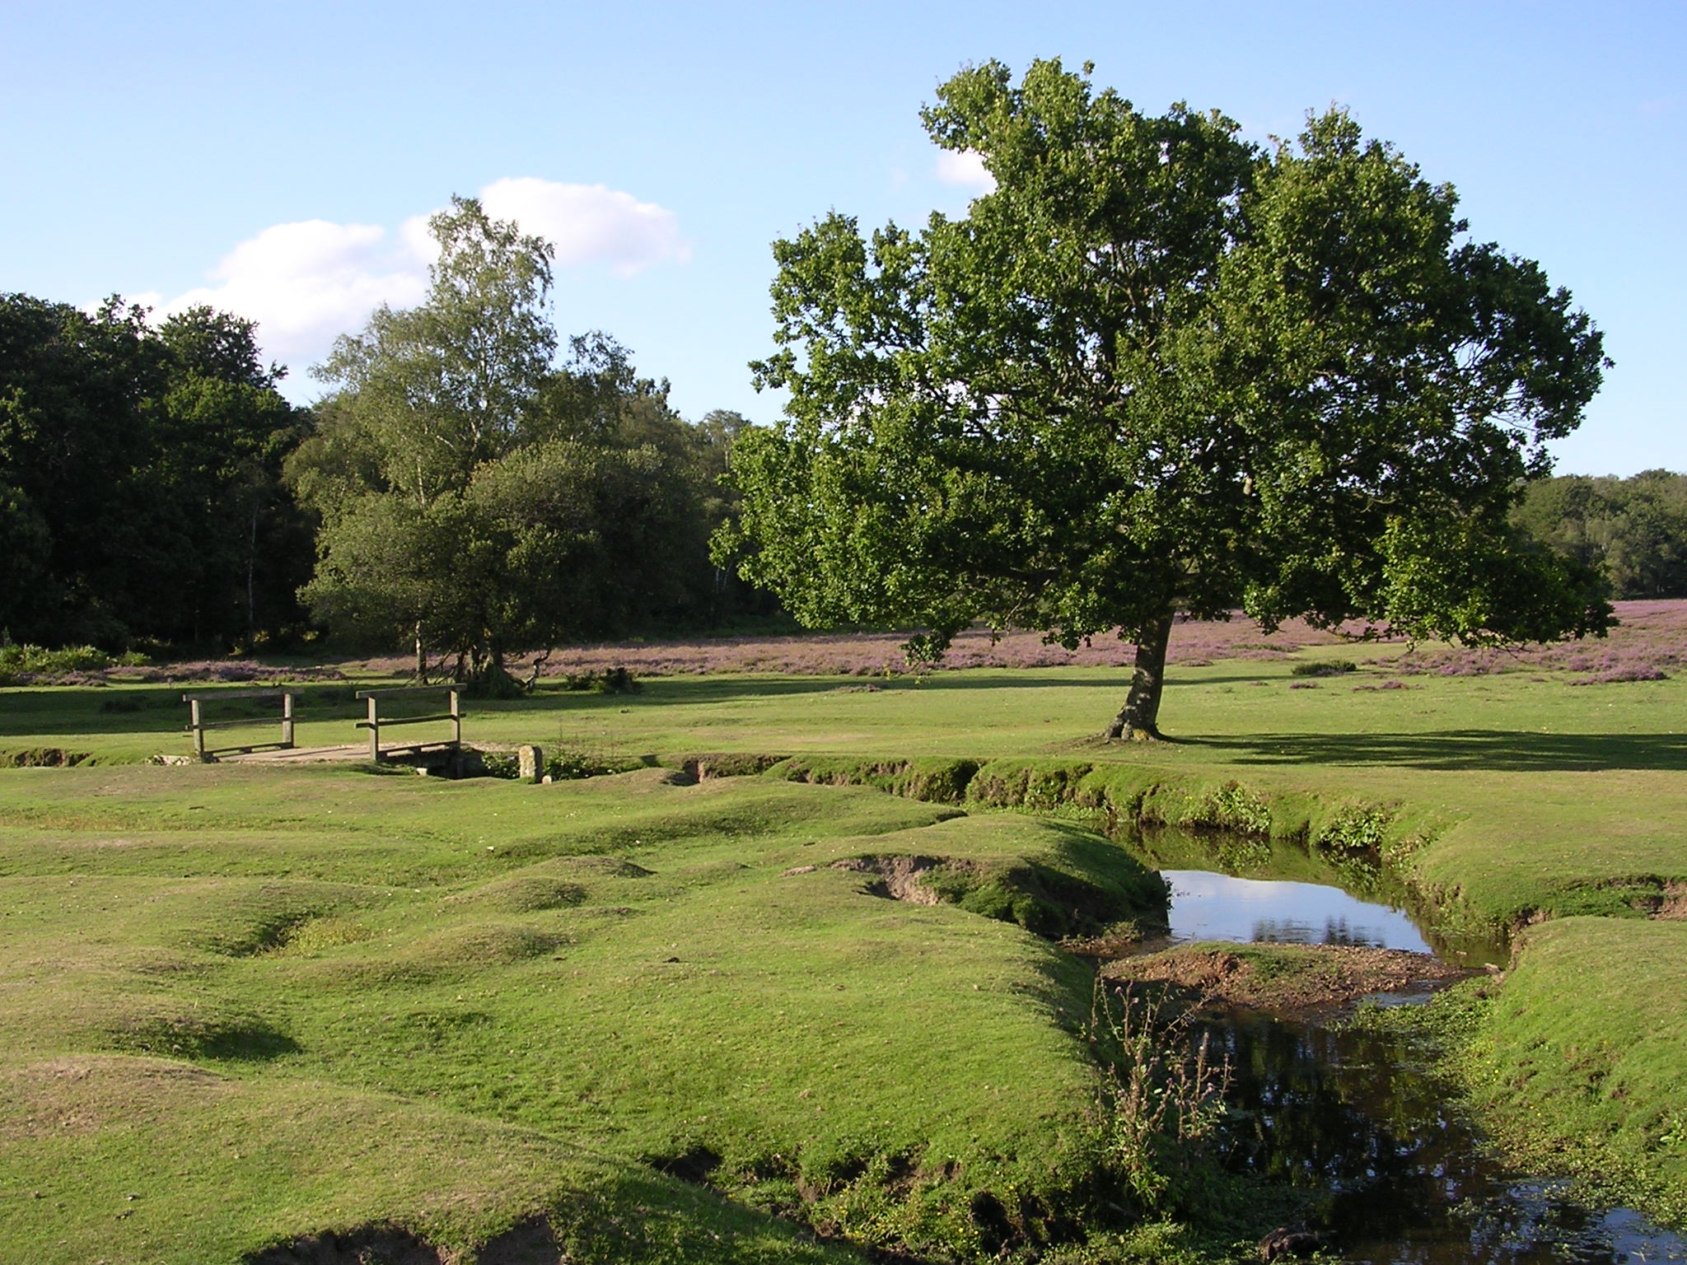

Why is it renowned?
The New Forest is renowned for its;
Beautiful countryside.
Free roaming animals (horses, pigs, goats, ponies, sheep and lambs)
Wildlife (badgers, birds of prey, fallow deer)
Wide range of family and fun filled activities – making it a great holiday location and day out.
Historical interest.
Wetlands (home to reptiles, beautiful colourful butterflies and rare ground-nesting birds.

Slide 7
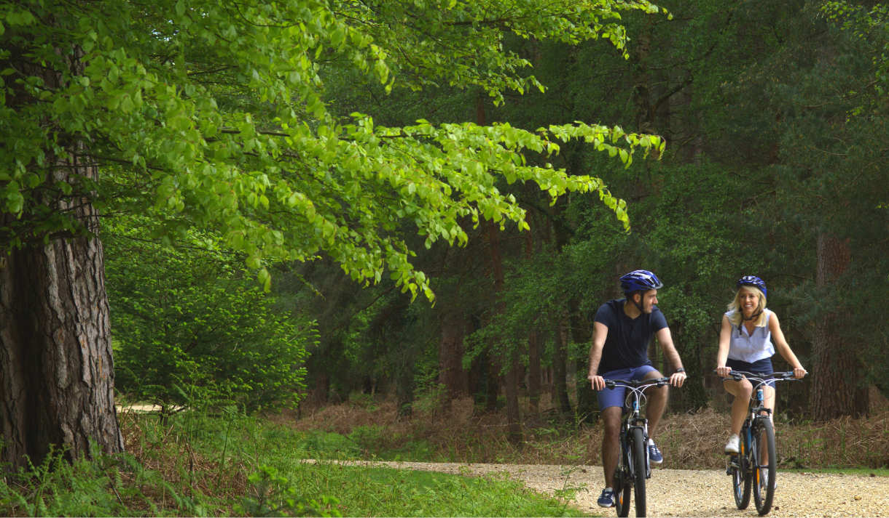

The activities on offer
Whilst you are visiting the New Forest there will be multiple activities on offer such as;
Walking
Cycling (you can hire a bike at one of the local villages)
Hiking
Camping
Visit the beach
Stay the night in a log cabin
Horse riding
Photography

Slide 8
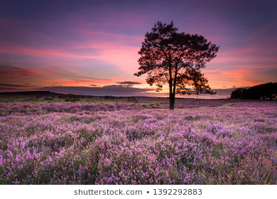

Some of the local wildlife and flowers include:
Yellow Gorse in Spring.
Purple Heather in Summer.
Different types of Fungi.
There is the highest concentration of ancient trees in Weston Europe with many oak trees dating back over 400 years.

Slide 9
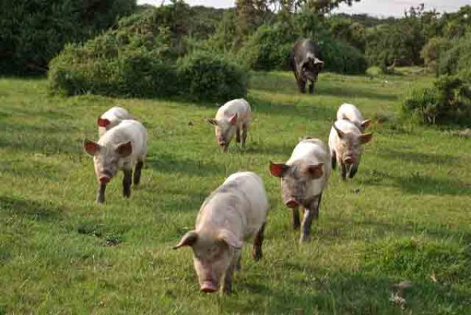
Local Area Information
Some interesting facts about the New Forest Area are:
Bucklers Hard is a nearby 18th Century hamlet (a hamlet is a row of small houses) where some of Admiral Nelson’s navy was built.
Lepe is a nearby seaside town where soldiers set sail for occupied France on D-Day.
Alice Liddell lived in Lyndhurst, she was the inspiration for Alice in the Alice in Wonderland books (written by Lewis Carrol).
Arthur Conan-Doyle (who wrote Sherlock Holmes) is buried under a large tree in the Minster ChurchYard.
A lot of the livestock (including the ponies) are not wild, they belong to the people who live in the neighboring villages. The right to let their animals roam free comes as a right of title with their home – these rights are called Common Rights and the people are called Commoners.
The animal owners employ Verderers to keep watch over the animals and make sure they stay safe and don’t wander too far. They also employ Agisters to look after any sick or injured animals – these animals are taken back to the owners’ house to be taken care of.
In Autumn the locals release pigs into the New Forest to eat all the acorns, this is because acorns are poisonous to horses and ponies.

