Slide 1
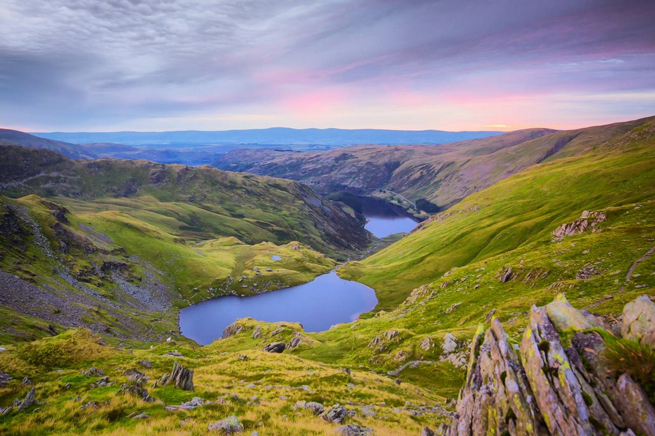
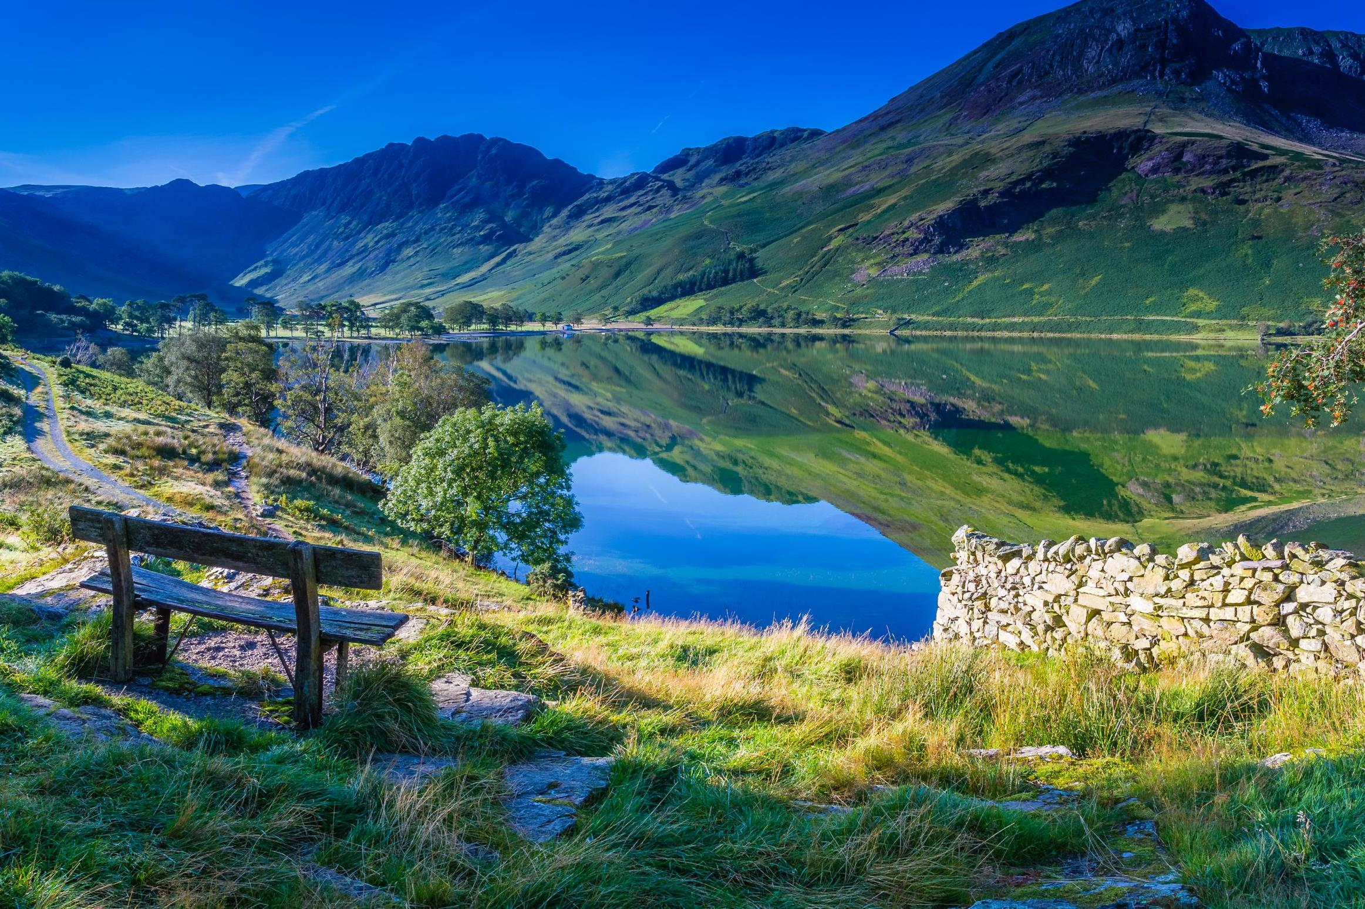
The Lake District

Slide 2
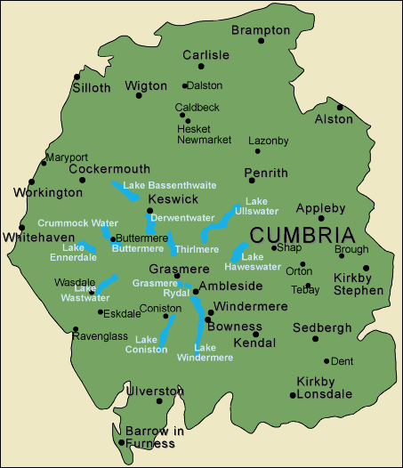
Location
The Lake District National Park is in Cumbria, which is in the North West corner of England. It covers 912 square miles, making it the 2nd largest national park in the UK, after the Cairngorns National Park (Scotland).

Slide 3
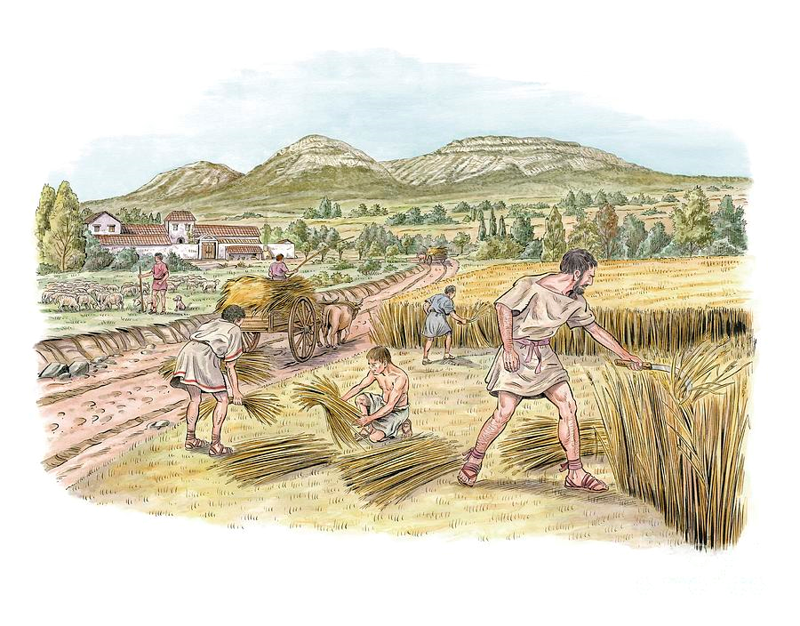

The history of The Lake District
The Lake District became a National Park in 1951. It became a National Park to conserve and enhance the natural beauty, wildlife and cultural heritage of The Lake District.
It was designated a UNESCO world heritage site in 2017 so it is now protected by international treaties to preserve the interests of humanity.
In Cumbria, Farming has been a major industry in the region since Roman times!

Slide 4
Features and Wildlife
The Lake district is well known for its Lakes, Mountains and woodland, or fells.
The largest mountain in England is Scarfel Pike at 978 metres (3210 feet). There are 5 more mountains that are over 900 metres/3000 feet.
Also in The Lake District are Wast Water Lake, which is the deepest and Lake Windermere, which is the largest, in England. This is why it is sometimes known as The Lakes.
Rare Animals such as the Red Squirrel, the Peregrine falcon and arctic char live in the Lake District. Other protected species living in the area include the NatterJack, Barn Owl and Vendace Fish.

Slide 5
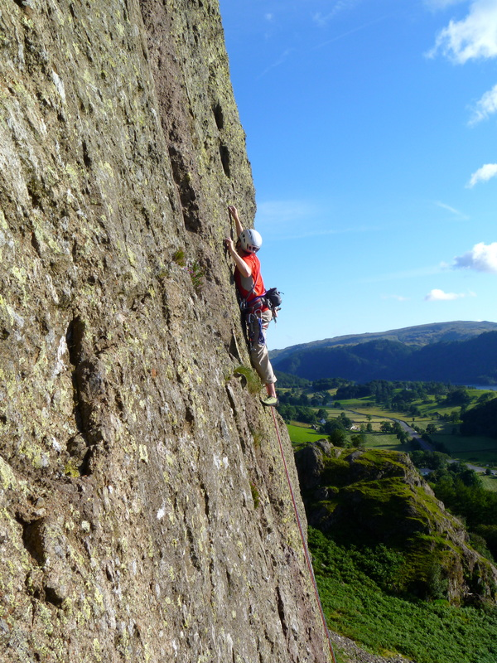
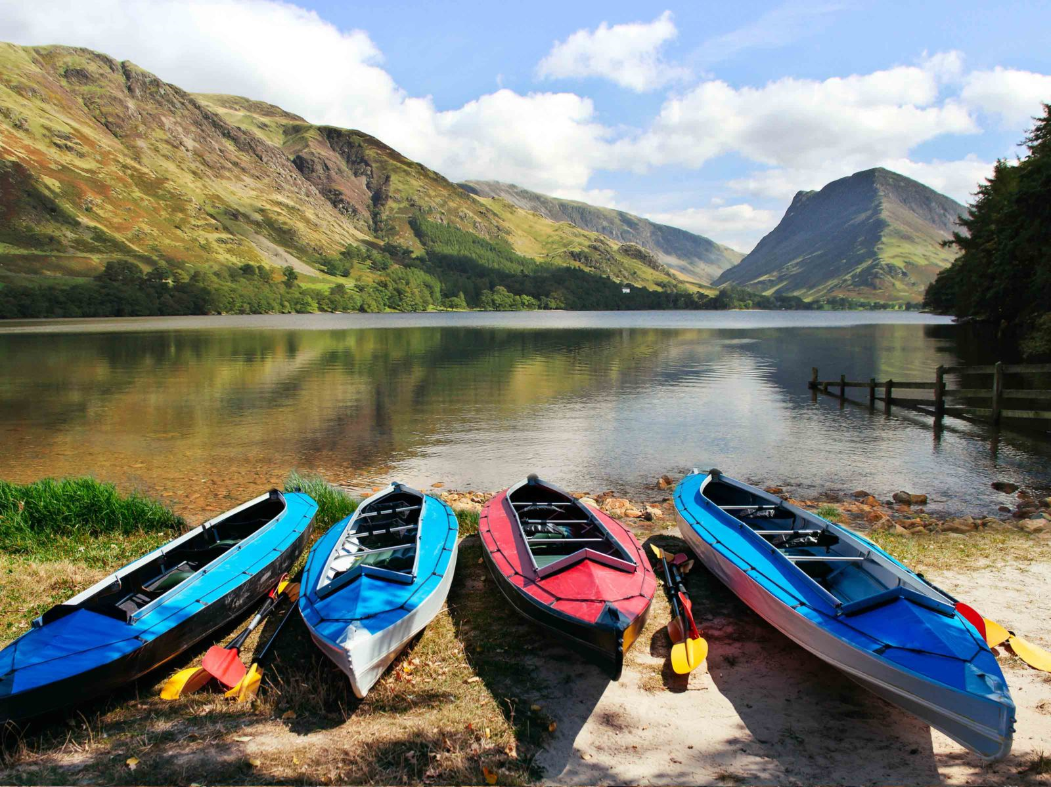
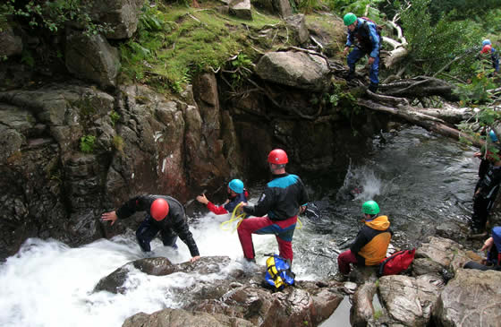
Activities
So many people go to The Lake District (15.8 million visitors per year ) because of the large amount of activities to do there, here are some : abseiling, gorge scrambling, canoeing, The Lakeland legend challenge, Rock climbing, hiking, walking and rambling. Because there is so much to do Stag and Hen do’s , courses and private guiding is also very popular.

