Slide 1
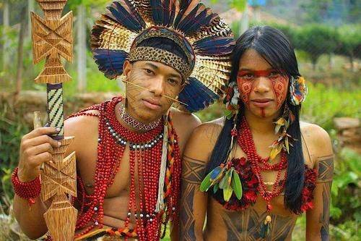
The Jaguar Tribe

Slide 2

The Jaguar Tribe
The Jaguar Tribes territory is 32000 square miles (the same size as Australia). The Jaguar Tribe are also known as the Matis people and are classic slash and burn agriculturalists and expert hunters .They are remarkably playful people for whom The longhouse remains a cultural focus.

Slide 3

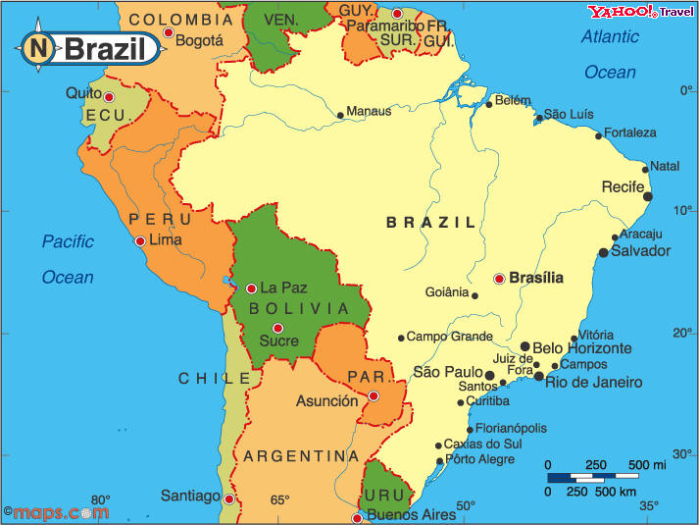
The Jaguar Tribe live in brazil and Peru (South America)

Slide 4

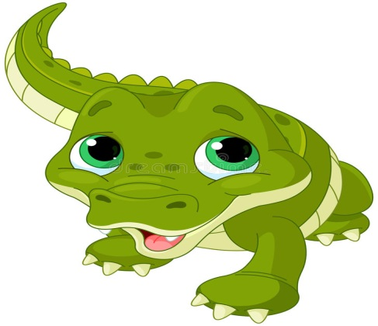
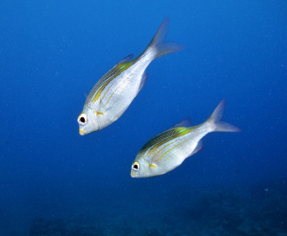

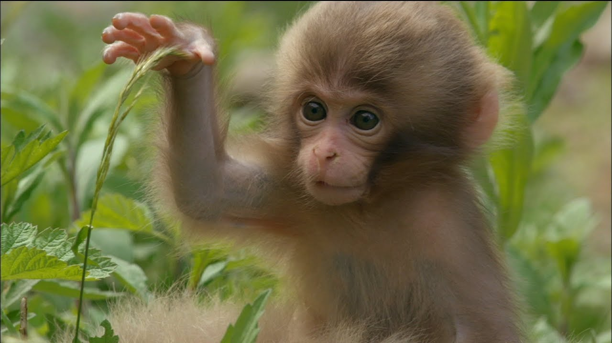
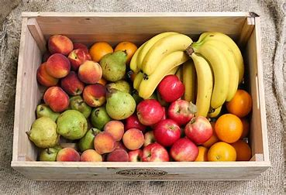
Food
The Jaguar tribe hunt most of their food, they tend to kill monkeys ,Alligators, frogs and fish, they use 3.5 metre long blow darts coated with poison to kill the animals. They use large nets with food in them to lure the fish and then trap them in a banana leaf.

Slide 5
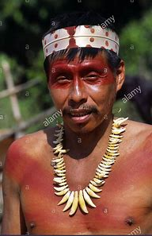
bodies
bodies
The Jaguar Tribe tend to wear little clothing only wearing short shorts made out of cloth. They tattoo their bodies from head to toe covering their faces with markings also they pierce their faces with sharp sticks to go along with their markings.

Slide 6

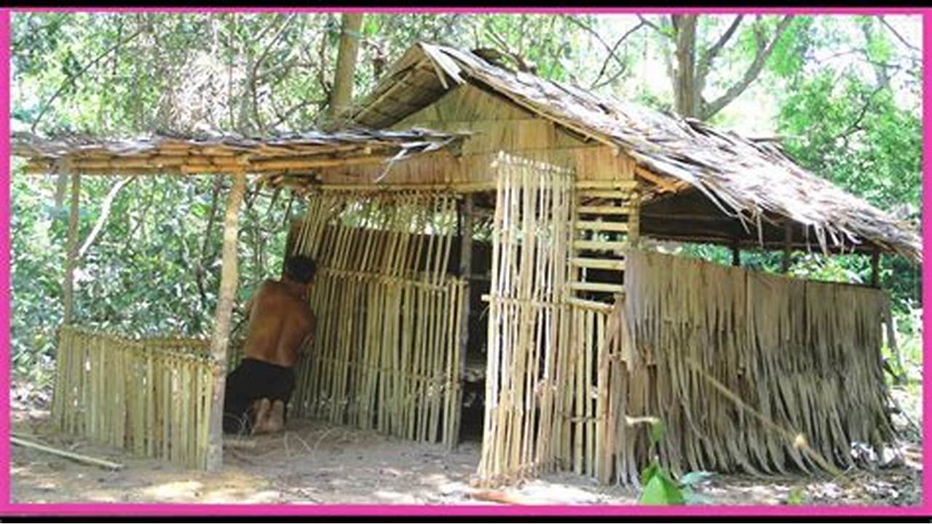
Shelter
The jaguar tribes homes are small wooden triangular or circular buildings with planked doors and straw roofs .They tend so be thinly structured and have low basements for more room .They have small homes for themselves but have large cotton gazebos were they eat and other gatherings.

