Slide 1
The five pillars of islam
By Oliver Blogg

Slide 2
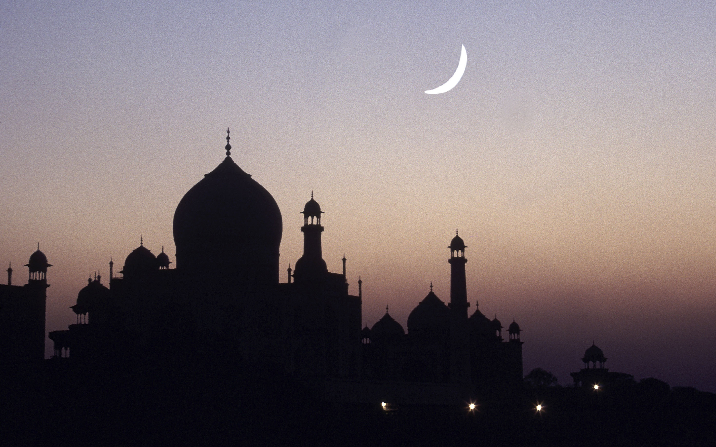
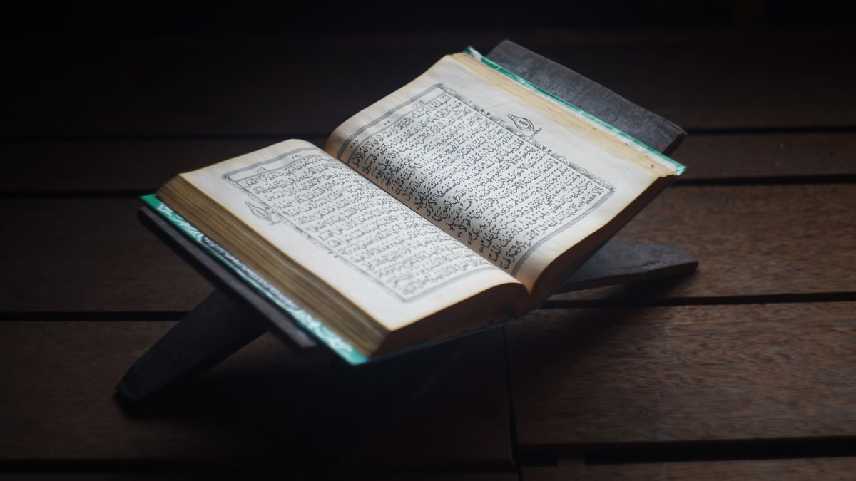
What is Islam?
Islam is the second largest religion in the world after Christianity and people who follow Islam are called Muslims. They read from their holy book the Quran. Islam started in Mecca, in modern-day Saudi Arabia, during the time of the prophet Muhammad’s life. Today, the faith has spread all over the world.

Slide 3
What are the rules of being a good Muslim?
Muslims are guided by ‘The Five Pillars of Islam’ set out in the Quran, whereas Christians and Jews follow ‘The Ten Commandments’ set out in The Bible.
‘The Five Pillars of Islam’ are also known as ‘the five pillars of faith’.

Slide 4
What is the 1st Pillar of Islam?
SHAHADA
Shahada is the Muslims profession of faith (‘there is no god but Allah and Muhammad is the messenger of Allah’).

Slide 5
What is the 2nd Pillar of Islam?
SALAh
Salah is the ritual prayer of Muslims and it must be performed five times a day: before sunrise, early afternoon, late afternoon, sunset, at night.

Slide 6
What is the 3rd Pillar of Islam?
Sawm
Sawm means fasting from dusk till dawn during daylight hours in the month of ramadam .

Slide 7
What is the 4th Pillar of Islam?
Zakah
Zakah means (‘that which purifies’) and is considered a way to purify ones income and health by giving personal wealth, such as your time and care , to those in need.

Slide 8
What is the 5th Pillar of Islam?
HAJJ
Hajj is the greater pilgrimage to Mecca. Mecca takes place in the last month of the year and every Muslim is expected to go there at least once in their lifetime.

Slide 9
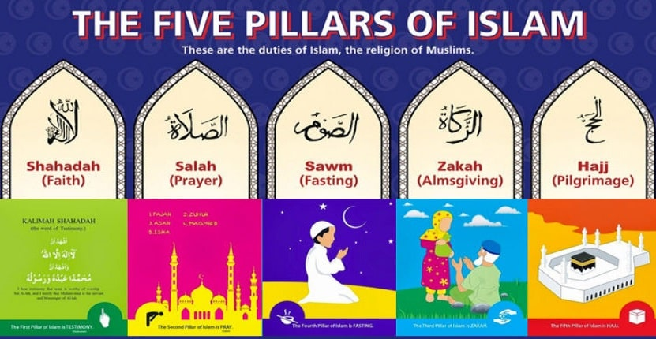
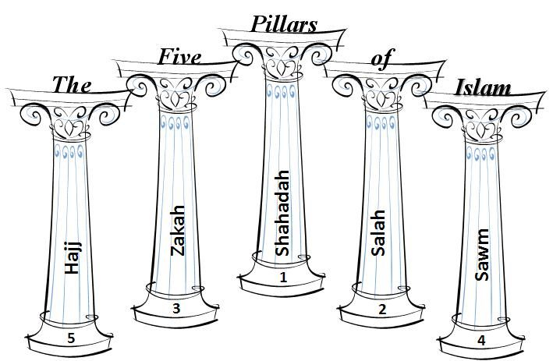
That is the five pillars of Islam

