Slide 1
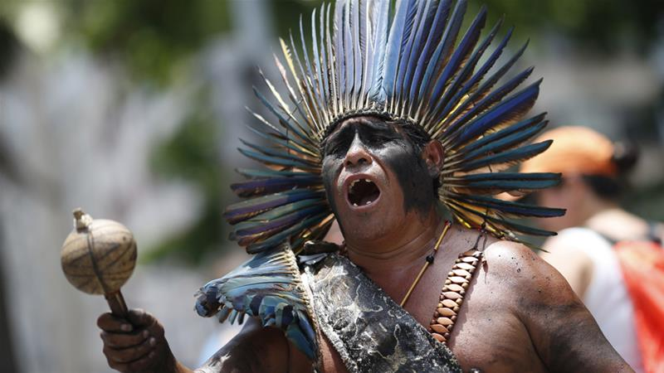
The Jaguar Tribe

Slide 2
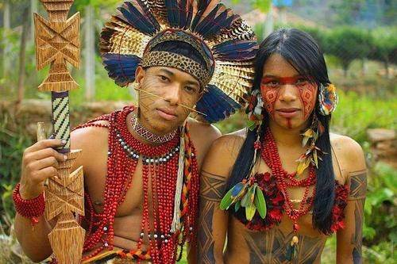
The Jaguar Tribe are a tribe that live in the tropical Amazon Rainforest . There are about 3000 people in the tribe and they are from Peru and Brazil. They use red dye to decorate spears which they hunt down animals with. They are fearless warriors and you wouldn’t want to mess with them! Some animals that live near there area are : Frogs ,Monkeys, Alligators and Fish. At the moment, numbers are decreasing due to western diseases. They are also known for there facial tattoos and decorating there bodies.

Slide 3
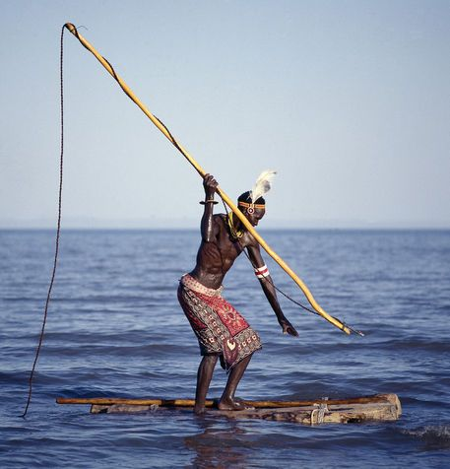
Diet/what they eat
They get most of their food by hunting , fishing and farming and collection of wild food. They grow vegetables and fruit like manioc, corn, beans and bananas. They also hunt and fish using plant-based poisons to stun the fish. They use bow and arrows and spears for hunting.

Slide 4
Quick Facts
The Jaguar Tribe lives along the Javari and Galvez rivers.
Their huts are made of reeds/canes.
They are known for their ceremonial practices.
They are also known for their facial tattoos.
There are about 3000 people who live in The Jaguar Tribe.
The Jaguar people are fearless warriors who hunt animals like fish, frogs and others.
They love decorating their bodies and they also say that they do it to scare off the evil.

