Slide 1
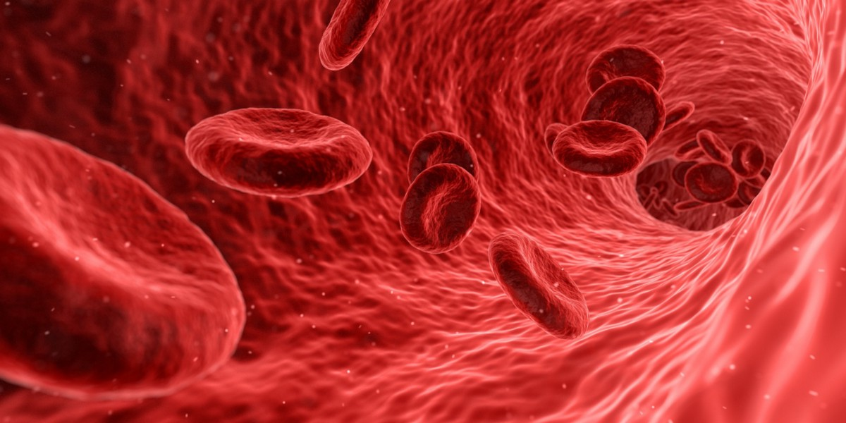

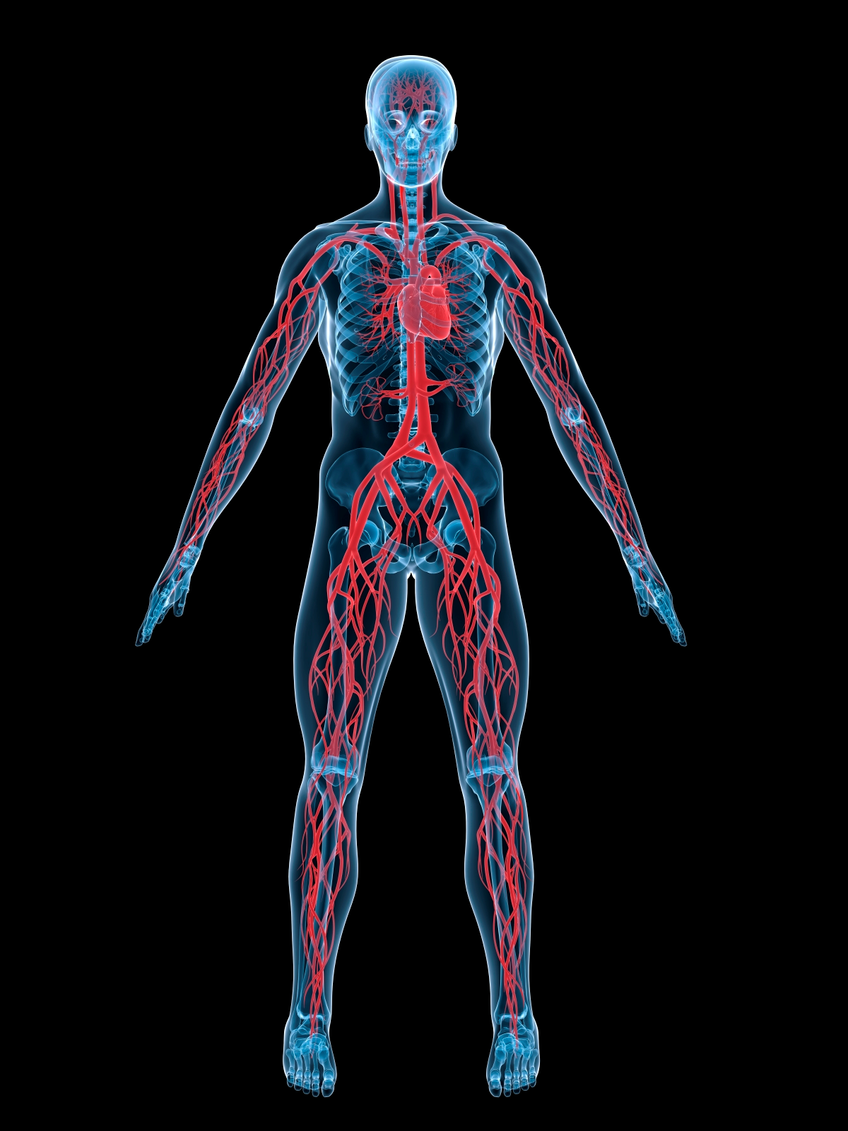
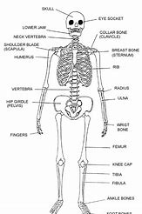
BY EVIE HOY

Slide 2
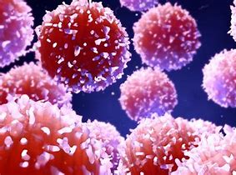
BLOOD CELLS
Red blood cells deliver oxygen to where it’s needed and collect carbon dioxide.
White blood cells are on the look out for germs to stop them.
Blood cells are VERY important.

Slide 3

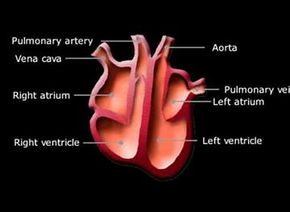
THE HEART
The heart is the strongest muscle in your body.
The heart weighs between 7 and 15 ounces (about 200 to 425 grams) which is about the same as a bottle of Heinz Ketchup.
Your heart pumps 2,000 gallons per day!!
It’s made up of the atria, ventricles, valves, and various arteries and veins. The main function of your heart is to keep blood that’s full of oxygen circulating throughout your body.

Slide 4
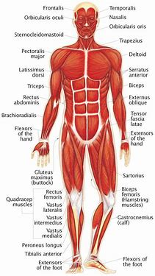


Slide 5

THANKS FOR WATCHING ! :D

