Slide 1
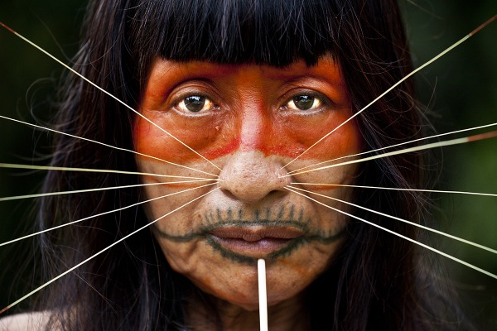
The Jaguar Tribe
By Max Eagle 6CK

Slide 2
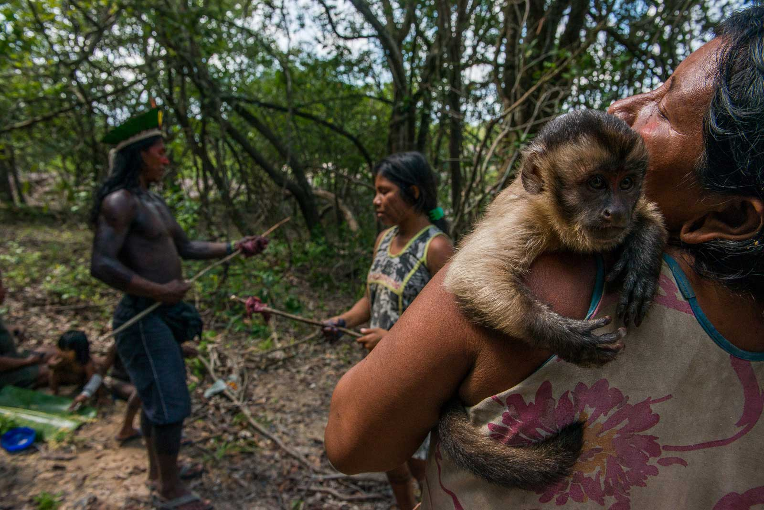
FACTS
Until 50 years ago, The Jaguar Tribe owned the parts of the Amazon near Ecuador. They were the lords and masters of the waterfalls and rivers.
For centuries, The Jaguar Tribe were not a tribe, most of them thought they were alone with there small groups of families.
The oldest members of the Jaguar Tribe still use blowpipes to hunt while the young men now use shotguns and rifles.
When The Jaguar Tribe go hunting they suffocate their victim with a wild, toxic plant that is smeared on the top of the dart.
Above is a picture of a suffocated monkey that the men caught and now the women are preparing dinner.

Slide 3
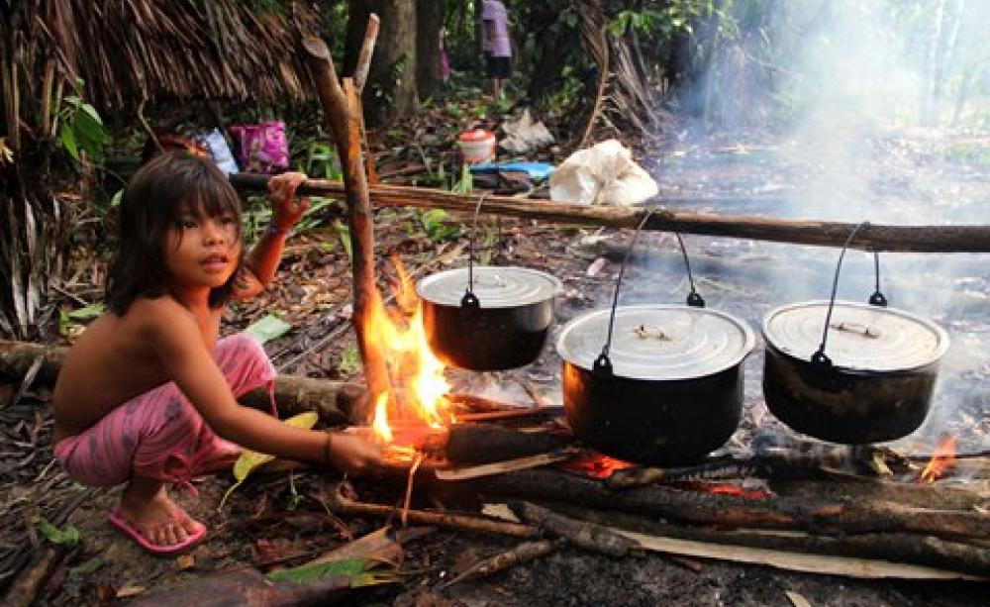
Diet
The Jaguar tribe base their diet from hunting and wild plants they grow in their camps. When they go hunt, they look for groups of monkeys and it might be weird they chose monkeys because they can swing across trees and can be hard to hit but they are the easiest to suffocate and they do the least amount of harm. They also eat wild plants which fills 90% of their diet.

Slide 4
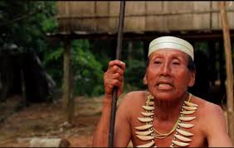
Beliefs
They believe that before anything the Grandfather of the Earth created the jungle with all its trees, rivers, waterfalls and animals. They believed that the first animal he created was the Jaguar and then the Jaguar gave birth to the first people of The Jaguar Tribe (that is where there name is from.)

Slide 5
Extra Information and facts
The Jaguar Tribe is a biological museum with by far the most interesting things on the planet. They only contacted neighbouring tribes if they needed canoes. They would do trades with tribes like the Swa or the Quitra.

Slide 6


Thank you for watching

