Slide 1
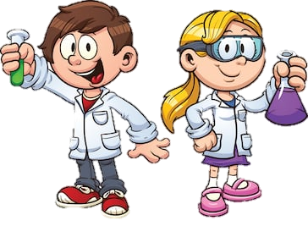
Y6 Science - Classification
This is the final lesson of our unit on ‘Classification’.
Objective:
To use classification keys to sort and identify living things
This is a practical lesson which you can hopefully do in your garden or whilst out for your daily walk with family.

Slide 2
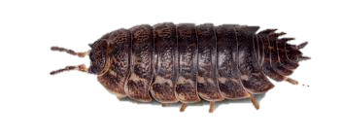
Y6 Science - Classification
Many of you will have seen woodlice in your garden before. They are invertebrates. It may surprise you to find out that they are crustaceans (as are crabs and lobster) and there are over 45 different species in the UK.
There are many different nicknames for woodlice around the UK. If you’d like some extra info click here:
https://www.countrylife.co.uk/nature/bizarre-world-of-woodlice-164708

Slide 3
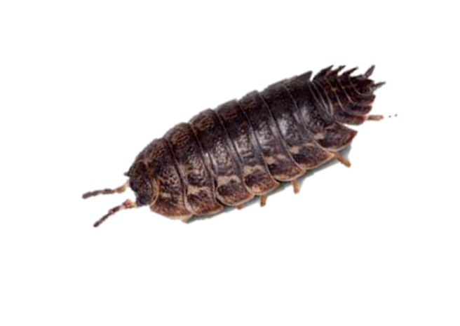
Y6 Science - Classification
In today’s session, you are going to hunt woodlice!
Remember to take care if handling them and wash your hands well afterwards. Return the creatures to where you found them and treat them with care!
A woodlouse’s preferred habitat is dark and damp so you may need to lift a few stones/logs to find some.
Use the classification key on the following slide to identify the species of woodlice you find.

Slide 4
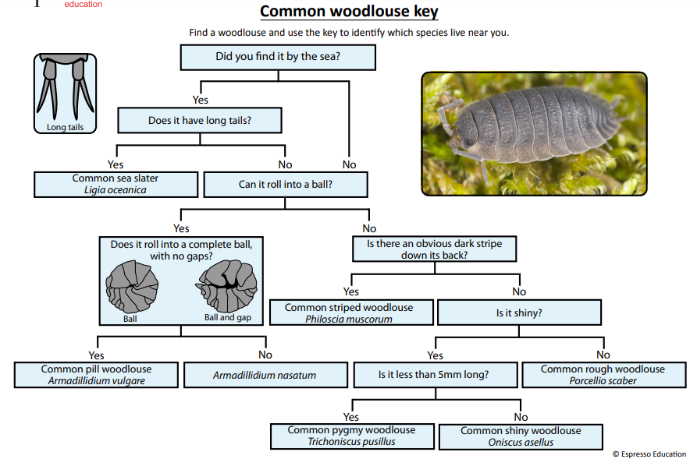

Slide 5
Y6 Science - Classification
Keep a tally on your key of how many of each species you find.
Perhaps you could compare two different locations to see if the quantity or species of woodlice differ?

Slide 6

Y6 Science - Classification
Write/type up your findings in a report under the following headings:
What I did:
What I observed:
How I kept myself/the woodlice safe:
Improvements/further investigations I could do:

Slide 7
Y6 Science - Classification
Useful vocabulary:
woodlouse/woodlice
species
habitat
Classification key
observed
features
invertebrates
crustaceans

