Slide 1
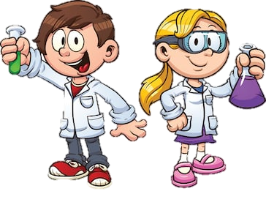
Y6 Science – Body Health
This is the first lesson in our new unit on the Human Body.
Objective:
To recognise the impact of diet, exercise, drugs and lifestyle on the way our bodies function.
This lesson links with science work you did back in Y3, and more recent work in PSHE in Y5/6.

Slide 2
Y6 Science – Body Health
You will remember the ‘Eatwell Plate’ which shows the proportion of your daily food intake that should come from each of the 5 food groups
(carbohydrates, fruit/veg, protein, dairy and fats).
Think about the food you ate yesterday.
Do you think you have a healthy, balanced diet?

Slide 3
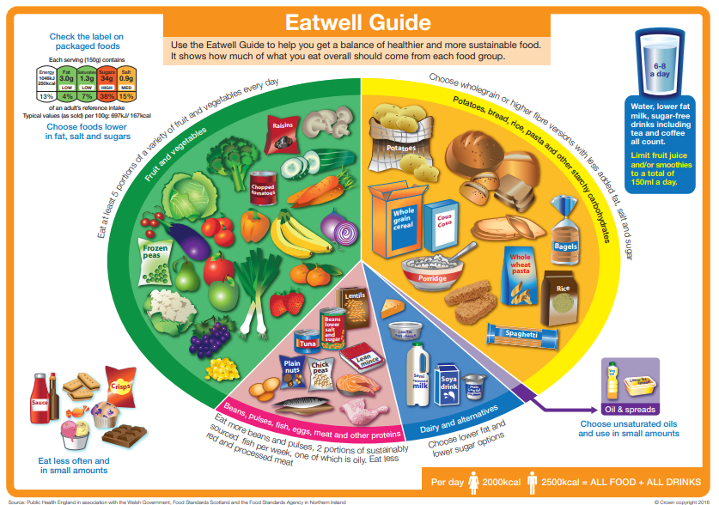

Slide 4
Y6 Science – Body Health
Login to Espresso (Discovery Education).
Username: student28853
Password: oaktree
Search in KS2 Science, in the ‘Animals, including Humans’ section.
Watch the two videos linked to the impact of diet, drugs and exercise on the body in ‘Bodies (Upper)’.
Read the fact-file: ‘Why is sleep necessary?’

Slide 5
Y6 Science – Body Health
Login to Espresso (Discovery Education).
Username: student28853
Password: oaktree
Search in KS2 Science, in the ‘Animals, including Humans’ section.
Watch the two videos linked to the impact of diet, drugs and exercise on the body in ‘Bodies (Upper)’.
Read the fact-file: ‘Why is sleep necessary?’

Slide 6
Y6 Science – Body Health
Now complete the following tasks in the ‘printable resources’ (in the same section of Espresso as videos):
Food labelling
How much in your dinner?
Extension task: create a poster or PowerPoint presentation on the things we should do/not do to keep our bodies healthy.

Slide 7


