Slide 1
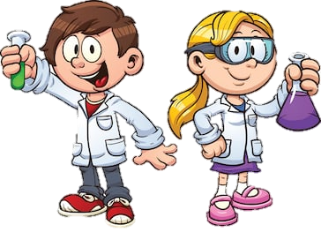
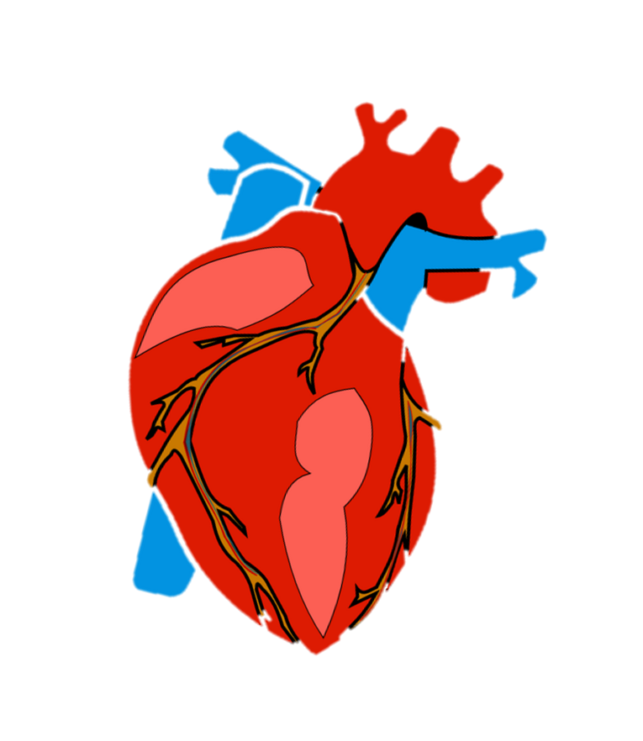
Y6 Science – Human Circulation
Objective:
To identify and name the main parts of the human circulatory system, and describe the functions of the heart, blood vessels and blood.

Slide 2
Y6 Science – Human Circulation
Login to Espresso (Discovery Education).
Username: student28853
Password: oaktree
Search in KS2 Science, in the ‘Animals, including Humans’ section. Click into ‘Bodies (upper)’.
In the ‘fact files’ section, read ‘The Heart’.

Slide 3
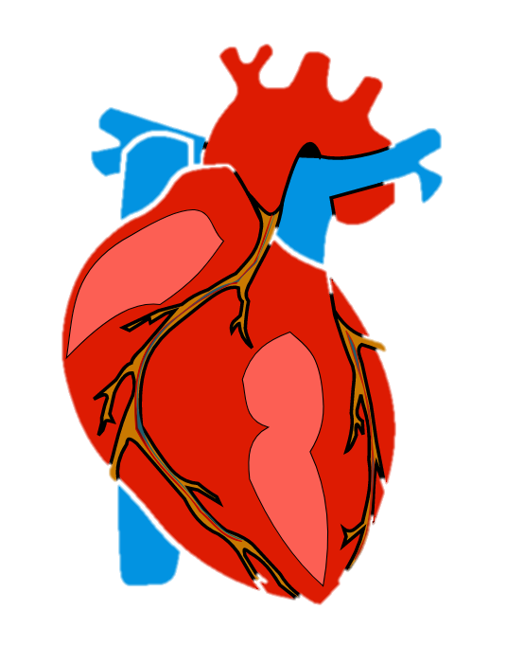
Y6 Science – Human Circulation
Now watch: https://www.bbc.co.uk/bitesize/topics/zwdr6yc/articles/zs8f8mn
https://www.bbc.co.uk/bitesize/topics/zwdr6yc/articles/zqv4cwx
https://www.bbc.co.uk/bitesize/topics/zwdr6yc/articles/zw8xb82
https://www.bbc.co.uk/bitesize/topics/zwdr6yc/articles/ztg6gdm

Slide 4
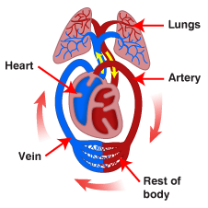
Y6 Science – Human Circulation
Watch this video on YouTube:
https://www.youtube.com/watch?v=-s5iCoCaofc

Slide 5
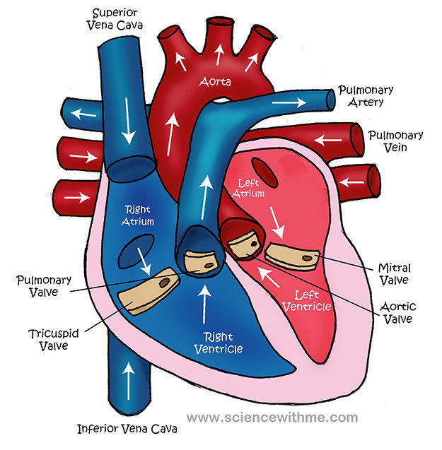
Y6 Science – Human Circulation
Here is a diagram of the human heart. It is made up of four ‘chambers’. The valves ensure the blood only flows in one direction. The de-oxygenated blood is blue, while the oxygenated blood (from the lungs) is red.

Slide 6
Y6 Science – Human Circulation
Task:
Present your knowledge on the main parts of the human circulatory system, including the functions of the heart, blood vessels and blood in the way that you prefer.
It could be through labelled diagrams and explanations,
a PowerPoint presentation, a video of yourself explaining it, or even a life-sized model (see useful attachments).
Make sure you include KEY VOCABULARY (next page).

Slide 7
Y6 Science – Human Circulation
Key vocabulary to include:
Circulatory system
Heart/muscle/pump
Lungs/breathe
Blood vessels (arteries and veins)
Valves
Red blood cells
Oxygen and carbon dioxide

Slide 8
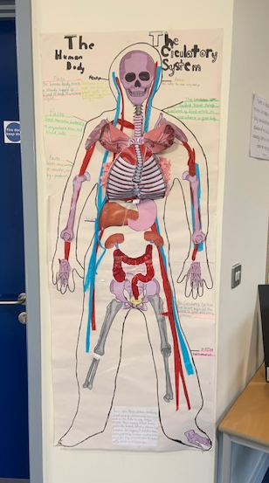
Y6 Science – Human Circulation
Here is a life-size diagram created by a group
of Y6 pupils for inspiration!
If you or your parents have registered to ‘Twinkl’ (it is free at the moment), there are lots of useful resources on there linked to this learning objective… I’ve downloaded a few packs and put them on the website in case you find them useful or interesting.

