Slide 1

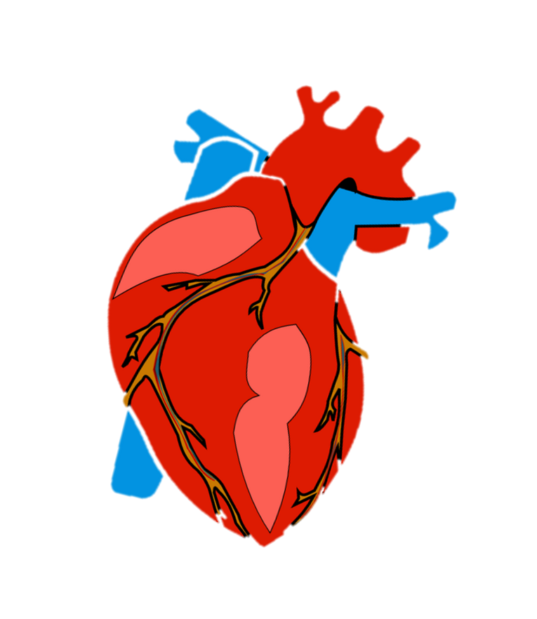
Y6 Science – Pulse Rate Investigation
Objective:
To recognise the impact of exercise on the way your body (heart/lungs) functions.
To make a series of repeated measurements with precision.

Slide 2
Y6 Science – Pulse Rate Investigation
Your pulse rate is the number of beats your heart makes per minute.
How do we take our pulse rate? Watch this video:
https://www.bhf.org.uk/informationsupport/tests/checking-your-pulse
Resting Pulse Rates:
Babies/newborns = 120-160 beats per minute
Under 12's = 80-110 bpm
Adults = 60-100 bpm
These are 'normal' ranges, but there are exceptions e.g. a pulse rate below 50 bpm for an athlete is considered perfectly healthy.

Slide 3

Y6 Science – Pulse Rate Investigation
You are going to design your own experiment to investigate how your pulse rate is affected by different types of exercise e.g. resting, walking, skipping, running.
You will need to do each activity more than once (with sufficient rest in between!) then get a mean (average) reading for each type of exercise.

Slide 4
Y6 Science – Pulse Rate Investigation
Questions to consider:
*How long will you do each exercise for before
measuring your pulse? You’ll need a timer!
*How will you ensure your results are accurate/consistent?
*Do you need to count your heart beats for a
whole minute or could you do 20/30 seconds
then multiply by 3/2?

Slide 5
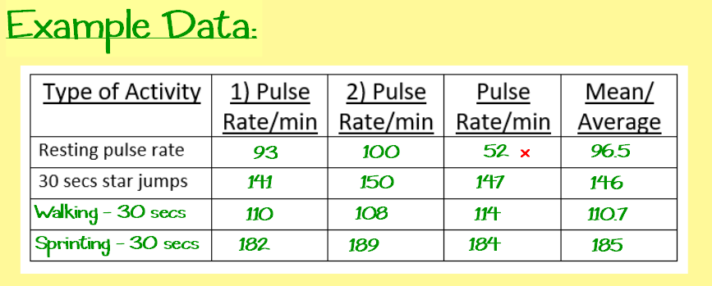
Y6 Science – Pulse Rate Investigation
x = We should discount any ‘outliers’ (a piece of data that looks inaccurate because it is significantly higher/lower than the rest)

Slide 6

Y6 Science – Pulse Rate Investigation
Task:
Write up the investigation. You can use the sheet provided on the school website to do so, if it helps.
Remember to focus on how you ensured your results were precise and accurate.
In your conclusion, you should say what you learnt from your results
i.e. what impact did exercise have on your pulse rate and why you think this is.

