Slide 1
Lesson 4
How do you draw circuit diagrams?

Slide 2
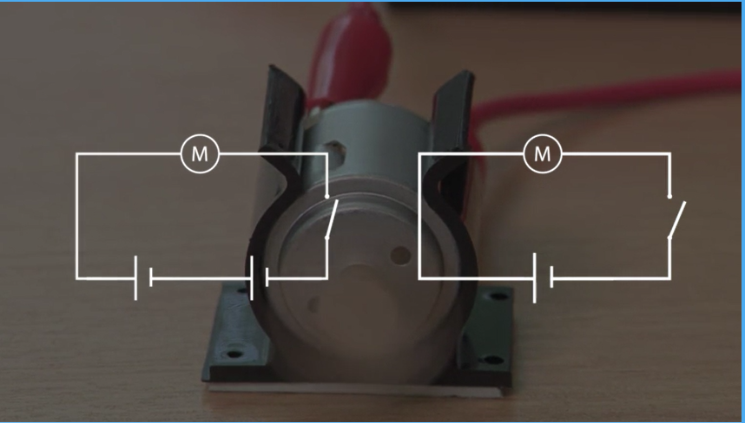
Which of these two circuits will make the motor quicker?
A
B
What did you find out last lesson?

Slide 3
This lesson you will try drawing different circuit diagrams
You found out last lesson that the different components in a circuit can be shown using symbols.
The next slide shows some of the symbols and a picture of the component.

Slide 4
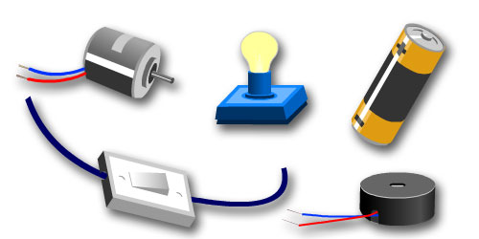
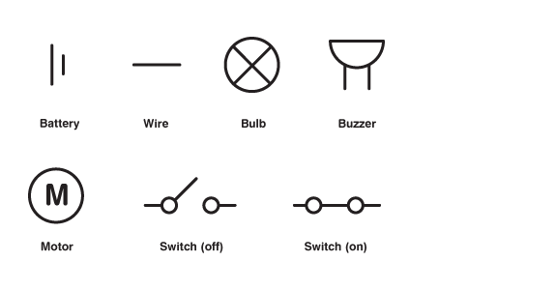


Can you match the symbol with the component?

Slide 5
 | Battery or cell
 | Wire
 | Bulb
 | buzzer
 | motor
 | Switch open
 | Switch closed

Slide 6
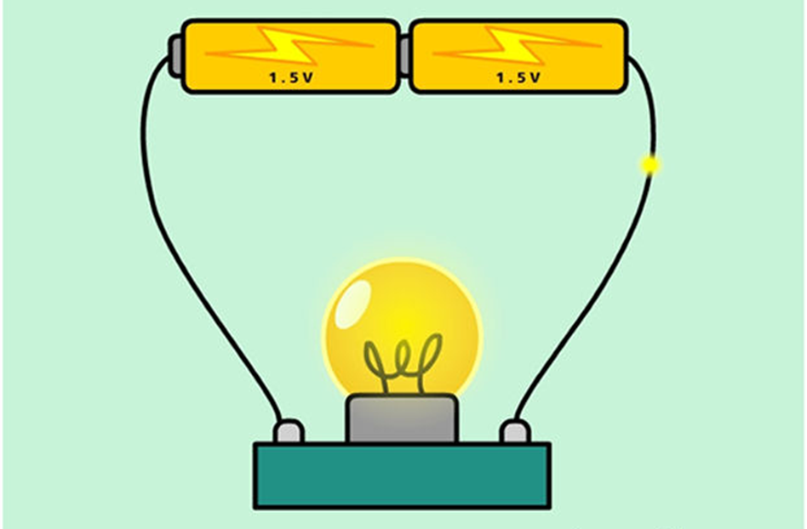
Using the pictures on the school website draw a circuit diagram for each picture using the correct symbols.
REMEMBER to use a ruler.

Slide 7
How do you build a basic circuit?
Go to the Oak National Academy website and find the YEAR 5 lessons for week 9 (22nd June).
This lesson will give you information on how to build a basic circuit.
Science lessons can usually be found in the foundation lesson for Wednesday.
https://classroom.thenational.academy/schedule-by-year/year-5/

