Slide 1
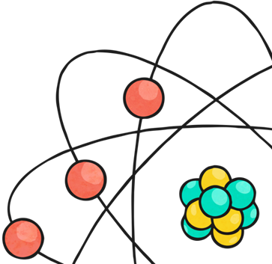
Electricity
Hello year 6.
This is the second lesson in our topic about electricity.
This lesson you will learn what electricity is and
look in more detail at static electricity.
You will find 2 balloons useful
but not essential

Slide 2
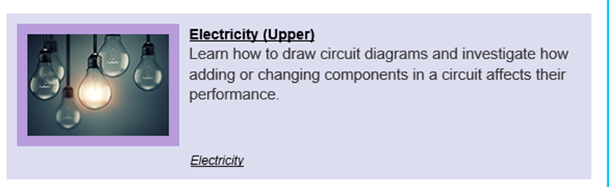
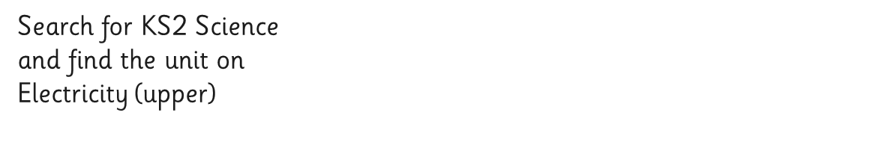
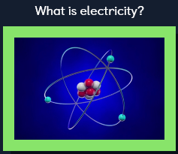
What is electricity?
Log on to https://www.discoveryeducation.co.uk/
Select the Espresso dropdown box in the top right hand corner.
Username: student28853
Password: oaktree
Watch this video clip that explain what electricity is.

Slide 3
We will now focus on static electricity
You will for the rest of this lesson be using the science lesson on Oak Academy.
The teacher will take you through different elements of static electricity. Any questions that she asks I have included on the slides in this PowerPoint.
The next slide will show you how to access the Oak National Academy lesson.

Slide 4
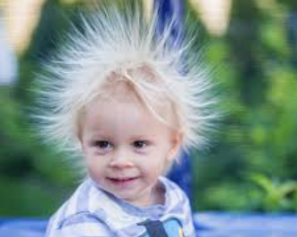
What causes static electricity?
https://classroom.thenational.academy/lessons/what-is-static-electricity/
Use this link to take you to the lesson on Oak Academy. Complete any questions and diagrams on a piece of paper.
If the link does not take you to the lesson you can access it by going to:
https://www.thenational.academy/
Click on:
Classroom
schedule
YEAR 5
week 7
Wednesday
Lesson 2

Slide 5
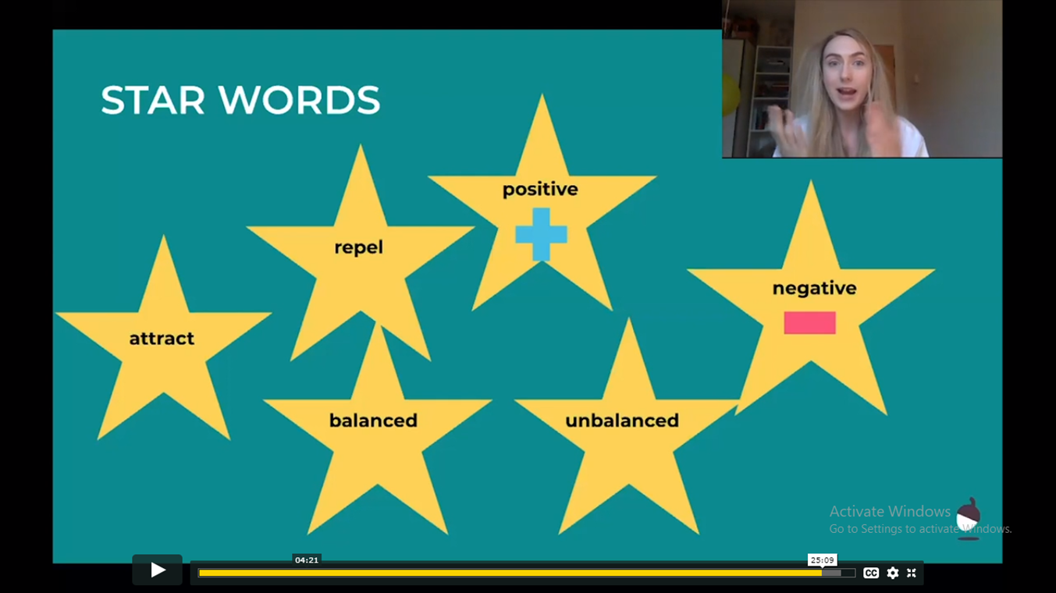

Slide 6
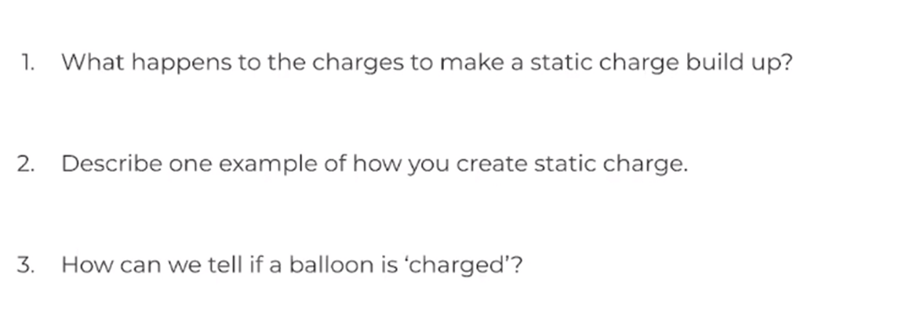
Can you answer these questions about static charge?

Slide 7
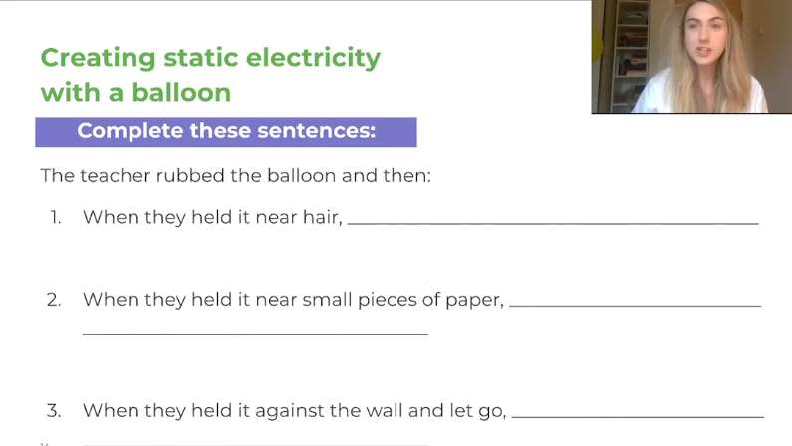
Questions to think about for the balloon investigation.

Slide 8
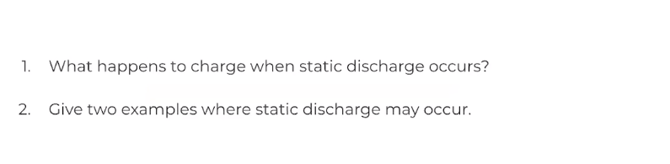
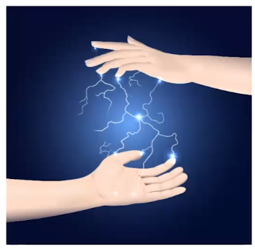
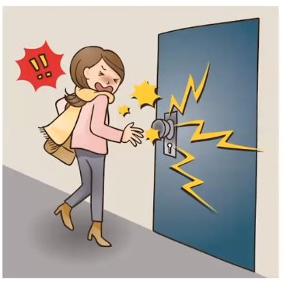
Questions about static charge

Slide 9
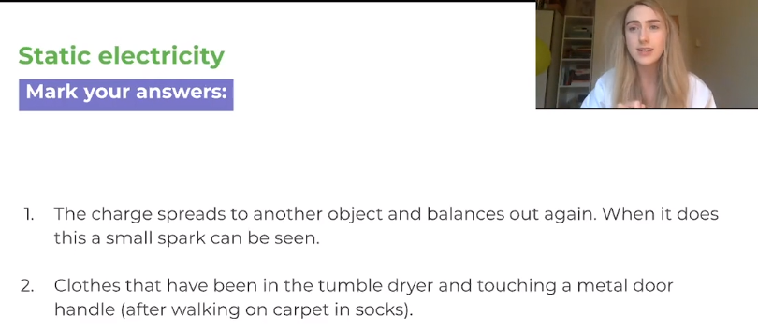
How did you do?

Slide 10
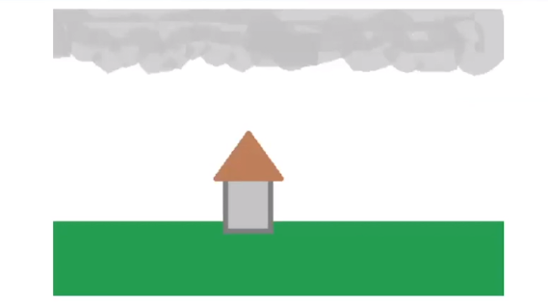
Add labels and notes to the diagram to explain what happens when lightning strikes.

Slide 11

How many star words do you now know?

Slide 12
Hopefully you have learnt a lot about static electricity in this lesson.
In your next lesson will look at electrical circuits and how you can alter the brightness of a bulb.

