Slide 1
Lesson 3 - Electricity

Slide 2
What are the different components in an electrical circuit?
Go to the Oak National Academy website and find the YEAR 5 lessons for week 8 (15th June).
You will watch the science lesson for this week that will explain the different components in an electrical circuit.
Science lessons can usually be found in the foundation lesson for Wednesday.
https://classroom.thenational.academy/schedule-by-year/year-5/
This lesson will remind you of some of the things you learnt in year 4 about the different components (elements) in an electrical circuit.

Slide 3
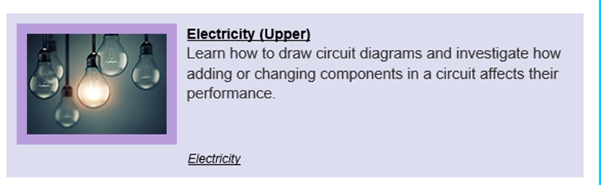
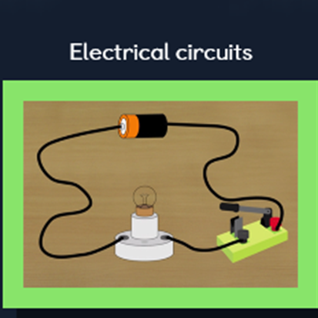
How can you change the brightness of a bulb?
You will now explore how to make the bulb in a circuit brighter.
Log on to https://www.discoveryeducation.co.uk/
Select the Espresso dropdown box in the top right hand corner.
Username: student28853
Password: oaktree
Search for KS2 Science and find the unit on electricity (upper).
Watch the video called electrical circuits

Slide 4
How can you change the brightness of a bulb?
You will now try and create some circuits yourself to test what you have learnt about how to change the brightness of a bulb. You will need to have flash on your device in order to use this website
http://flash.topmarks.co.uk/4055
Follow the instructions on the website to see the effects of altering some of the components in a circuit.

Slide 5
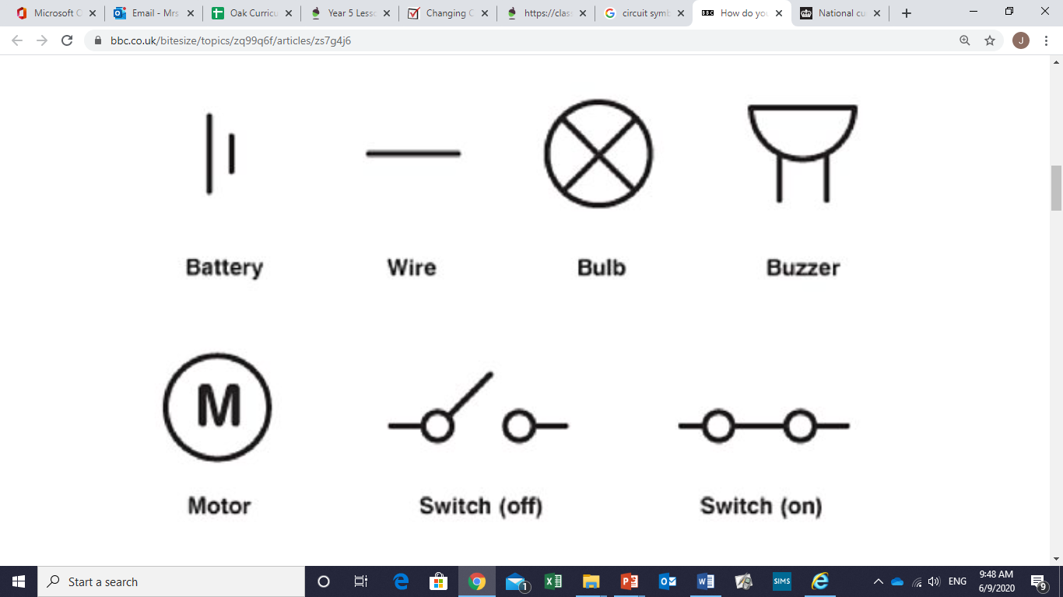
How can you change the brightness of a bulb?
Your Conclusions
Use the symbols sheet from the school website and the information from the video to help you to draw the circuit that you created that made the bulb brighter.
Write a sentence that explains
how you can make bulbs brighter.

Slide 6
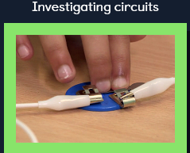
Does the thickness of the wire alter the brightness of a bulb?
You will now explore another way to make the bulb in a circuit brighter.
Log on to https://www.discoveryeducation.co.uk/
Select the Espresso dropdown box in the top right hand corner.
Username: student28853
Password: oaktree
Search for KS2 Science and find the unit on electricity (upper).
Watch the video called investigating circuits.
What do you find out from the children’s investigation?

Slide 7
What have you learnt this lesson?
Can you:
Name different elements in an electrical circuit?
Explain how to alter the brightness of a bulb or the speed of a motor?
Next lesson we will look in more detail at drawing circuit diagrams.

