Slide 1
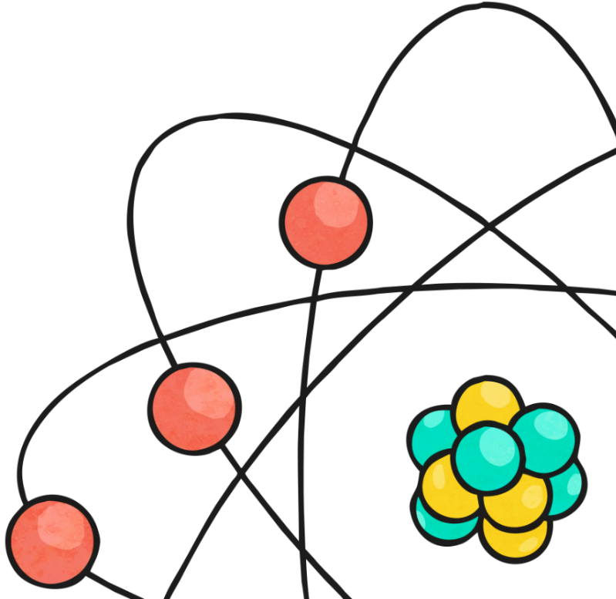
Electricity
The year 6 science unit for this half term is electricity. Unfortunately you can’t do some of the practical lessons at home but you can still learn a lot about this fascinating topic. These lessons will use a mixture of videos on Espresso and Oak Academy.

Slide 2
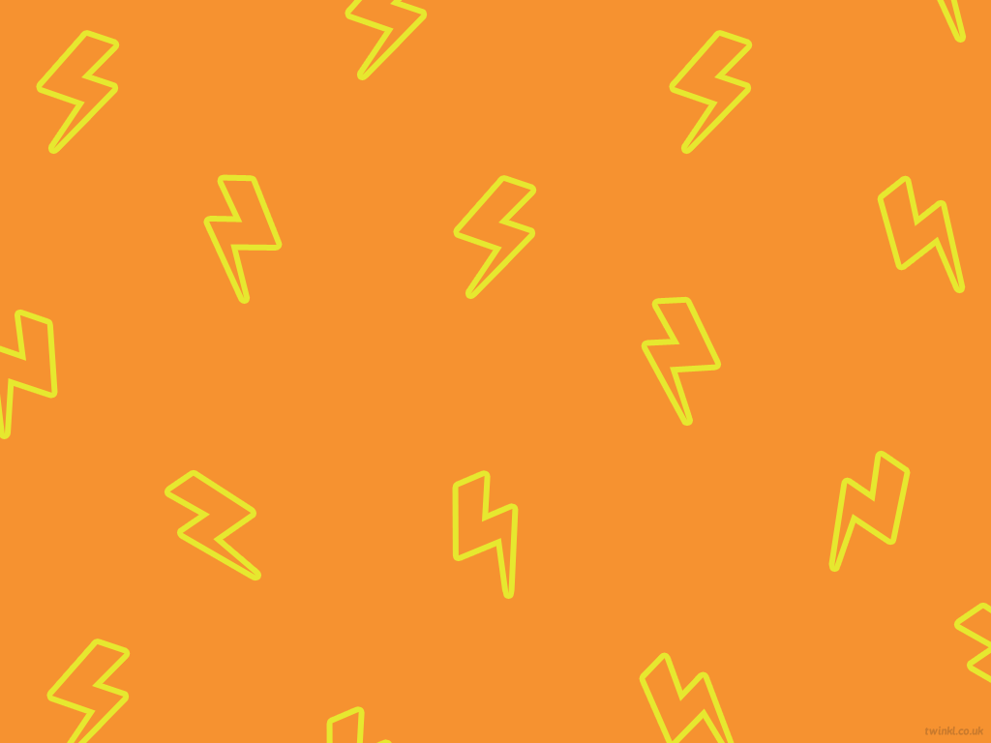
Learning objective
To explain the importance of the major discoveries in electricity.
Success Criteria
I can identify how our understanding of electricity has changed over time.
I can explain how major discoveries affected our understanding and use
of electricity.

Slide 3

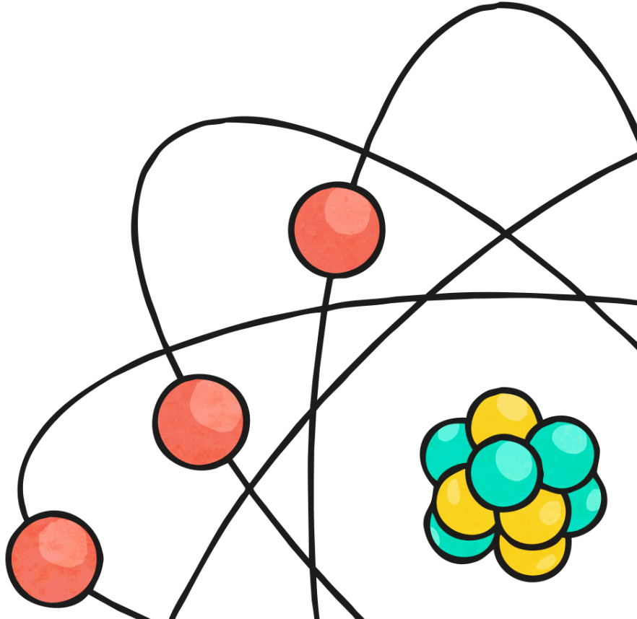
Electricity Quiz
You studied electricity in year 4 but what can you remember? Try this quiz. Don’t worry if you don’t know all of the answers as you will revisit some of the information in the videos and lesson over the next few weeks

Slide 4
Electricity Quiz
1. What two types of electricity are there?
a) natural and static electricity
b) natural and man-made electricity
c) man-made and animals producing
electric shocks

Slide 5
Electricity Quiz
2. Which of the following is not naturally occurring electricity?
a) static electricity
b) electric shock from an electric eel
c) electricity produced by solar panels

Slide 6
Electricity Quiz
3. Name two man-made types of electricity?
a) solar panels and lightning
b) static electricity and wind turbines
c) power stations and solar panels

Slide 7
Electricity Quiz
4. Materials that do not conduct electricity are called…
a) insulators
b) conductors
c) electrical appliances

Slide 8
Electricity Quiz
5. Which of the following does not conduct electricity?
a) wood
b) copper
c) water

Slide 9
Electricity Quiz
6. Which of the following does conduct electricity?
a) iron
b) wood
c) cotton

Slide 10
Electricity Quiz
7. What do we call a circuit that does not work?
a) complete circuit
b) incomplete circuit
c) broken circuit

Slide 11
Electricity Quiz
8. How can we create a break in the circuit without creating an incomplete circuit?
a) disconnect the wires from the source of electricity
b) remove the bulb/motor/buzzer from the circuit
c) add a switch to the circuit

Slide 12
Electricity Quiz
9. Which of the following is not a type of switch?
a) pinch switch
b) toggle switch
c) paddle switch

Slide 13
Electricity Quiz
10. What are the two types of electrical sources we use?
a) power station and batteries
b) mains and gas power station
c) mains and batteries

Slide 14
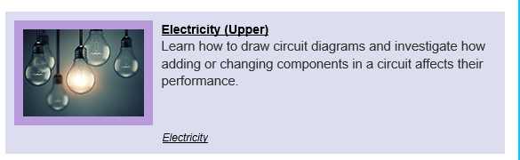
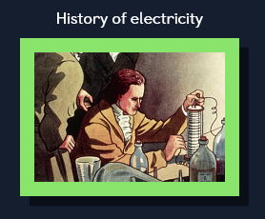

History of Electricity
Log on to https://www.discoveryeducation.co.uk/
Select the Espresso dropdown box in the top right hand corner.
Username: student28853
Password: oaktree
Search for KS2 Science
and find the unit on
Electricity (upper)
Watch these two videos
That will give you some information about the history of electricity.

Slide 15
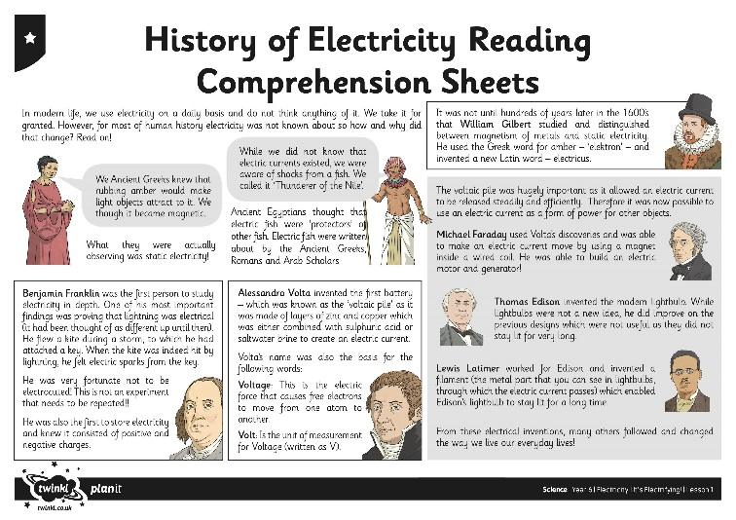
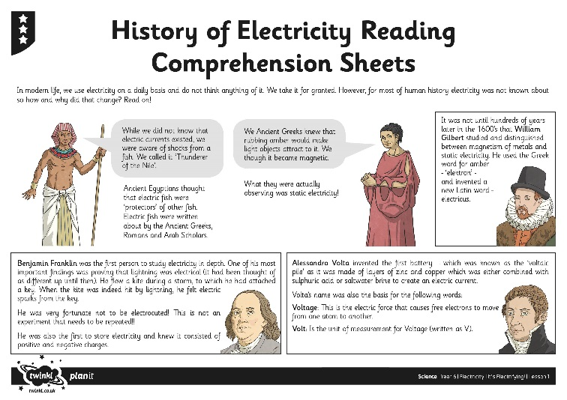
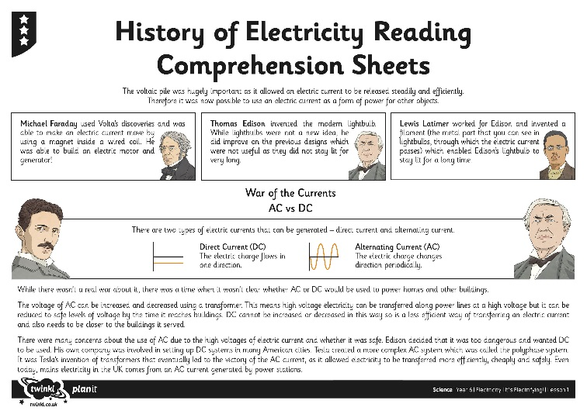
History of Electricity
Read the information about the fascinating scientists associated with electricity and their amazing discoveries. Choose the text and questions most suited to your ability (these are on the school website)

Slide 16

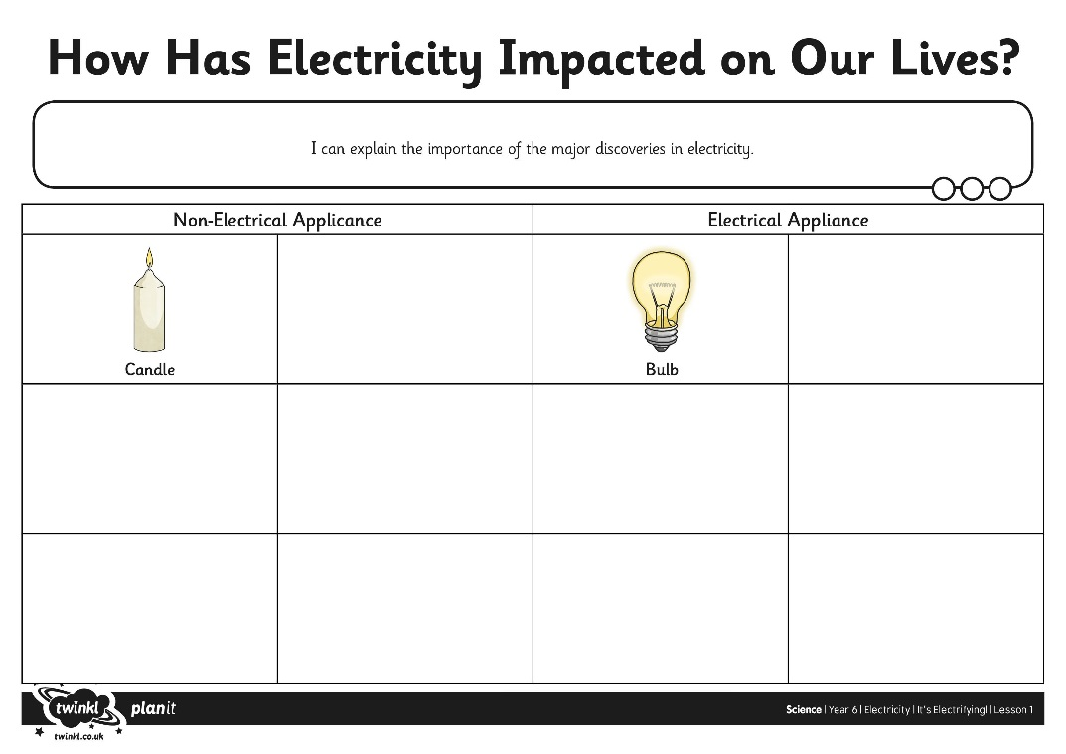
How Has Electricity
Impacted on Our Lives?
Look at or print the sheets on the school website that show pictures of objects that did not use electricity. Can you match them to the objects that now use electricity?
What impact have these electrical objects had on our lives?

Slide 17

Learning objective
To explain the importance of the major discoveries in electricity.
Can you now……
describe how our understanding of electricity has changed over time.
explain how major discoveries affected our use of electricity.

